Slide 1
A discussion of Open Educational Resources (OER) support provided by Higher Education Institutions (HEIs) and University Libraries in Scotland
Seth Thompson
Resource Librarian (Open Access)
Collections and Discovery
Glasgow Caledonian University
seth.thompson@gcu.ac.uk
Twitter: @sthom23
Presentation licensed under the terms of a CC-BY-4.0 license

Slide 2
Personal introduction
Seth Thompson
Resource Librarian (Open Access)
Collections and Discovery
RGU graduate November 2018: MSc Information and Library Studies
Worked at GCU Library for approaching 7 years (January 2020)
  4 years + in Collections Discovery
    Library Assistant – Senior Library Administrator – Resource Librarian (OA)
  2 years as a Library Assistant at Library Desk

Slide 3
Presentation overview
45-60 minute presentation
MSc Dissertation
  An investigation into academic library support of Open Educational Resources: a case study of Scottish universities
  January 2018- October 2018
Opportunities for questions throughout… and hopefully a few minutes at the end also!

Slide 4
Presentation content
What are OER?
My dissertation
  Research aim and objectives
  A brief overview of OER literature
  Case study methodology
  What I found out- results
  Conclusions and recommendations

Slide 5
What are OER?
OER are teaching, learning and research materials in any medium, digital or otherwise, that reside in the public domain or have been released under an open license that permits no-cost access, use, adaptation and redistribution by others with no or limited restrictions.
UNESCO Paris Declaration (2012)
UNESCO (2011a; 2011b)

Slide 6



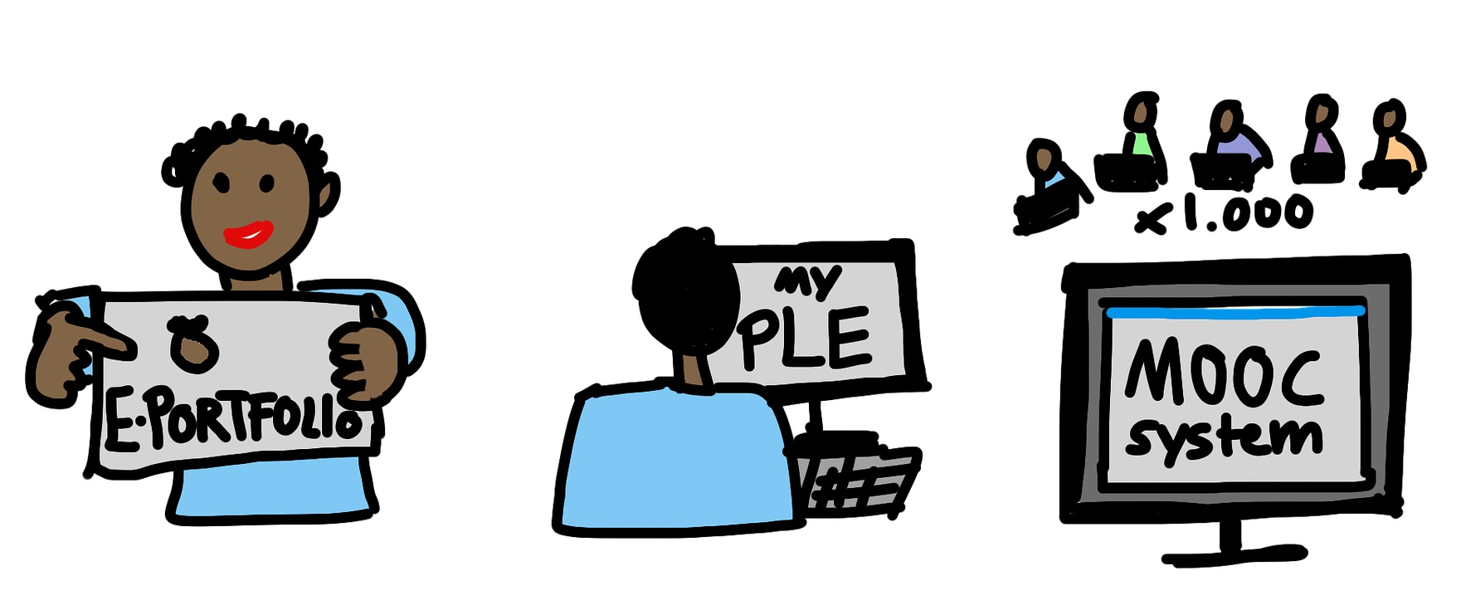
What are OER?
All images Pixabay Licensed. Free for commercial use. No attribution required.

Slide 7
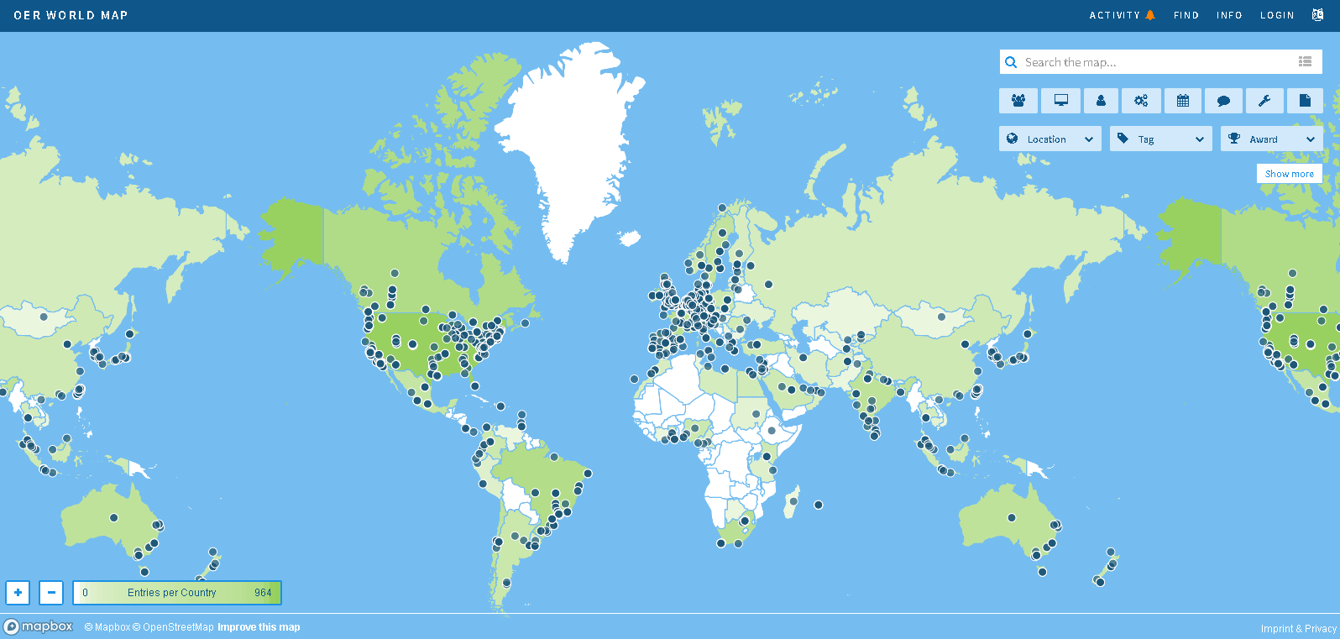

What are OER?
https://oerworldmap.org/
OER World Map. Licensed under a Creative Commons Attribution 4.0 International License
Notes:
Origins of OER:
USA: David Wiley, Utah State University – proposed license for free and open content (1998); Massachusetts Institute of Technology (MIT) – OpenCourseWare (OCW, 1999)
UK: OER being developed by communities of enthusiasts; HEFCE funded programme (£16m) of development through the HEA and JISC 2008-2012; Open Scotland Education Declaration (2013); OEPS Report (2017)

Slide 8
What are OER?
The 5 Rs of OER
  Retain- make, own, control
  Reuse- wide ranging
  Revise- adapt, adjust, modify, alter
  Remix- combine, create new
  Redistribute- share
  (Wiley n.d., available from: http://opencontent.org/definition/)

Slide 9
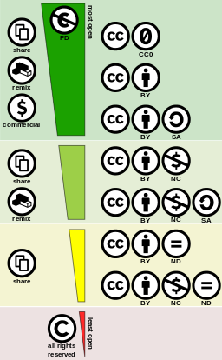
Open Licenses
Creative Commons Licenses
7 licenses with different level of openness
CCO- waive rights
CC BY- attribution
SA- share alike
NC- non-commercial
ND- non-derivatives
Creative commons license spectrum. Created by Shaddim and licensed under the Creative Commons Attribution 4.0 International License.

Slide 10
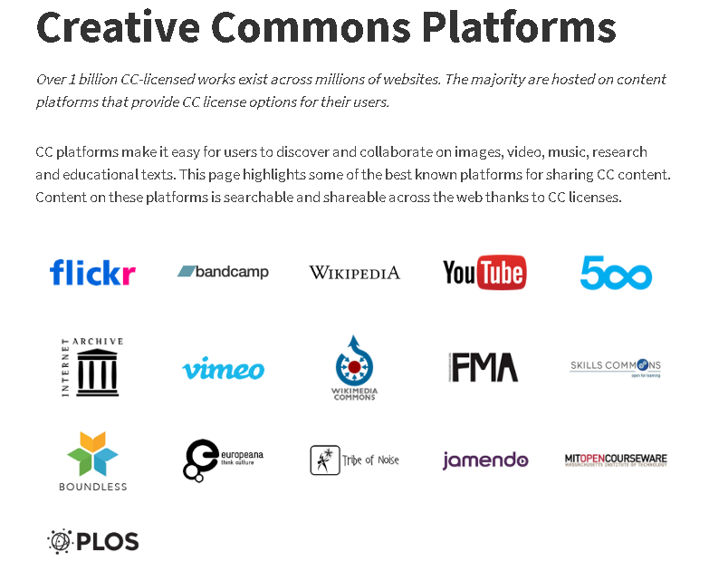
Open Licenses
Creative Commons Platforms. Creative Commons website. licensed under the Creative Commons Attribution 4.0 International License.

Slide 11
Does anyone have any questions?

Slide 12
Research Aim and Objectives
Aim…
To examine how Scottish HEI academic libraries support OER, and investigate if the academic library may be a viable support structure for OER within Scottish HEIs.
Objectives…
Discover why academic libraries may wish to support OER within their institutions
Identify any potential factors affecting academic libraries ability to support OERs within their institutions
Critically evaluate how academic libraries are currently supporting OER
Formulate recommendations on issues relating to academic libraries’ current and future ability to support OER
Notes:
Why?
An area that personally interested me. Wanted to find out how other libraries in Scotland support OER. An area where there has been little research

Slide 13


A brief overview of OER literature
Drivers for OER…
United Nations Educational, Scientific and Cultural Organisation (UNESCO)
Transformative potential
  OER could:
    Improve curricula
    reduce cost
    support educational transformation
UNESCO (2011b)
Image: Guidelines for OER in HE front cover. Adam Jones CC BY-SA
Image: OER and change in HE front cover. Commonwealth of Learning CC BY
Notes:
My literature review was 5000- not going to bore you to death with all of it, but some of the key areas

Slide 14
A brief overview of OER literature
JISC UKOER/SCORE Review of HEFCE funded OER projects:
  Increased access
  Improved pedagogy
  Greater sharing
  Increased confidence
  Improved collaborative projects
  Educator reflections
  quality of learning materials
  Enhanced digital literacies
Motivations to adopt OER:
    Reputation
    Improve efficiency (cost, quality)
    Open access
    Pedagogy and student experience
    Technological enhancement
    McGill et al. (2013)
Notes:
Identified OER engagement changing conventional institutional educational practices
Three significant OER teaching and learning outcomes were discovered:
Increased student resource access
Improved pedagogy
Greater sharing between educators
Examples of positive student experiences:
Increased confidence in learning
improved learning experiences within collaborative projects
Furthermore, educators had:
deeper reflections on teaching practices
improved quality of learning materials
enhanced digital literacies
Five broad motivations to adopt OER identified amongst educators and institutions:
To build reputation
Improve efficiency, cost and quality of resources
Open access to knowledge
Improving pedagogy and student experience
To build technological momentum
However, at the time I did my disseration, comparative or contradictory data was pretty much non-existent. I couldn’t find articles that disputed studies like the aboves claims

Slide 15
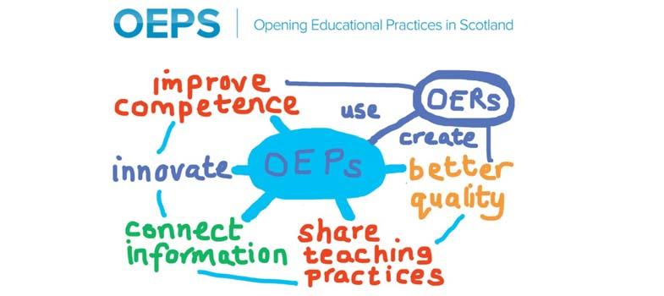
A brief overview of OER literature
OEPS
  Lack of awareness of OER
  Difficulties locating quality OER
  Lack of copyright and licensing confidence
de los Arcos et. al (2016)
Image: Anna Page CC-BY https://flic.kr/p/zgtHQ4
Notes:
However, what I did find…
The OEPS project ascertained OER awareness levels amongst Scottish HE educators to be generally low from an educator survey in 19 Scottish HE institutions
Recommended more advocacy work across HE

Slide 16
A brief overview of OER literature
Other issues...
Shared drives, institutional repositories or wider social sites?
Institutional policy- hard mandate or soft encouragement?
Institutional culture- collegiate
Sustainability- financial and critical mass of resources
Educators, academics themselves- personal open practice, to share or not to share?

Slide 17
Does anyone have any questions?

Slide 18
Case study methodology
What is a case study?..
Yin in Remenyi (2013 p. 2) defines a case study as:
… an empirical enquiry that investigates a contemporary phenomenon within its real-life context, when boundaries between phenomenon and context are not clearly evident, and in which multiple sources of evidence are used.
Case studies may be appropriate when research attempts to investigate ‘how’ or ‘why’, there is little control over behavioural events, and research focuses on contemporary events (Yin 2018).

Slide 19
Case study methodology
Environmental scan of all Scottish HEI webpages for OER support services identified three potential cases
A multiple-case case study (three cases) utilising Yin’s (2018) framework
  University of Glasgow (UoG)
  Glasgow Caledonian University (GCU)
  University of Edinburgh (UoE)
Notes:
Environmental scan of all Scottish HEI webpages that mention OER. Purposive sample
A multiple-case case study provided evidence from multiple sources, and provided greater opportunities to compare, contrast and triangulate.

Slide 20
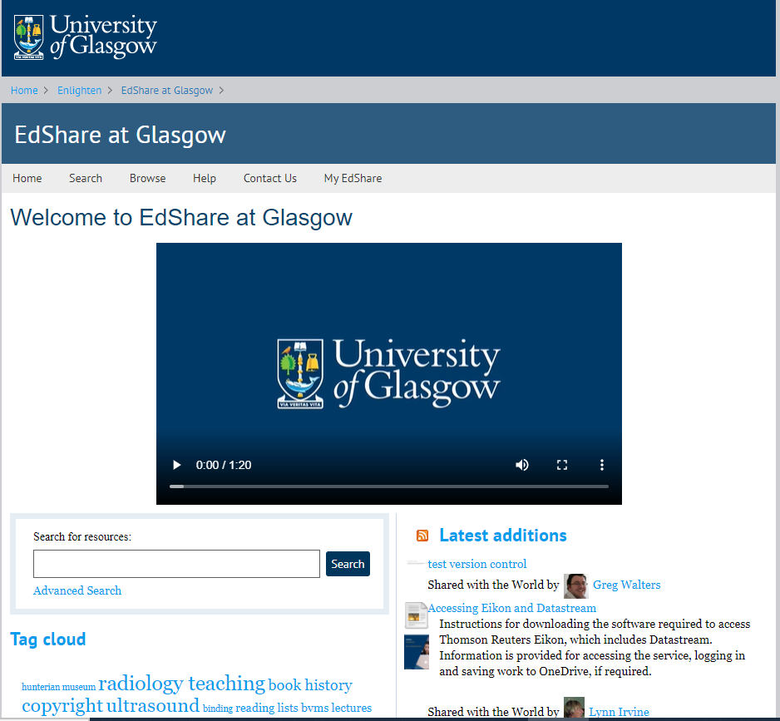
Case study methodology
OER related services:
Learning and teaching repository (edShare)
No formal edShare training- delivered as and when
Copyright advice service
OER and CC webpages
MOOC statement

Slide 21
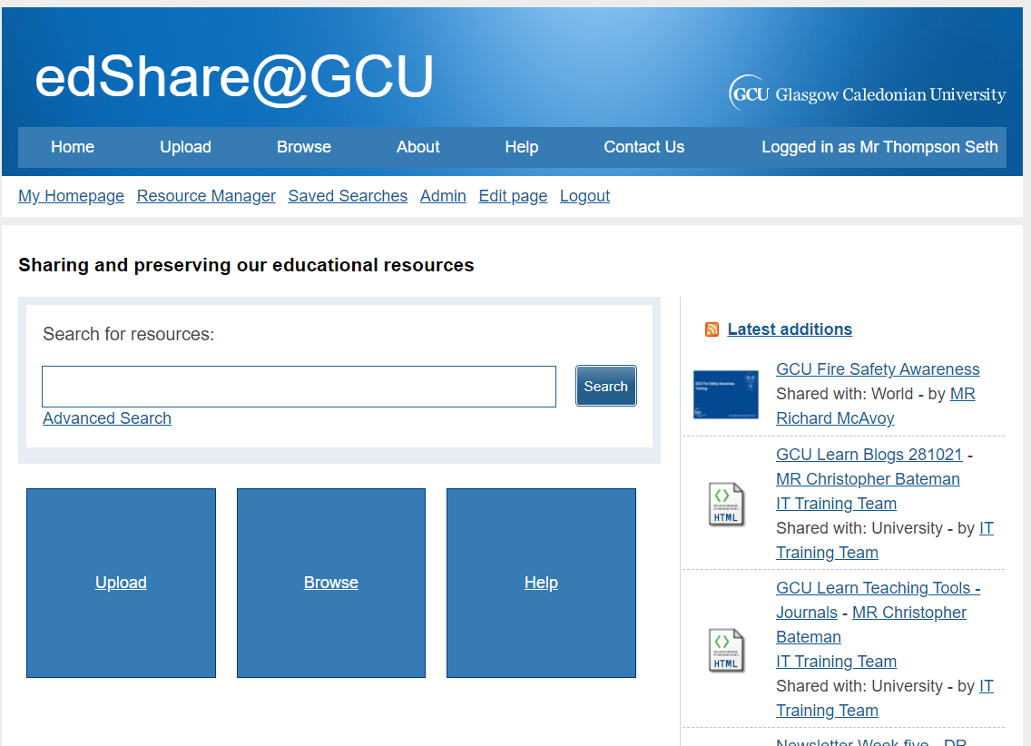
Case study methodology
OER related services:
OER policy support (led policy development)
OER repository (edShare)
edShare training, webpages and guides
Copyright training and advice service
OER and reusing content/ CC webpages

Slide 22
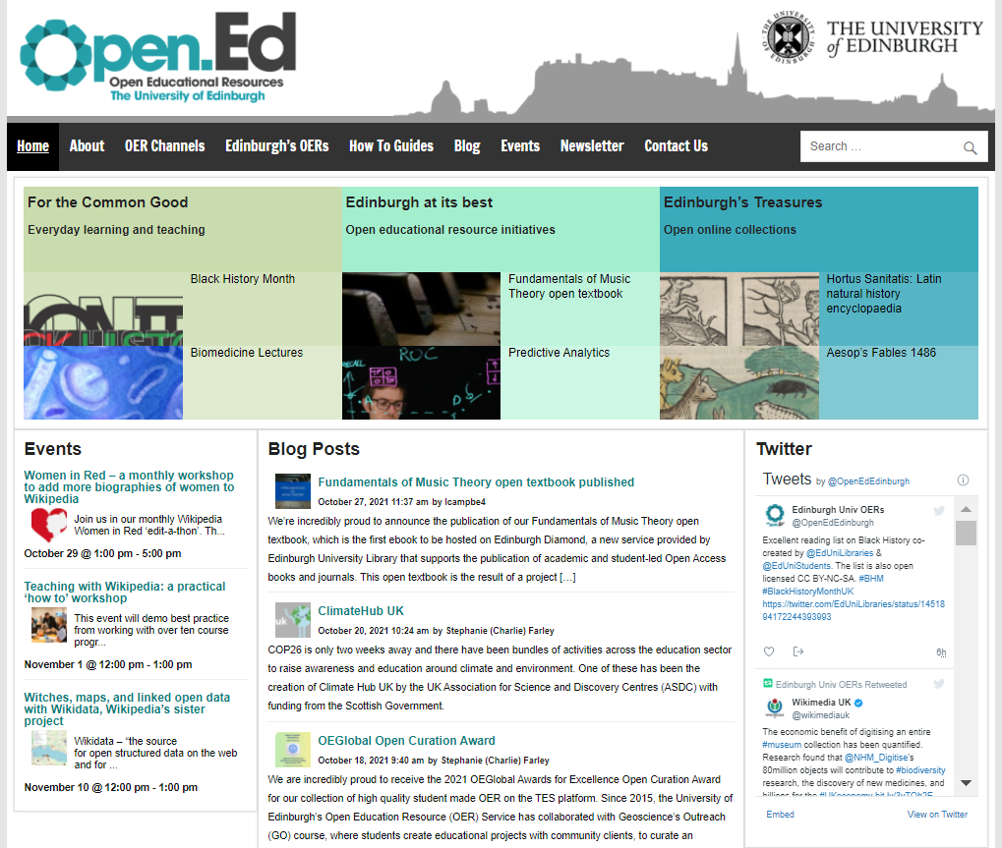
Case study methodology
OER related services:
Designated, centrally funded OER service
OER policy support
OER service webpages
Copyright and licensing service
Ongoing OER, copyright and licensing, and digital literacy training schedule
OER channel
OER guides, blogs and events webpages

Slide 23
Case study methodology
At each case…
Thematic analysis of qualitative interview and case documents
Data transcribed, coded and organised into themes for analysis, discussion and completion of dissertation
Notes:
3 interviews at GCU and UoG, 2 interviews at UoE
Semi-structured interview schedule and document request

Slide 24
Does anyone have any questions?

Slide 25
What I found out- results
Five main themes
Academic libraries and departments within HEIs should support OER
Institutional approaches to OER
Approaches to OER service delivery at cases
Educators and OER
Copyright and licensing

Slide 26
UoG- libraries have a responsibility to support, but haven’t mastered ‘joining it all up’ yet
Need for institutional OER frameworks
Strong consensus- yes!
Need for collaboration, value in co-creative approaches
Academic libraries and departments within HEIs should support OER?
Some difficulties ‘pitching’ OER- institutionally and to educators
Educator OER inclination
Lack of external drivers
UoE- OER a growing movement, don’t want to get left behind
GCU/UoG- libraries uniquely place to support discovery and location of OER
Notes:
Collaboration with individuals and departments external to OER services to develop and improve services
Libraries should be setting an example
Supporting moves toward digital teaching
Providing a service for educators to showcase resources (especially if they do not perform research)
However…
All cases tempered responses with cautionary statements:
Frameworks- policy, guidance, statements
Institution- not monetized
External drivers- not REF equivalent, not mandated by institutions
Educator OER inclination- more on this later
Uniquely placed- knowledge in online searching and digital skill development

Slide 27
Do policies represent the institutional OER view? What role does institutional culture play? Educator agency/attitude?
UoE- OER service centrally funded, strategic institutional focus
GCU/UoG- edShare and OER services received project funding
UoE- service must present evidence of service impact
Institutional approaches to OER
UoE- students association, diverse curriculums and freely available resources
Senior Management ‘buy in’
GCU/UoE policy- provides guidance on attribution, copyright, licensing and IP ownership
Lack of external motivators-
OER as professional development initiatives? Library incentivised OER use? Should OER engagement be optional or mandated?
UoE- 3 strand policy: common good, university at it’s best, and institutional treasures

Slide 28
All cases agree- need for OER advocacy and training
UoE approach- focus on developing digital skills and copyright literacy, no designated educational resource repository
All cases- staff resource and time an impacting factor on service capabilities
GCU, UoG similar approaches- edShare and OER supporting services
Approaches to OER service delivery
edShare default level of openness- GCU/UoG
UoE- service based in Learning and Teaching directorate (not library)
GCU, UoE- OER policy
Notes:
All cases agree- need for OER advocacy and training amongst educators
GCU, UoG- edShare. edShare training provided when requested. Initial edShare advocacy sessions, however not continually timetabled. Copyright and licensing advice/training also on request. Copyright OER developed at GCU, suite of copyright tools/docs available from UoG. Both libraries provide webpages supporting OER- how to find/how to use
UoE- focus on developing digital skills and copyright literacy. Do not have an institutional educational resource repository (do have a media asset platform). Encourage sharing on web based OER channels- TES Connect, Sketchfab, Wikimedia Commons, Flickr and Youtube
UoE/GCU- support OER policy. UoG- no policy
All cases- staff resource and time an impacting factor on service capabilities. GCU/UoG- edShare and OER not the sole responsibility of one person or their entire role. UoE- 1 x full time, 1 x ¾ time member of staff limits reach across institution
UoE- service based in Learning and Teaching directorate- interviewees felt this may be why skill development favoured over curation based services.
edShare level of openness- GCU open ‘worldwide’, UoG open to institution. Risk averse/risk managed? Openness at UoG was considered an improvement on previous approaches

Slide 29
Fear of peer judgement, loss of control, resource protectionism, anxieties surrounding quality, reputation, job security
All cases- positive examples of educators using their services
Lack of OER, copyright and licensing awareness and understanding
GCU/UoE- educate CC license, any resource can be an OER
Educators and OER
GCU/UoE- OER searchers of an adaptation/remix mind-set
Have services met the pedagogical needs of educator?
Institutional culture impact upon educator agency?
All cases- educators responsible for resources
Open practice- complex, personal, contextual and negotiated
Have services considered educator perspective?

Slide 30
All cases- lack of educator copyright and licensing knowledge
GCU/UoE- importance of good copyright and licensing practices from the outset of OER creation.
Mitigate against retrospective checking, license stacking and ‘copyright debt’
Copyright a challenge…
a potential barrier
All cases- interviewees wished to educate but not take responsibility.
GCU/UoE- Policy may assist
Copyright and licensing
All cases- services to address copyright and licensing
UoE- engagement with OER copyright services- leading to widening of access/use of resources
Copyright a facilitator
Fear of loss of control of resource may highlight lack of CC license understanding
Notes:
All cases identified a lack of educator copyright and licensing knowledge
Copyright can be challenging!
All cases- a potential barrier to engagement with OER services.
Fear of loss of control of resource may highlight a lack of CC license understanding amongst educators.
Services to address copyright and licensing presented at each case, though staff not qualified to deliver legal advice
GCU/UoE- importance of good copyright and licensing practices from the beginning of OER creation process. Costs associated with retrospective license checking, copyright debt. Mitigate Potential for license stacking
Interviewees at each case stated desires to educate teaching staff in copyright and licensing- however, also agreed educators must take responsibility for resource copyright and license compliance. At GCU/UoE policy states this
UoE- highlighted examples of educators who engaged with OER services becoming more copyright and CC license conscious- leading to potential widening of access to/use of resources. Focus on positive framing of copyright and licensing as facilitating open access as opposed to closing access

Slide 31
Does anyone have any questions?

Slide 32
Conclusions and recommendations
Research aim to compile a multiple-case study which examined how Scottish HEI academic libraries support OER, and investigate if the academic library may be a viable support structure for OER within Scottish HEIs.
Based on findings, it is considered that Scottish HEIs academic libraries may be a feasible institutional OER support structure
… however, as you can imagine there are a number of ‘ifs, buts, wells and maybes!’
Notes:
… did not aim to suggest that OER support should be library exclusive- as identified by UoE

Slide 33
Conclusions and recommendations
Recommendations based around themes...
Academic library and HEI department OER support
  Libraries looking to support OER should create OER themselves
  Collaboration can enable OER projects, whilst OER is a catalyst for collaboration
  May be beneficial to state agreed missions, objectives, and goals to focus service scope

Slide 34
Conclusions and recommendations
Institutional approaches to OER recommendations
  Libraries may wish to consider lobbying senior executives to deliver an OER support statement
  Libraries should consider institutional culture and if OER philosophies reflect institutional mission and vision
  Libraries may wish to consider encouraging senior executives and educators to think about open practice
    A supportive collegiate culture may foster an environment within which educators feel free to exhibit high levels of OER agency

Slide 35
Conclusions and recommendations
Approaches to OER service delivery
  Consultation with educators to establish OER related needs is identified as critical to ensuring service developments reflect institutional and educator pedagogical needs
  Developing services that advocate OER benefits, enhance educator knowledge, understanding and digital skills relating to OER and associated areas such as copyright and CC licensing may be key to success

Slide 36
Conclusions and recommendations
Educators and OER
  Natural sharing instincts may be complex
  Moral standing may be influenced by cultural surroundings
  Create environments that value open practice and social responsibility which may boost educator sharing instincts
  Reinforce that OER are adaptable resources to address fear of resource judgement

Slide 37
Conclusions and recommendations
Copyright and licensing
  Facilitating copyright understanding amongst educators may be an ongoing task which requires continual support
  Librarians may require copyright training to support educator’s OER needs
  Copyright services should aim to empower staff to make educated risk aware decisions and guard against retrospective OER copyright and license checking

Slide 38
Last chance for questions?
Thanks for coming!
All references and full dissertation available on request

