Slide 1
Seth Thompson
An introduction to Open Educational Resources (OER) and edShare@GCU
Presentation by Seth Thompson. Licensed under the terms of a CC-BY-4.0 license

Slide 2
Session Recording
Notes:
Session Recording
This webinar is being recorded
Participants contributions via “Chat” is anonymised for the purpose of recording

Slide 3
Seth Thompson
An introduction to Open Educational Resources (OER) and edShare@GCU
Presentation by Seth Thompson. Licensed under the terms of a CC-BY-4.0 license

Slide 4
What we will cover in this workshop
Webinar objectives and key skills
What are Open Educational Resources (OER)?
Things to consider when creating OER
OER and Creative Commons licenses
What can I do with OER?
Where can I find OER?
What is edShare@GCU?
edShare@GCU and Planet eStream
What can edShare@GCU be used for?
Practical demonstration
Uploading a file
Adding metadata and versioning
edShare guides and resources

Slide 5
Webinar objectives and key skills
Objectives
To gain a basic understanding of Open Educational Resources (OER)
To gain a basic understanding of Creative Commons (CC) licenses
To gain a familiarity with the edShare@GCU educational resource repository
Key skills
How to create an edShare resource
How to add metadata to an edShare resource
How to upload a file to an edShare resource
How to add a Creative Commons license to an edShare resource (how to create a licensed OER)

Slide 6
What are Open Educational Resources (OER)?
Part of broader concept of open education…
‘… a way of carrying out education, often using digital technologies. Its aim is to widen access and participation to everyone by removing barriers and making learning accessible, abundant, and customisable for all. It offers multiple ways of teaching and learning, building and sharing knowledge. It also provides a variety of access routes to formal and non-formal education, and connects the two.’
European Commission (2016), available from: https://joint-research-centre.ec.europa.eu/what-open-education_en

Slide 7
What are OER?
… and open educational practices (OEP)
OEP is a term inclusive of the use of OER and open pedagogy
‘… collaborative practices that include the creation, use, and reuse of OER, as well as pedagogical practices employing participatory technologies and social networks for interaction, peer-learning, knowledge creation, and empowerment of learners.’
Cronin (2017), available from: https://doi.org/10.19173/irrodl.v18i5.3096
Notes:
Another way of conceptualising and realising the potential of open education is through the enactment of open educational practices (OEP)
In practice, educators who use OEP seek to build opportunities for learners to:
access education, open educational resources, open textbooks, and open scholarship,
collaborate with others, across the boundaries of institutions, institutional systems, and geographic locations,
create and co-create knowledge openly, and
integrate formal and informal learning practices, networks, and identities

Slide 8
What are OER?
Open Educational Resources (OER) are teaching, learning and research materials in any medium – digital or otherwise – that reside in the public domain or have been released under an open license that permits no-cost access, use, adaptation and redistribution by others with no or limited restrictions.
UNESCO (2011), available from: https://en.unesco.org/icted/content/basic-guide-open-educational-resources-oer

Slide 9
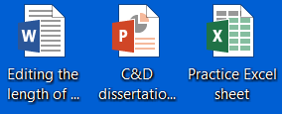
What are OER?
They can be anything!
… the everyday, like a basic Word document
… GCU ‘at it’s best’… a big shiny, ‘show stopper’, fancy resource!
Image of lake, mountains and clouds in sky, and image of textbooks Pixabay Licensed. Free for commercial use. No attribution required.
Notes:
OER can be documents, images, moving image, software (open source), data sets, textbooks, MOOCs…

Slide 10
What are OER?
Some GCU library examples…
GCU UK Copyright Advisor:
https://edshare.gcu.ac.uk/4481/13/CARP/index.html

Slide 11
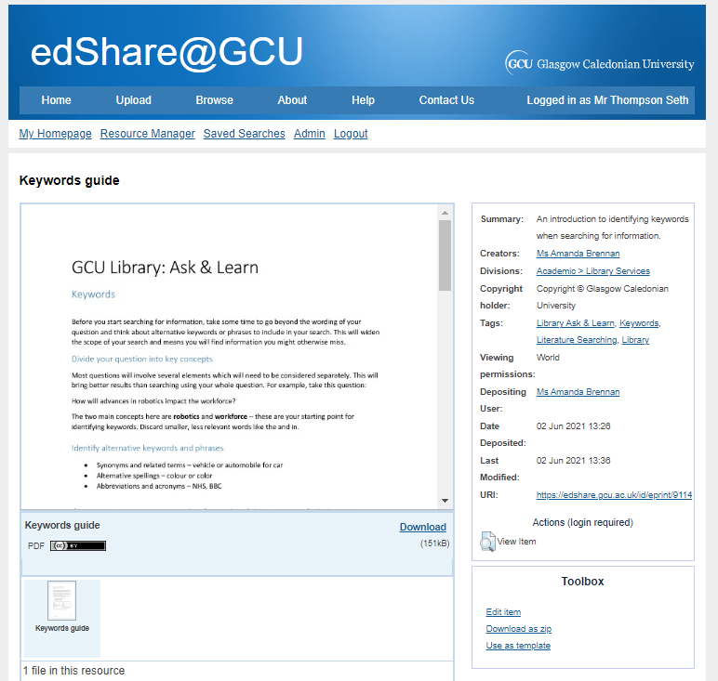
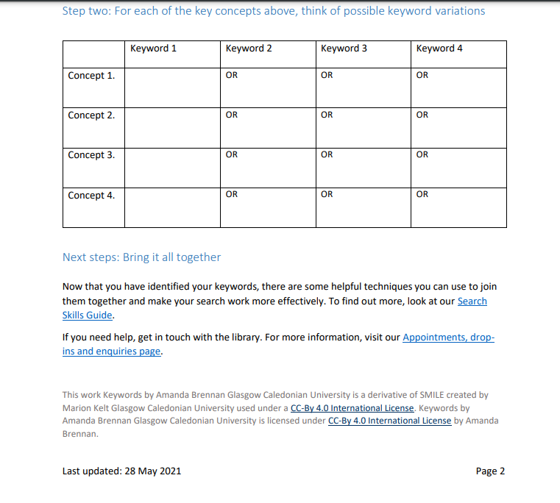
What are OER?
Some GCU library examples…
Keywords guide:
https://edshare.gcu.ac.uk/9114/

Slide 12
Things to consider when creating OER
Your GCU contract of employment
Contains information on copyright and intellectual property rights for resources created whilst employed by the University
GCU had a policy on Open Education Resources (OER), encourages:
Depositing resources in edShare@GCU
Make resources openly available to the world
License resources so they can be reused and adapted
Approved by GCU Executive Board in 2015
https://edshare.gcu.ac.uk/5415/
Notes:
Approved by GCU Executive Board in 2015

Slide 13
Things to consider when creating OER
If you’re using third party copyright material, do you have permission to use it?
Is the material available under a license?
Are there circumstances under which you might be able to apply an exception to copyright?
Use the GCU UK copyright advisor for basic queries
Check out- https://edshare.gcu.ac.uk/help/KeepingItLegal.pdf
… or get in touch, libraryresearch@gcu.ac.uk

Slide 14
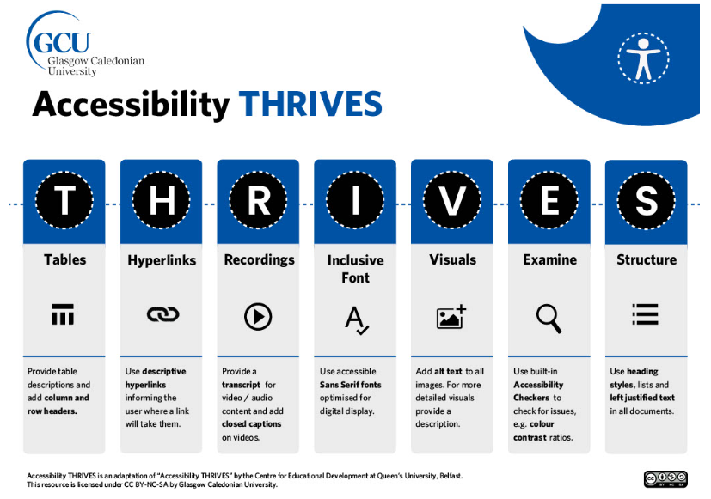
Things to consider when creating OER
Things to consider when creating OER…
Digital accessibility
Are your OERs accessible and inclusive by design?
Check out- https://www.connected.gcu.ac.uk/sites/AcademicDevelopment/Pages/Digital-Accessibility.aspx
Consider copyright, licensing and digital accessibility from the beginning of resource creation!

Slide 15
Things to consider when creating OER
Things to consider when creating OER…
Good practice when creating a resource is to add a standard attribution statement, for example…
Presentation: An introduction to Open Educational Resources (OER) and edShare@GCU by Seth Thompson. Licensed under a CC-BY 4.0 license.
Type of content: Title (link to source), author, license (link to license).

Slide 16
OER and Creative Commons licenses
OERs and Creative Commons (CC) licenses
7 licenses with different level of openness
CCO- waive rights
CC BY- attribution
SA- share alike
NC- non-commercial
ND- non-derivatives
Creative commons license spectrum. Created by Shaddim and licensed under the Creative Commons Attribution 4.0 International License.
Notes:
CC An international legally binding scheme which is complimentary to copyright laws
Provides people and organisations with a simple, and standardised method to grant copyright permissions for creative and academic works; ensure proper attribution; and allow others to copy, distribute, and make use of those works
You may encounter CC licenses when searching online for teaching materials
You can apply a CC license to any resources you develop- allows you to control how your resource can be reused
(Creative Commons, n.d. CC-BY 4.0)

Slide 17
What can I do with OER?
Pretty much whatever you like... as long as you stick to the terms of the license applied to the resource!
The 5 Rs of OER
Retain- make, own, control
Reuse- wide ranging
Revise- adapt, adjust, modify, alter
Remix- combine, create new
Redistribute- share
Wiley (n.d.), available from: http://opencontent.org/definition/
Notes:
Retain - make, own, and control a copy of the resource (e.g., download and keep your own copy)
Revise - edit, adapt, and modify your copy of the resource (e.g., translate into another language)
Remix - combine your original or revised copy of the resource with other existing material to create something new (e.g., make a mashup)
Reuse - use your original, revised, or remixed copy of the resource publicly (e.g., on a website, in a presentation, in a class)
Redistribute - share copies of your original, revised, or remixed copy of the resource with others (e.g., post a copy online or give one to a friend)
(Wiley, n.d.)

Slide 18
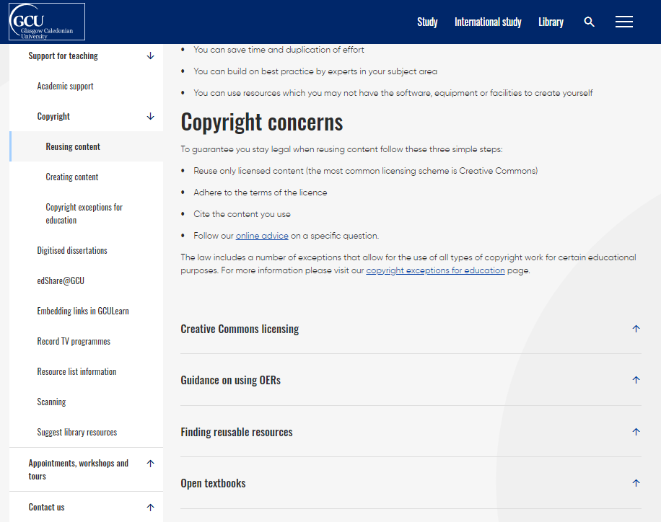
Where can I find OER?
You can start by having a look at the links on our reusing content webpage:
https://www.gcu.ac.uk/currentstudents/essentials/library/teaching/copyright/reusingcontent
… have a look under ‘Finding reusable resource’ and ‘Open textbooks’ drop down sections

Slide 19
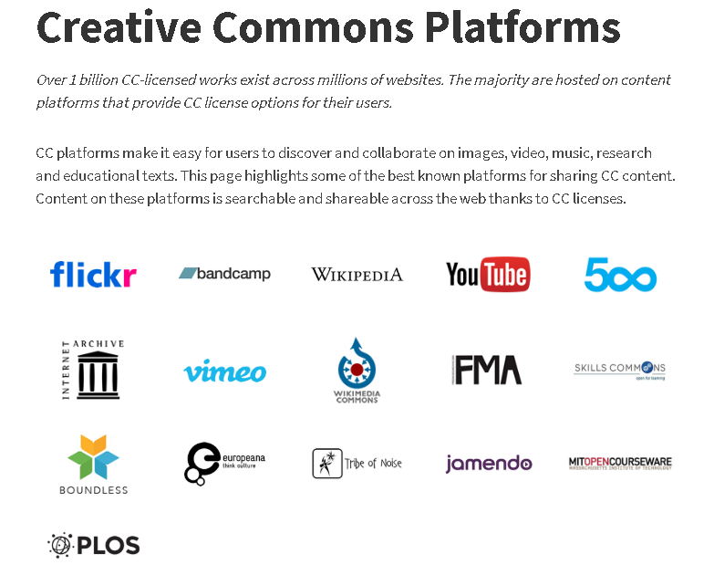
Where can I find OER?
Creative Commons Platforms. Creative Commons website. licensed under the Creative Commons Attribution 4.0 International License.

Slide 20
Where can I find OER?
Where can I find OER images?
https://www.pexels.com/
https://pixabay.com/
Both sites have non-commercial ‘free to use’ license
However, check terms as some conditions!
Google image search
https://images.google.com/
Tools > Usage rights > Creative Commons licenses

Slide 21
Questions
Notes:
Session Recording
This webinar is being recorded
Participants contributions via “Chat” is anonymised for the purpose of recording

Slide 22
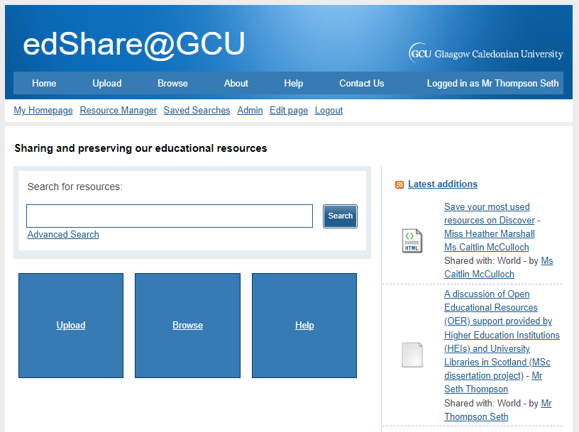
What is edShare@GCU?
edShare@GCU is a learning and teaching resource repository for the GCU community
Accepts any permanent resources created by GCU staff
The services that support edShare@GCU also provide a point of contact for copyright, licensing and intellectual property rights (IPR) advice
Notes:
edShare@GCU launched 2016
edShare repositories developed by the University of Southampton School of Electronics and Computer Science using a variant of their EPrints repository platform

Slide 23
What is edShare@GCU?
edShare@GCU aims to:
Enhance learning and teaching by enabling staff to manage, store and share a greater variety of digital resources, providing broader and deeper learning opportunities for students
Enable long-term preservation of University’s educational output
Support flexible learning by enabling digital resources to be embedded into GCU Learn and GCU website
Enable GCU staff to make digital resources openly available online
By opening access, supports learning in developing communities by providing free access to educational resources
Support the “Common Good”

Slide 24
edShare@GCU and Planet eStream
Planet eStream is a streaming media server and primarily used for lecture recordings and request TV programmes to be added to GCULearn (under ERA license terms)
EdShare is for long term preservation of teaching materials, and for where resources can be made openly available
Notes:
Can use Planet eStream for accessibility functionality- automated captioning
If you would like to have your resource on Planet eStream and on edShare, or you would like to have your resource on edShare with captions – please contact us

Slide 25
What can edShare@GCU be used for?
Store, share and preserve a wide variety of learning and teaching materials in one central location
Staff can upload and manage their own resources and have the option to share them openly on the internet, with all members of the University, or with a select group of students or staff

Slide 26
What can edShare@GCU be used for?
What can I upload?
Virtually anything you have created
Multimedia (video, audio, animations)
Images
Documents (including PDFs)
Exam past-papers
eLearning resources (for example iSpring, Captivate)

Slide 27
What can edShare@GCU be used for?
What should not be uploaded to edShare…
Library’s electronic and print resources
Copyright held by various publishers
In general, edShare@GCU not the place to deposit
You must not scan published articles or chapters and deposit in edShare@GCU- contact Library Scanning Team
clascanrequests@gcu.ac.uk
Resources from the internet
Check terms and conditions
Reuse only licensed content (for example Creative Commons)
Adhere to license
Cite content

Slide 28
Questions
Notes:
Session Recording
This webinar is being recorded
Participants contributions via “Chat” is anonymised for the purpose of recording

Slide 29
Practical demonstration
Practical demonstration of edShare@GCU
Uploading a file
Adding metadata
Version control (versioning)
https://www.gcu.ac.uk/currentstudents/essentials/library/teaching/edsharegcu

Slide 30
Demonstration
Notes:
Demonstration

Slide 31
Questions
Notes:
Session Recording
This webinar is being recorded
Participants contributions via “Chat” is anonymised for the purpose of recording

Slide 32
edShare guides and resources
edShare@GCU webpage and guides:
https://www.gcu.ac.uk/currentstudents/essentials/library/teaching/edsharegcu
Full edShare user guide
Uploading content
Creating new versions of resources
Uploading eLearning resources
Keeping it legal guide (copyright and licensing)
Editing videos
Top tips for stress free edShare use!

Slide 33
Thanks for coming and contact details
If you have any queries about OER or edShare@GCU you can contact us at:
libraryresearch@gcu.ac.uk
edshare@gcu.ac.uk
You can also check out our edShare, copyright, reusing and creating content webpages for more information:
https://www.gcu.ac.uk/currentstudents/essentials/library/teaching/edsharegcu
https://www.gcu.ac.uk/currentstudents/essentials/library/teaching/copyright
Thanks for coming!
Presentation by Seth Thompson. Licensed under the terms of a CC-BY-4.0 license

Slide 34
References
Cronin, C. (2017). Openness and Praxis: Exploring the Use of Open Educational Practices in Higher Education. The International Review of Research in Open and Distributed Learning, 18(5). https://doi.org/10.19173/irrodl.v18i5.3096
What is open education? (2016) Available at: https://joint-research-centre.ec.europa.eu/what-open-education_en (Accessed: 10 July 2023).
Butcher, N. Kanwar, A. and Uvalic-Trumbic, S. (2011) A basic guide to Open Educational Resources (OER). British Columbia, Canada: Commonwealth of Learning and Paris, France: UNESCO.
Wiley, D. (no date) Defining the "open" in open content and Open Educational Resources. Available at: http://opencontent.org/definition/ (Accessed 10 July 2023).

