Slide 1
AcWriMo: Library Support for Research
Seth Thompson
Resource Librarian
Collections & Discovery
17 November 2023
Presentation by Seth Thompson. Licensed under the terms of a CC-BY-4.0 license

Slide 2
Presentation overview
Library Support for Research
Pure
Profile
Modules
Developments
ResearchOnline
ORCID
Scopus and SciVal
Publishing support
Research Data Management (RDM)

Slide 3
Pure
Pure is GCU’s Current Research Information System (CRIS)
Library Pure support webpage
Pure system, user accounts and access, general queries contact email: librarysystems@gcu.ac.uk
Notes:
Pure
Stores and preserves digital content relating to research at GCU, including staff research outputs, funding applications and projects, activities and impact.
The system is fully supported and maintained with upgrades and new functionality available each month.
A cloud-hosted system providing reliability and scalability.
Access Pure directly on and off campus without the need for VPN software.
Access for all academic staff.

Slide 4
Pure profile
Updating your researcher profile in Pure
Notes:
We would encourage all staff to populate their profile for example, add a photo, name variants, social media links, research interests, external positions, qualifications and person expertise.
All this information will be reused across the system and in integrated systems.

Slide 5
Pure modules
A number of modules available to staff in Pure
Modules are owned by various teams across the institution

Slide 6
Pure modules
Research outputs
Book/Report
Contribution to specialist publication
Working paper
Contribution to journal: Article, Letter, Comment/debate; Editorial...
Chapter in Book/Report/Conference Proceeding
Contribution to conference
Thesis
Non-textual form
Patent
Research outputs contact email: libraryresearch@gcu.ac.uk
Notes:
Research output records can be populated from scratch or imported from external sources such as Scopus or Crossref, or imported from a file.
The research output module in Pure is managed by the Library Reseach Team and all outputs go through a library validation process. This is to ensure the correct metadata is recorded for each record in Pure and displayed publicly on ResearchOnline.

Slide 7
Pure modules
Research outputs and REF 2028
Early decisions made for REF 2028
With regard to research outputs:
'Until new policies come into force, institutions should continue to follow REF 2021 open access policies'

Slide 8
Pure modules
REF 2021 open access policy, in scope:
All journal articles with an ISSN and conference contribution in conference proceedings with an ISSN
REF 2021 open access policy, requirements:
Output deposited in Pure as soon after acceptance as possible (no later than 3 months)
Output must be discoverable (deposit in Pure enables this)
Output must be open access
Green (self archived author accepted manuscript (AAM)
Gold (published open access version of record (VoR)

Slide 9
Pure modules
Activities and Prizes
Activity and Prize records in Pure are self managed by academics
Activities and Prizes do not go through a library validation process
Notes:
You can record your research activity that did not result in a research output using the Activities module.
Examples of activities could be editorial work, participating in or organising an event, or delivering a invited talk or oral presentation.
Similarly, Prizes are also self-managed by academic staff.

Slide 10
Pure modules
Award Management and Funding Opportunities
Award Management and Funding Opportunities modules are managed by Research Innovation Office (RIO)
Contact email: riogeneral@gcu.ac.uk
Funding Institutional
Notes:
Applications for competitive funding are managed and approved in Pure.
Successful applications will generate an award record and a public facing project record (where confidentiality permits).
Award management data is managed by the research office.
You can also use Funding Institutional, a tool which helps identify new funding opportunities from thousands of funders worldwide. The tool integrates with Scopus so you can identify tailored funding opportunities based on your existing publications, and Pure so you can import relevant funding opportunities and link them to your funding application.

Slide 11
Pure modules
Impact
Record the impact your research is having
Update your data as your impact matures
Record evidence of your impact
Used to identify areas of strength ahead of for REF2028
Impact data is managed by GCU Impact Officers
Contact email: impact@gcu.ac.uk
Notes:
The impact module allows you to capture the impact your research is having on society.
All categories of impact can be recorded and you can update your records over time, as your impact matures.
You can also use the module to record evidence of your impact.
The module is currently being upgraded with the help of our new impact officers and guidance on how best to record impact will be available in the coming months.
It is hoped the module will be used to identify areas of impact strength ahead of the next REF exercise.

Slide 12
Pure modules
Curriculum Vitae and Faculty and Academic Activity Report (FAAR)
Reuse Pure data to save time
Generate a public or private Curriculum Vitae based on your data in Pure
Generate a "FAAR" for the last academic year to use in PDARs or academic promotions
Line managers can request FAARs for their department / school
Notes:
Data entered in Pure can be reused in multiple ways.
You can generate a CV from your data or a Faculty and Academic Activity Report (FAAR). These reports detail your activity (outputs, funding, activities, prizes, impact) from the last academic year and can be useful for PDARs or applications for academic promotions.
Line managers can also requests these reports for whole departments or schools.

Slide 13
Pure modules
Reporting
Powerful reporting module covering almost all data in Pure
Share reports, schedule regular snapshots of data
Useful for research management, performance, benchmarking, and data maintenance
Request ad hoc reports from the relevant data owner
Managers and administrators can request direct access to the module
Notes:
Pure utilises a powerful reporting module which covers almost all data held in the system.
Ad hoc reports can be requested from the relevant data owner whilst managers and administrators can request direct access to the module. Reports can be scheduled and shared, with snapshots of data generated automatically.

Slide 14
Pure developments
Research student access
Peer review of applications
Student thesis
REF support for REF2028
Notes:
Forthcoming Pure developments include...

Slide 15
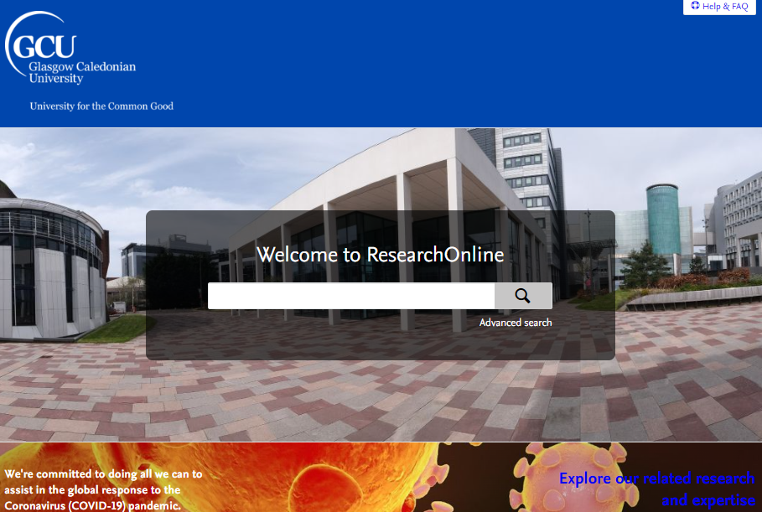
ResearchOnline
ResearchOnline is GCU’s research repository – displays content in Pure
Contact email: librarysystems@gcu.ac.uk
Notes:
ResearchOnline is the public facing online GCU research portal.
Increases the visibility of research at GCU by providing open access to research outputs which are free to read and download and allows staff to comply with REF, funder and University policy requirements.

Slide 16
ORCID
Open Researcher and Contributor ID (ORCID)
Provides an open and independent registry- the de facto standard for contributor identification in research and academic publishing
Benefits: name flexibility; uniquely yours: more time for research: reduce admin burden: portable profile data
GCU encourages all academic staff to register for an ORCID and enable data exchange between Pure and ORCID
Library ORCID webpage
Notes:
ORCID is a free, unique, persistent identifier (PID) for individuals to use as they engage in research, scholarship, and innovation activities.
Benefits:
Name flexibility: ORCID helps reduce the negative consequences of name changes so you will no longer be limited to the name you used when you began your career.
Uniquely yours: Use your ORCID whenever you publish to distinguish yourself and claim credit for your work, no matter how many other researchers share your name.
More time for research: By allowing trusted organisations such as GCU to add your research information to your ORCID record, you can spend more time conducting your research and less time managing it.
Reduce admin burden: Experience greater ease as an increasing number of manuscript submission and grant application forms can be auto-populated when you log into their systems with your ORCID.
Portable profile data: Easily share your data between your ORCID record and an increasing number of funding, publication and data repositories, including Pure.
Add your ORCID to your Pure profile, and how to authorise the export of your research data from Pure to ORCID.

Slide 17
Scopus and SciVal
Scopus is the world's largest abstract and citation database of peer-reviewed literature
Scopus Content Selection and Advisory Board
Scopus author profile
Pure ingests data from Scopus > export to ORCID
SciVal is an analytics solution based on Scopus data
Provides access to the research performance of thousands of research institutions and their associated researchers worldwide
Library Scopus and SciVal webpage
Notes:
All content indexed in Scopus goes through a thorough selection process administered by the Scopus Content Selection and Advisory Board.
Scopus author profiles are generated using powerful algorithmic data-processing which groups papers to an individual's profile with a high degree of accuracy based on matching of name, email, affiliation, subject area, citations, and co-authors.
Pure's integration with Scopus enables two way data exchange with data being ingested from Scopus, and if you also have an ORCID, as mentioned data can be exported from Pure/Scopus in order to populate your ORCID.
GCU's subscribes to four modules in SciVal: an overview module; benchmarking module; trends module and a reporting module. This can help you to visualise your research performance, benchmark against peers, develop strategic partnerships, identify emerging research trends and create uniquely tailored reports.

Slide 18
Publishing support
Where to publish?
Responsible use of research metrics
GCU is a signatory of the San Francisco Declaration on Research Assessment (DORA)
Predatory journals
Think, check, submit
Contact email: libraryresearch@gcu.ac.uk
Notes:
GCU is strongly committed to the principle that the outcomes arising from its publicly funded research are a public good that should be made as widely available as possible.
The Library Research Team can assist you when deciding how and where to publish your research.
With regard to analysing research metrics, we have a dedicated section of our website that provides detailed advice on output, journal, author, and alternative metrics and their responsible use.
GCU is also a signatory of DORA, whose mission is to advance practical and robust approaches to research assessment globally. DORA recognizes the need to improve the ways in which researchers and the outputs of scholarly research are evaluated.
Predatory journals and publishers are entities that prioritize self-interest at the expense of scholarship, and ask authors to publish for a fee (in the same way as open access journals) but do not follow high academic standards of peer review or editing.
The library's predatory journals webpage can help you to identify such journals.
Think, check, submit offers a range of tools to educate researchers, promote integrity and build trust in credible research and publications. Particularly useful are the checklists which allow authors to evaluate a journal or publisher to ascertain if it is a trusted venue of publication.

Slide 19
Research Data Management (RDM)
GCU RDM policy and requirements
All new research proposals should have a research data management plan (DMP)
DMPonline
In line with funder requirements
Library RDM webpages
Notes:
Research data management (RDM) is the active, mindful handling of the information produced or re-used during the course of academic research.
All new research proposals must include research data management plans or protocols that explicitly address data capture, management, integrity, confidentiality, retention, sharing and publication
DMPonline helps you to create, review, and share data management plans that meet institutional and funder requirements. It is provided by the Digital Curation Centre (DCC).
Library RDM webpages provide a wide range of information on data management planning, creating data, managing data, storing and sharing data, archiving data and additional resources and courses for help with RDM.

Slide 20
Thanks for listening!
Email contact details
Library research support queries:
libraryresearch@gcu.ac.uk
Pure support queries:
librarysystems@gcu.ac.uk
Presentation by Seth Thompson. Licensed under the terms of a CC-BY-4.0 license

