Slide 1
Digital Learning: building digital capability
Professor Linda Creanor
Head of Blended Learning
GCU LEAD
l.creanor@gcu.ac.uk
@lcreanor
GCU Annual Programme Leaders Event, 2 March 2016

Slide 2
GCU Strategy for Learning (2015-20)
Inspirational approaches to learning, teaching and assessment which embrace innovation and the imaginative use of learning technologies
Enabling our people
Digital development
Campus development
Evidence base for enhancement
Partnership & collaboration
Student support systems
University systems
Students as partners
Enablers
www.gcu.ac.uk/gaq/strategyforlearning2015-2020/

Slide 3
Digital Learning at GCU means…
__________________________________________________
…developing creative approaches to learning, teaching and assessment through the effective use of technology
on campus and online
to enhance student engagement and enable flexible access through a range of digital devices.
__________________________________________________

Slide 4
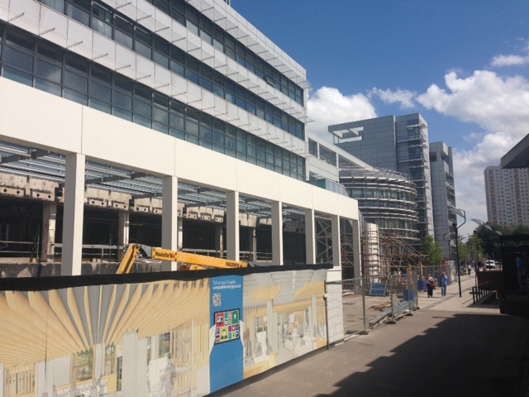
Transitions

Slide 5
Online Development
Planning & Goal Setting
Storyboarding & development of online activities
Peer Review & sharing designs/approaches/challenges
FOCUS
DESIGN
REVIEW
Guides & Resources available in GCULearn, under STAFF HELP tab

Slide 6
Blended Learning
EMPOWER
ENHANCE
EXTEND
ENHANCE: Adopting technology in simple and effective ways to actively support students
and increase their activity and self-responsibility
EXTEND: Further use of technology that facilitates key aspects of students’ individual and
collaborative learning and assessment through increasing their choice and control
EMPOWER: Developed use of technology that requires higher order individual and
collaborative learning that reflect how knowledge is created and used in professional
environments
3E Framework (Smyth et al, 2011)

Slide 7
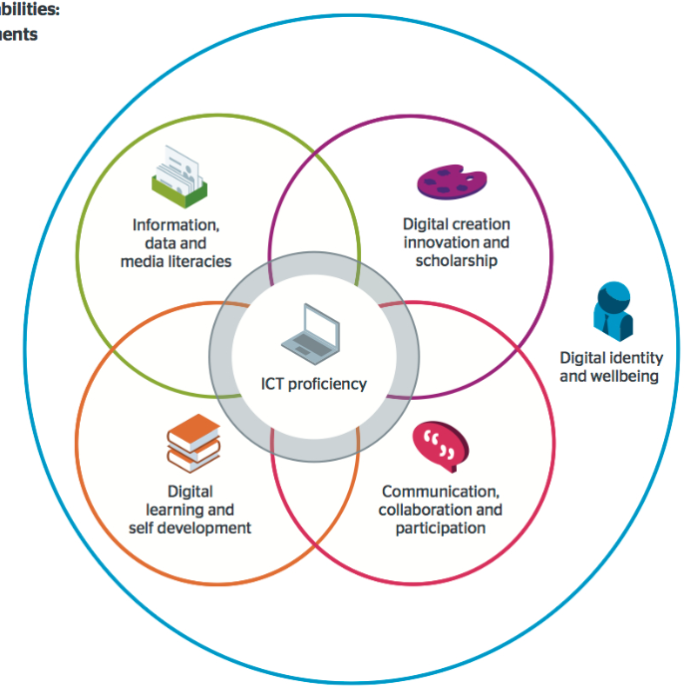
Jisc Digital Capabilities Framework
The six elements

Slide 8
GCU Survey on Digital Learning (2015):
129 Respondents from across all three Schools (academic staff)
How useful over the past year?
How useful in the coming year?
How confident in the use of GCULearn?
Do you use social media channels for learning & teaching?
What are the enablers/drivers/ barriers?
What tools do you actually use within your modules?

Slide 9
High confidence
HIGHLY
MODERATELY
HIGHLY
MODERATELY
VERY
VERY

Slide 10
Low confidence
NOT VERY
SLIGHTLY
MODERATELY
NOT VERY
SLIGHTLY

Slide 11
Do you use any of the following social media channels in your learning & teaching activities?
TWITTER | 42
SKYPE | 42
GOOGLE+ | 20
LINKEDIN | 19
FACEBOOK | 16
WHATSAPP | 11
INSTAGRAM | 4
SNAPCHAT | 0

Slide 12
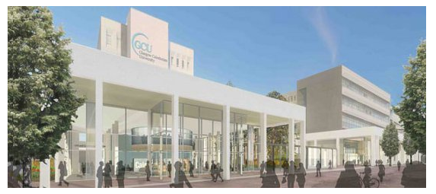
Transformed….?
www.gcu.ac.uk/campusfutures/media/

Slide 13
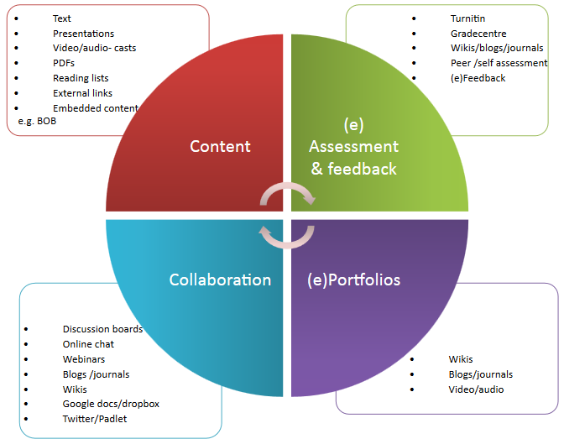
Activity 1: Digital Learning in your programmes

Slide 14
Activity 2: The Programme Leader’s role in embedding Digital Capabilities
GOOD PRACTICE PRINCIPLE | First Steps | Developing | Developed | Outstanding
Provide (access to) excellent digital learning content
Embed digital capabilities into modules
Adapted from Jisc NUS Benchmarking Tool: the Student Digital Experience
http://repository.jisc.ac.uk/6140/1/Jisc_NUS_student_experience_benchmarking_tool.pdf

Slide 15
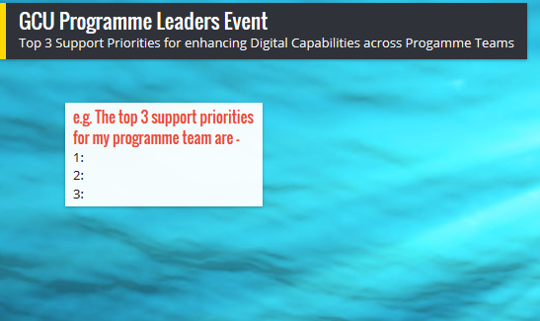
Activity 3: Supporting Digital Learning across Programmes
Identify your top THREE CPD priorities for enhancing digital capabilities across your programme.
What form should this support take?
Padlet link - http://padlet.com/l_creanor/ylh7e23gkhbk

