Slide 1
Engage 4 Induction
Ideas to inspire active and collaborative learning strategies throughout induction and transition

Slide 2
Engage 4 Induction - Summary
Engage cards are designed to inspire active and collaborative learning strategies.
Each card has the name and description of an active learning strategy, together with an outline of why the activity holds value for student learning.
The active learning strategies in this sub-set are particularly suited to supporting learners through induction and transition activities.
On the flip side of the card, there is a link and/or QR code leading to an example, and some prompts to help you consider how the learning strategy can be contextualised and adapted to meet the needs of your specific learners.
A KEY has been generated to help you identify which active learning strategy may be most suitable for the learning context that you are working within.
The KEY is explained in the following pages and relate to:
Learning activity type,
Learning modality,
Learning activity size / scalability,
Learning activity duration.

Slide 3
Key : Learning types
Acquisition
e.g. listening, watching.
Collaboration
e.g. working together on small group projects.
Discussion
e.g. articulating (and responding to) ideas/concepts.
Investigation
e.g. exploring, investigating, evaluating.
Practice
e.g. developing and practicing skills.
Production
e.g. creating evidence that demonstrates learning.

Slide 4
Key : Learning modality
Best suited to an in-person activity
Best suited to an online activity
Can be either in-person or online

Slide 5
Key : Learning activity size/scalability
Best suited to a small group format (e.g. ~ 5/6 learners per group)
Best suited to a larger group format (e.g. lecture style)
Can be used by all sizes of groups

Slide 6
Key : Learning activity duration
Activity duration is approximately 10 minutes or less
Activity duration is approximately 20 minutes
Activity duration is approximately 30 minutes
Activity duration is approximately 40 minutes or longer

Slide 7
Engage 4 Induction Ice Breaker Connections
How to use the activity:
Value for student learning:
Using a digital board (e.g. Padlet), learners are asked to come together in an informal way to help create social connections. This can be particularly useful at the start of a module or learning unit.
Select a theme and ask learners to post comments and respond to the posts of others. For example, ‘something that has made you smile in the last week’ or ‘a piece of music that motivates you’.
Ice breaker activities can offer learners the opportunity to engage in low stakes activities and build confidence to participate in subsequent tasks. The ice breaker activities can also act as a catalyst for discussion.
Discussion

Slide 8
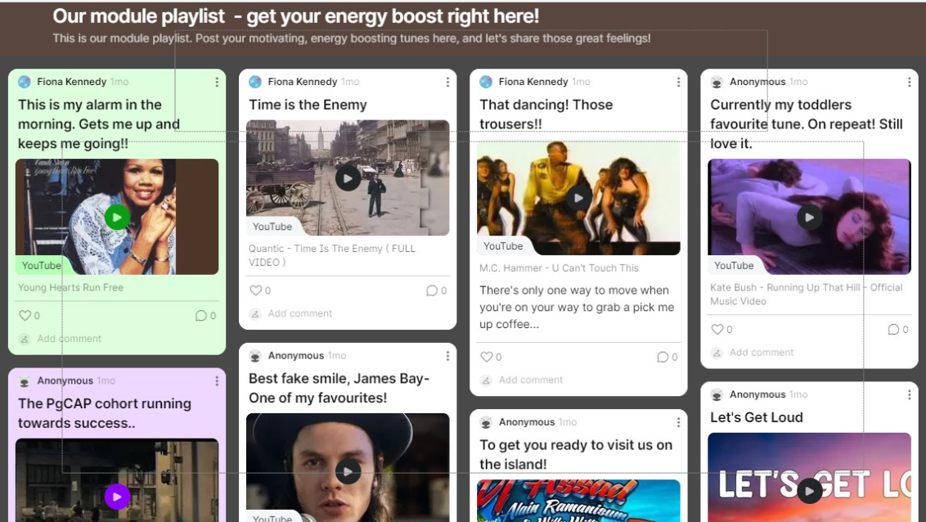
Ice Breaker Connections
For example…
Ideas for adapting the activity…
Here is an example of a module playlist created from a module ice breaker using a Padlet board.
Engagement
You could give learners the opportunity to choose the theme for the ice-breaker.
Representation
You could encourage learners to explain why they selected a specific song / image etc. to contribute to the ice breaker.
Action & expression
You could invite learners to provide feedback to peers on the specific contributions made to the ice breaker.

Slide 9
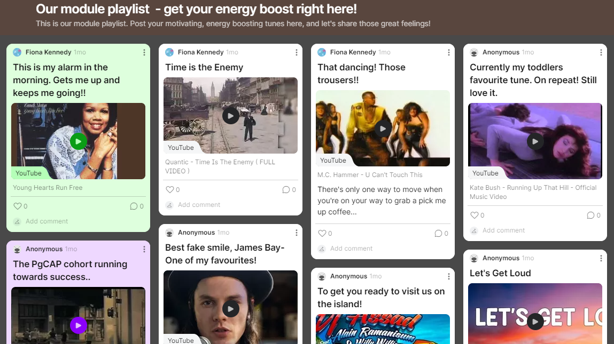

Slide 10
Engage 4 Induction Virtual Treasure Hunt
How to use the activity:
Value for student learning:
Learners are asked to work in groups to explore a specific course site on the institutional VLE in a bid to find items and information that has been embedded within the site.
The items to be found can be housed in any area, folder or document within the online course site. The activity can be given a competitive edge by offering a ‘prize’ as appropriate.
This activity supports learners to explore and investigate the institutional online learning environment, and to learn from their engagement with the structure of the module.
Creating a space to facilitate learner familiarity with the structure and content of the course site acts as a foundation for further engagement with the virtual learning environment.
Investigation

Slide 11
Virtual Treasure Hunt
For example …
Ideas for adapting the activity …
Here is an example of how a virtual treasure hunt was used with learners to help familiarize them with a GCU Learn course site.
Engagement
You could ask learners to reflect on the parts of the online course site that they found most challenging / easy and to discuss these.
Representation
You could ask experienced learners to help design the virtual treasure hunt by suggesting specific places where items / information could be embedded.
Action & expression
You could provide prompts or clues to support learner planning and engagement with the activity.

Slide 12
Virtual Treasure Hunt: What to do
Go to the course site for your module
Find the following ‘treasure’:
Images of the module leader (there may be more than one, so search carefully…)
Timetable of your classes
The module code
Names of two people from the module team
Details about the module assessment (what it is and when the submission deadline is)
Details of the work that you are required to do before this class next week
Take a note of the course section where you find these things
Submit your answers to the module leader as soon as you find them using the quiz that is in the online site (yes, you have to find that too!)
The team submitting the correct answers in the shortest time will get a prize!
EXAMPLE

Slide 13
Engage 4 Induction: Ranking Activity
How to use the activity:
Value for student learning:
Working in small groups, learners are asked to rank statements into order (most important at the top, least important at the bottom). MS Forms is an example of a digital tool that can be used.
Alternatively, the activity could be completed using paper in an in-person learning environment.
The results of the activity can be presented back to learners as a summary of responses, and can act as a catalyst for discussion.
This activity allows learners to consider their individual perspectives and compare to the summary presented at the conclusion of the activity.
As an induction activity, this can help establish expectations and create the conditions for a related discussion.
20
Practice

Slide 14
Ranking Activity
For example …
Ideas for adapting the activity …
Here is an example of how a ranking activity was used with staff new to teaching during induction to their programme of study.
Engagement
You could vary the demand of this activity by asking learners to create their own list and then rank this in order of importance.
Representation
You could ask learners to highlight patterns and/or differences across the ranking of the groups.
Action & expression
You could ask two groups to share their ranking and discuss, before moving on to a full group discussion.

Slide 15
Let’s get started!
EXAMPLE
Each group has a set of characteristics associated with an effective learning environment.
Please arrange these in order of importance, with the most important one at the top of your list.
If you feel there is something additional that you would like to add then please add this on a different coloured piece of paper and add to the list.

Slide 16
Engage 4 Induction
Understanding Feedback
How to use the activity:
Value for student learning:
Learners are asked to explore their perceptions and list the types of feedback that they can get from classes and other learning situations.
Simultaneously, tutor(s) compile their own list of where they get feedback from learners. This activity can be a pen and paper exercise, or a digital tool (e.g whiteboard) can be used to capture responses.
Ideas are shared and explored in a subsequent discussion.
This activity allows learners and tutors to share their experiences and expectations associated with feedback.
Comparing learner and tutor responses allows an insight into the perspectives of both.
Discussion

Slide 17
Understanding Feedback
For example …
Ideas for adapting the activity …
Here is an example of an activity used to promote the understanding of feedback.
Engagement
You could encourage learners to keep a note of their expectations associated with feedback and reflect on this at a later stage in their studies.
Representation
You could encourage learners to vote on the types of feedback that they have most and least experience of, to explore links to their prior knowledge.
Action & expression
You could ask learners to share an image or description of what they think feedback is to set the scene, and provide multiple means of expression and communication.

Slide 18
Understanding feedback
EXAMPLE
What is feedback?
Linked to progress, identifying strengths and areas for enhancement.
Who needs feedback?
Everyone! It is a 2-way process.
Why is it needed?
Professional and personal development; optimising experiences
Anyone ever given feedback in a restaurant?
Task for you: Think about the types of feedback that you get in classes from different sources. How many can you come up with?
Task for me: List some of the ways in which I get feedback from you
Task for us: Let’s compare the things that we come up with.

Slide 19
Engage 4 Induction Time Capsule
How to use the activity:
Value for student learning:
Learners are asked to identify a personal goal that they would like to achieve within a designated timescale and submit this information.
Contact the learners at the end of the designated timescale, to follow-up on progress.
Paper / postcards / envelopes, or online tools such as MS Forms can be used to capture the goals.
Engaging learners with setting goals can encourage personal learning and development.
Having a follow up to the time capsule activity affords learners the opportunity to evaluate their achievement against their previously set goals.
Practice

Slide 20
Ideas for adapting the activity …
Time Capsule
For example …
Here is an example of how the time capsule activity was used with undergraduate students during first year induction.
Engagement
You could encourage learners to share their personal goals with Personal Tutors and align this with the value that can be gained from engaging with their Personal Tutor.
Representation
You could encourage learners to capture their responses to the questions using text, images, audio recordings etc.
Action & expression
You could enhance learner capacity for monitoring their progress by identifying a specific time for them to respond to their time capsule entries.

Slide 21
Induction: Time capsule activity
EXAMPLE
Each student gets a piece of A4 paper and pens. Ask the students to note the following two points:
How you are feeling right now (about starting University)
One goal that you would like to achieve by the end of first year (preferably something other than passing all assessments!!)
Fold the piece of paper and put it inside an envelope. Each student writes their name on the outside of the envelope and seals it. They will get this back at the end of first year.
On returning the time capsules, students are encouraged to reflect on their time capsule entries and to identify what has helped them to achieve / stopped them from achieving their intended goal.

Slide 22
Engage 4 Induction Think, Pair, Share
How to use the activity:
Value for student learning:
Learners are asked to work individually to respond to a question, problem or topic.
Learners then work in pairs to discuss their responses.
The tutor then draws responses from the pairs to generate a whole class discussion.
Having the opportunity to think individually supports learners to process information before moving on to share with a peer, where they can discuss their answers.
Completed in pairs, think, pair, share can be used in any size of group and can provide opportunities for learners to organise their thoughts (e.g. at the start of a class) or reflect on their learning (e.g. at the midpoint or end of a class).
Discussion

Slide 23
Think, Pair, Share
For example …
Ideas for adapting the activity …
Here is an example of how think, pair, share was used with students during a module induction to encourage them to explore their perceptions about an introductory module topic.
Engagement
You could encourage engagement with the activity by making the relevance of the problem / topic explicit to learners.
Representation
You could present the key words noted across the class in a word cloud to offer the information in multiple formats.
Action & expression
You could provide learners with prompts or checklists to support their engagement with the problem / discussion topic.

Slide 24
What is communication?
EXAMPLE
Working on your own, write down a brief description / definition of what communication is.
Compare your description with the person sitting beside you – any similarities / differences?
In what ways do we communicate with each other?
Let’s take the key words that help us understand what communication is across the class.

Slide 25
Engage 4 Induction Peer Learning World Cafe
How to use the activity:
Value for student learning:
Experienced learners are asked to facilitate groups / breakout rooms where specific topics can be discussed. For example, for induction or preparation for work-based placement.
The tutor moves student facilitators around groups / breakout rooms after a designated period to allow participants to engage with all group sessions.
In this activity, learners are given the opportunity to engage with a number of groups, offering a time limited engagement with a variety of topics. Peer learning can encourage participation and allows sharing of others’ experiences.
Moving the facilitators as opposed to the learners can create a fixed space for learners to engage in discussions and develop connections with fellow learners. In the online environment, moving the facilitators is more practical.
Discussion

Slide 26
Peer Learning World Cafe
For example …
Ideas for adapting the activity …
Here is an example of how the peer learning world café activity was used to design induction activities for first year undergraduate learners (notes pages included in slide deck).
Engagement
You could give learners choice in this activity by encouraging them to identify topics that they can explore with peers during the world café.
Representation
You could support learners to understand how and why their previously learned skills and information can be used as a starting point for developing new knowledge and ideas.
Action & expression
You could provide multiple ways for learners to engage with and record their responses for each of the world café activities.

Slide 27
Group activities for today
EXAMPLE
Working in groups of approximately 15, you go round different tables.
You will spend ten – fifteen mins at each table; we will let you know when the time is up and signal your move to the next table.
You will continue until you have been at all tables.

Slide 28
Table 1- breaking the wall of problems
EXAMPLE
The group gets a “wall” with detachable bricks. Each brick has a problem written on it and the group has to discuss ways of dealing with / solving that problem. As they ‘solve’ a problem, the brick can be removed from the wall and the solution written on a post it and stuck on top of the problem. Aim is to get the wall of problems broken down!

Slide 29
Table 2 - tablecover introductions
EXAMPLE
Each person in the group has to write a couple of sentences about themselves as an introduction, on their part of the tablecover and sign their name. They can add contact details if they want to do so.
Then the paper is rotated around. Each time the cover is rotated, the students read the intro written by someone else and they should write them a message in response.

Slide 30
Table 3 – Expectations
EXAMPLE
This activity is about identifying what you expect from your University, your lecturers and yourselves!
There are 3 categories. Take each category in turn and ask the group:
What are your expectations in relation to …….
1. Assessments and feedback
2. Communication and relationships with your lecturers
3. Your own learning experience
Group facilitators should keep a note of the things in each category on a bit of paper and pop into discreet bundles.

