Slide 1
Preparing your Doctoral Thesis for Open Access
Toby Hanning, Research and Information Systems Manager

Slide 2
Session overview
Requirements when submitting your thesis
Electronic submission and open access
Preparing your thesis for open access
Licensing your thesis
Completing the deposit declaration form
Uploading your final thesis
Support available from the library
Support available from the graduate school

Slide 3
Session outcomes
The University's requirements when depositing your final thesis
The benefits of open access and of using GCU's institutional repository
Your responsibilities regarding accessibility, sensitive data and third party copyright
When to request permission to reuse content in your thesis
The access and licensing options for your work
How to deposit your thesis and complete the library declaration form

Slide 4
Thesis submission regulations
7.65: Following the completion of the examination process the candidate must send the final, revised version of the thesis/portfolio […] in .docx or .pdf formats to Academic Registry.
7.66: An award letter from Academic Registry will not be issued to the candidate until the final, revised version of the thesis, and all relevant documentation, is received by the Academic Registry.
7.70: The candidate is responsible for ensuring that the full content of the final thesis/portfolio can enter the public domain without compromising ethical principles, research integrity and that the thesis/portfolio meets the requirements of all data protection legislation in statute at the time of final submission.

Slide 5
Benefits of open access
Exposure
Citations
Opportunities
Best practice

Slide 6
Benefits of using Pure
Authority
Security
Governance
Protection

Slide 7
Common concerns
Plagiarism – having your work in plain view with a date-stamp, clear attribution and institutional authority makes it much easier to assert authorship and serves as a deterrent.
Research development – some researchers worry their work will be developed by others without their involvement. Again, the presence of the authoritative record online with clear attribution makes this unlikely.
Prepublication – your thesis as one work among many that are derived from your research. This is the prevailing view of publishers.

Slide 8
Preparing for open access
You should consider the following before and during the writing up phase of your project:
Accessibility
Personal and sensitive data (GDPR)
3rd party copyright
Licensing and reuse of your work

Slide 9
Accessibility
Accessibility means making sure your content can be used and understood by the widest possible audience.
It has been law in the UK since 2018 that all documents publicly available should meet Web Content Accessibility Guidelines (WCAG) Level AA. In practice this means:
Using headings and styles
Colour is not used to convey meaning
There is sufficient contrast between background colours and text
Images include alt text
Embedding links correctly
Tables have column headers and no split or merged cells
Use in-built accessibility tools, for example Microsoft Accessibility Checker.
GCU guidance available on the intranet.

Slide 10
Personal and sensitive data
Your thesis should contain no personal information about an individual unless permission to include the information has been granted by the individual. This includes, but is not limited to:
Personal contact information, for example email addresses, postal addresses, telephone numbers
Signatures
Vehicle registration numbers
IP addresses
Images identifying a person
Where permission has been granted this should be clearly stated in the thesis, for example:
Photograph reproduced with the permission of the subject(s).
Collate and retain proof of permissions granted and, where appropriate, submit this as an appendix to your thesis.

Slide 11
Using third party copyright works
Material created by other people (a third party) will usually be protected by copyright, for example:
Extracts of text from books, articles or websites
Artistic works such as images, figures, photos or graphs
Maps such as OS maps, online maps (Google, Apple)
Data such as extracts from a database.
It is your responsibility to ensure that material in your thesis that is authored or created by a third party is either:
Free of copyright restrictions or openly licensed
Falls under the UK copyright quotation exception
Can be made openly available under permission you have obtained from the rights holder (not always the creator).

Slide 12
Third party copyright checklist
Step 1: Identify third party copyright works
Identify content where you are not the copyright owner, for example:
Text from books, journal articles, conference papers, websites
Images, photographs, figures, tables, graphs
Maps
Databases
Computer programs
Web pages

Slide 13
Third party copyright checklist
Step 2: Decide if you need to seek permission
Permission is not necessary where:
Your use is covered by a copyright exception
A work is out of copyright
You already have permission
In all other cases, you must seek permission.

Slide 14
Third party copyright checklist
Step 3: Identify the copyright holders
Where you need to seek permission, identify the copyright holder. Look for the copyright symbol © followed by the name of the author or publisher.
If copyright is held by the author you can attempt to find their contact details using the WATCH Project or Society of Authors.
If you can't trace the copyright holder it is important to assess the risk of reproducing the work. If you include the work, show evidence that you carried out a ‘good faith’ search for the author’s contact details and record this in your permission summary table.

Slide 15
Third party copyright checklist
Step 4: Request, store and collate permissions
The library website links to some template text you can use when requesting permission and to a template log you can use to track and record your requests.
Do not leave your permission requests until the end of your writing up period as publishers can take a long time to reply. If you don't receive a response after four weeks try contacting them again.
Retain proof of permission where this has been granted, and letters requesting permission, where no reply was received. If you like you can submit this material as an appendix to your thesis.

Slide 16
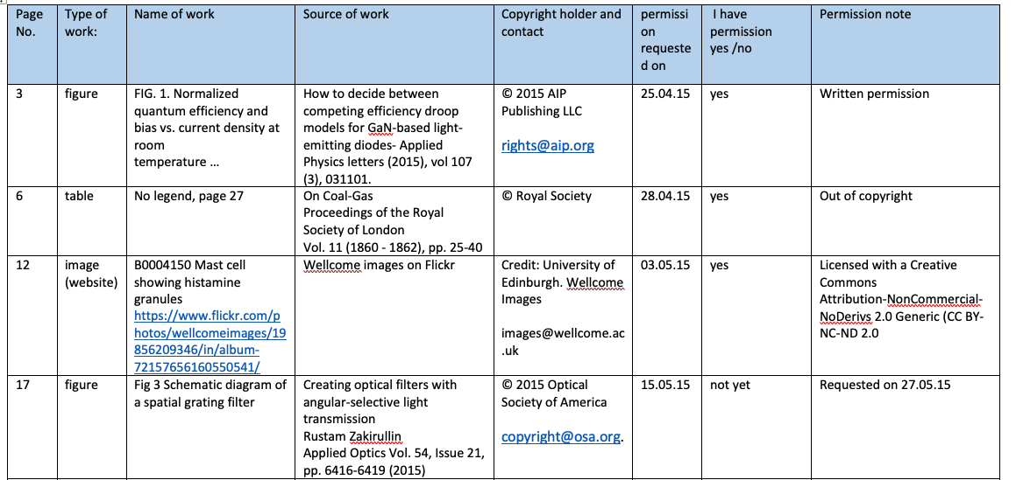
Third party copyright checklist
Step 4: Request, store and collate permissions
Template request log

Slide 17
Third party copyright checklist
Step 5: Acknowledge permission
Where permission has been granted, reference the extract and add a statement next to the content, for example:
Image reproduced with permission of the rights holder.
Where permission has been denied you must not include the work in the version of your thesis to be made open access. You may replace it with a reference or description and, where possible, provide a link to the original work.

Slide 18
Redacting content
You must always deposit the complete final version of your thesis in Pure.
If certain material in your thesis cannot be made publicly available you should also deposit a second version of your thesis without that material. This is known as a redacted version.
Make redactions in the original file format of your thesis, then convert the file to PDF.
To redact text, delete all restricted information and replace it with the text [REDACTED].
To redact images or large sections, delete them and replace them with [REDACTED]. You may need to add padding to keep your page numbering the same.
Don't conceal text behind black highlighting or a black box.
Don't delete any reference to the content you have removed.
If the material is so intrinsic to the thesis that it cannot be removed you should still deposit the complete final version in Pure and request an appropriate restriction on access.

Slide 19
Quiz
For each of the following scenarios is permission required to include the content in your thesis?

Slide 20
Quiz
For each of the following scenarios is permission required to include the content in your thesis?
1. A photograph you took yourself of your project team on a site visit
2. The name and NHS email address of a doctor on an ethical approval form
3. An original image from your own previously published journal article
4. A diagram you found online through a Google search
5. A short excerpt of text from a recently published textbook
6. A still image from the latest Ryan Gosling film
Notes:
Yes. You own the copyright of the image but you need to obtain written permission from any individual identifiable in the image
No. This information is already in the public domain, so it is not classed as personal information
Yes. Most likely copyright was transferred to the publisher so you would need to obtain permission from the publisher. However if the article was published open access under a Creative Commons licence, then you can reuse the image without permission as long as you adhere to the terms of the licence
Yes. You will need to identify the original place of publication and the copyright holder, then request permission. Again it's possible the diagram was made available under a Creative Commons licence in which case, as above, you can reuse the image without permission as long as you adhere to the terms of the licence
No. A short excerpt of text would fall under the quotation exception in UK copyright law, as long as you cite the original source
Yes. Photographs and images rarely fall under a copyright exception, even when they are just a small part of a much larger work.

Slide 21
Access and licensing
You must complete the Library Doctoral Thesis Deposit Declaration when you deposit your final thesis. This tells the library who can access your thesis and what they can do with it.
Immediate open access
Delayed open access (after a two year embargo)
A permanent restriction (very rare)
Most theses can be made open access immediately but occasionally a restriction may be required.
You should discuss any proposed restriction with your supervisor before completing the form. All requested restrictions will be checked with your supervisory team.

Slide 22
Access
Eligible restrictions on access are:
Future publication
Personal or confidential data
Copyright
Commercial information
Contractual restrictions
International relations, defence, national security or public safety

Slide 23
Licensing
Theses will usually be made open access in GCU's institutional repository under a Creative Commons (CC) licence.
CC licences enable you to specify how you would like your thesis to be used by others.
CC licences are legally binding and internationally recognised.
Specify which Creative Commons licence you would like to apply to your thesis when you complete the Library Doctoral Thesis Deposit Declaration.
Full information on each licence can be found on the Creative Commons website.

Slide 24
Completing the declaration form
Submit the declaration form once you've passed your viva and made any required corrections.
The declaration form has three sections:
Details: personal details, thesis title, supervisors, funder/commercial sponsor
Access: note any restriction(s) required, specify your chosen CC licence
Declaration: read this carefully, by submitting the declaration form you agree to all points specified in the declaration.
Questions? Speak to your supervisor or contact libraryresearch@gcu.ac.uk before you submit the declaration form!

Slide 25
Depositing your files
You are required to deposit the following documents:
The complete final version of your thesis in PDF format, incorporating any corrections. The file must not be locked or password protected. (MANDATORY)
Any supplementary files associated with your thesis. If these are too large to deposit they can be submitted on a USB. (MANDATORY)
A redacted version of your thesis with 3rd party copyright or sensitive material removed. Please name the files clearly, for example, "complete version" and "redacted version". (IF REQUIRED)
Email your file(s) to Registry:
researchdegreeexams@gcu.ac.uk

Slide 26
What happens next?
The library will check your files and declaration form
The library will confirm your deposit with Registry so your award can progress
The library will create a record for your thesis in Pure
The library will provide you with a DOI for your thesis
Your thesis will be added to GCU's library catalogue and to the British Library's Electronic Thesis Online Service (EThOS).

Slide 27
Support available
Thesis deposit guidance:
https://www.gcu.ac.uk/currentstudents/essentials/library/research/thesis-deposit
Thesis copyright guidance:
https://www.gcu.ac.uk/currentstudents/essentials/library/research/thesis-deposit/thesis-copyright
Contact:
libraryresearch@gcu.ac.uk

Slide 28
Support from The Graduate School
Dr Erifyli Tsagkari ets1@gcu.ac.uk

Slide 29
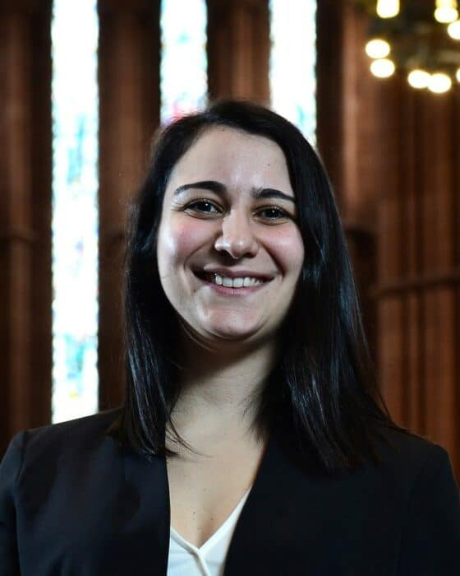
1:1 CONSULTATIONS
Support regarding:
Academic writing (thesis, report, grant, paper)
Researcher development
Practice a presentation (workshop, conference, viva, public engagement event)
Dr Erifyli Tsagkari
ets1@gcu.ac.uk
H208, William Harley building

Slide 30
Helpful links/videos/articles at the Academic Writing Centre:
https://caledonianac.sharepoint.com/sites/AcademicWritingCentreGCU/
Created by Dr Stephanie Zihms

Slide 31
University of East Anglia ONLINE TRAINING SERIES FOR PGRS 2024-25
https://bookwhen.com/ueaonlinetraining#focus=ev-s5ke-20241008190000

Slide 32
The Power Hour of Writing
This is protected writing time for you!
- 10 min chat and goal setting - 60 min focused time to write - 10 min follow-up

Slide 33
The Graduate School - Publications workshop series
Finding the right journal
Writing Introductions
Methodology vs Methods
Tables, Figures and Equations
Results and Discussion
Conclusions
Abstracts
Introduction to peer-review

Slide 34
The Graduate School - Creative methods to support your writing & Research methods
Overcoming imposter feelings with creative writing
Selection of research methods and resources

Slide 35
The Graduate School - Note taking & Reading
Getting started with note taking
Getting started with Obsidian
Making sense of your reading
Reference managers

Slide 36
Academic Disability Coordinator – Dr Erifyli Tsagkari
Support disabled PGRs (and their supervisors)
Diagnosed - Reasonable Adjustment Plan
Undiagnosed - Get in touch for support with your writing and general PhD journey
GCU Disability support information

Slide 37
My Workshops since I joined GCU in May 2024 (delivered and to be delivered)
Getting Started with Note-taking 13 June 11:00 – 12:00
Making Sense of your Reading 19 June 14:00 - 15:00
Editing your Writing 25 June 11:00 - 12:00
PhD Challenges 11 June (face-to-face) & 07 August (online)
Conferences 20 June (face-to-face) & 13 August (online)
Preparing for Presentations 27 June (face-to-face) & 22 August (online)
Writing your RDC2 report 05 June 10:00 – 12:00 (online & face-to-face)
Writing for a Grant Application 03 July 11:00 – 12:00
Thinking about development Opportunities 29 August 15.00- 16.00
Preparing for your Viva 27 August 15:00 – 16:00
Make the most of your PhD 05 September 11.00-12.00
Increase your Productivity 12 September 14.00-15.00
Manage your PhD 19 September 11.00-12.00
Publish your first paper 26 September 14.00-15.00

Slide 38
The structure of these workshops
•I present the topic of interest (40 minutes)
•Break out rooms are created so you have the opportunity to discuss with other peers on that topic (10 minutes)
•I summarize key ideas and give you useful resources (10 minutes)

Slide 39
October & November 2024
Dates | 7thNovember | 14th November | 21st November | 28th November
Presentations
11.00 – 11.10 am | 1 | 4 | 7 | 10
11.10 – 11.20 am | Q/As
11.20 – 11.30 am | 2 | 5 | 8 | 11
11.30 – 11.40 am | Q/As
11.40 – 11.50 am | 3 | 6 | 9 | 12
11.50 – noon | Q/As

Slide 40
Other things that are organised by us
Online Writing Retreats
Research Staff Mentoring Programme
Virtual Coffee Breaks
3MT

Slide 41
ANY QUESTIONS?
ets1@gcu.ac.uk
graduateschool@gcu.ac.uk

