Slide 1
Why innovation matters?
MANAGEMENT OF INNOVATION AND CREATIVITY
SUB-LECTURE 1.2A
Notes:
You will hear the term Innovation continually, in the media, in strategy documents and on company websites. Innovation is stressed as being important to customers/ shareholders, business and our future and most often, our survival and growth. There is innovation in all products from hairspray to hospital care and our lifestyles are constantly reshaped by the process of innovation.
Research evidence suggests a strong correlation between market performance and new products. New products help capture and retain market shares, and increase profitability in those markets. In more mature and established products, competitive sales growth comes from a variety of non-price factors e.g. design, customisation and quality.

Slide 2
Innovation?
The word ‘innovation’ comes from the Latin, innovare, and is all about change.
Perhaps a more helpful definition of innovation is:
‘the process of creating value from ideas’
Notes:
In a UK government report, innovation has been called ‘the motor of the modern economy, turning ideas and knowledge into products and services’
Not just large companies that benefit:
Factors characterising success of SME:
Innovation as most important characteristic associated with success
Innovative enterprises typically achieve stronger growth or are more successful than those that do not innovate
Enterprises that gain market share and increasing profitability are those that are innovative

Slide 3
Invention V Innovation
Innovation
‘a new way of doing things that is commercialised’ (Porter, 1990)
‘…successful exploitation of new ideas’ (DTI, 2004)
An idea, product, service or method of operation that has been developed and marketed to customers who perceive it as novel.
Invention
Tangible, new
e.g. new product, service, method of operation
Cannot always be put to immediate use
Challenge!! Can you find a good definition? Can you be critical of the definitions?
What is an entrepreneur?
Notes:
An innovation is applying creativity to come up with a unique idea or solution.
Whilst an entrepreneur applies the innovation to bring the ideas to life.
Entrepreneurship is a potent mixture of vision , passion, energy , enthusiasm, insight, judgement and plain hard work, which enables good ideas to become a reality.
As the famous management writer Peter Drucker put it;
‘Innovation is the specific tool of entrepreneurs, the means by which they exploit change as an opportunity for a different business or service. It is capable of being presented as a discipline, capable of being learned, capable of being practiced’
Entrepreneurship is a human characteristic that mixes structure with passion, planning with vision, tools with wisdom to use them, strategy with the energy to execute to and judgment with the propensity to take risks.
Tidd and Bessant (2021) say that it is possible to create structures within organisations, departments, teams etc. and the resources but effective changes wont happen without the ‘animal spirits’ of the entrepreneur

Slide 4
Innovation and entrepreneurship
‘Innovation is the specific tool of entrepreneurs, the means by which they exploit change as an opportunity for a different business or service. It is capable of being presented as a discipline, capable of being learned, capable of being practised’
(Peter Drucker (1985) as cited in Tidd and Bessant (2021, p20)
Notes:
Survival and growth pose a problem for established players but a huge opportunity for new-comers to rewrite the rules of the game. One person’s problem is another’s opportunity and the nature of innovation is that it is fundamentally about entrepreneurship – the skill is to spot the opportunity and create new ways to exploit them is at the heart of the innovation process.
Entrepreneurs are risk takers- but they calculate the costs of taking a bright idea forward against the potential gains if they succeed in doing something different.

Slide 5
Creativity is thinking up new things.
Innovation is doing new things.
Theodore Levitt
‘Innovation is creativity that ships’ Steve Jobs
Notes:
American economist and professor at Harvard Business School.
Steve Jobs famously said; “Real artists ship”. He was referring to the fact that everyone has ideas, but real artists deliver on them or ship them, as he put it. Creative Thinking can lead to amazing things, but only if you do something with it.

Slide 6
Creativity V’s Innovation
‘Creativity is a process of developing and expressing novel ideas that are likely to be useful
The end result of the creative process is an innovation, where innovation is the embodiment, combination, and or synthesis of knowledge in novel, relevant, valued new products, processes or services’
From ‘When Sparks Fly’
(Leonard and Strap, 2005)
GCU Core Value!
Well-led group interactions
Notes:
This definition suggests that if an organisation wants innovation they must commit to a creative process. E.g. Renishaw’s creativity is institutionalised in their product design process, it can be embedded in the culture with significant important placed on idea generation and collaboration in problem solving. Controversy over having the word innovation as a core value is not enough and the creative processes established around the small and flexible project team is more relevant in producing the innovation.
How do you create an environment where individual and organisation confidence is increased by participating in the creative process? Enable individuals to be confident that their radical or challenging idea has the potential to be valuable to the business. Leaders need to commit to supporting individuals who contribute to the creative process.
Managers need to create a context which encourages both creative people and then the application of those creative ideas into goods and services that people want to buy. In the business context it is useful to think of innovation as the process through which new ideas, objectives, behaviours and practices are created, developed and implemented into a product or service.
Sandy Stoddart on Creativity http:
“The discoveries of yesterday are the truisms of tomorrow, because we can add to our knowledge but cannot subtract from it.”
While creativity is at the core of invention and innovation, so too is the ability to spot market opportunities – and this is one very important role of the entrepreneur
creativity is clearly a requirement for truly successful firms. Because underpinning all of these challenges—and opportunities—is a single, unifying concept. Introducing a new service, delivering services in new ways, doing pricing differently, distinguishing your firm in the recruitment market, getting people out of their silos, determining a unique strategy that really differentiates—these can only be done if you have an idea first. And not just any old idea, but a good one. And if that isn't creativity, then I don't know what is.
The big question, of course, is: How? How can we use our brains, in a deliberate and systematic way, to generate ideas on demand? To answer that question, I'll invoke Koestler's Law. (Lawyers like laws, after all.)
//video.strath.ac.uk/streams/external/cap/p120-04/creativity.wvx
Creativity is linked to innovation
‘ability to combine ideas in a new way or to make unusual associations between ideas’ (Boddy and Paton, 2011)
Helps people and organisations to generate imaginative ideas or ways of working - Itself does not ensure added value
Organisations can be more innovative by
More innovative product or work methods, depends on both inputs and transformation of inputs.
Flourish in a favourable context
Van Grundy (1987) distinguishes creativity and innovation;
contributing to innovation, but used towards other ends
Creativity only part of the process of innovation
Where do the best creative ideas come from? Most managers assume that it's the readily identifiable "creative types" that offer the quickest route to out-of-the-box thinking. Yet, say Dorothy Leonard and Walter Swap, most innovations spring from well-led group interactions. The authors sweep aside conventional thinking about creativity and offer proven strategies for stimulating and directing the group dynamics that lie at the heart of innovative thinking. When Sparks Fly outlines and analyzes each step in the creative process and gives practical suggestions for managing teams. According to Fortune, "The insights in the lively book could turbocharge your team (and maybe even your career)."

Slide 7
Where does innovation make a difference
Innovation is about…
Identifying or creating opportunities
New ways of serving existing markets
Growing new markets
Rethinking services
Meeting social needs
Improving operations – doing what we do but better
Breakthrough drugs
low cost airlines, Zara
Henry Ford 'a car for everyman'
On-line banking, Amazon, ebay
Karlinska Hospital, reduced waiting time
Lean management
Notes:
So I would now like to give some examples across the spectrum showing how innovation makes a difference to organisatons of all shapes and sizes.
Identifying or creating opportunities
Innovation is driven by the ability to see connections, to spot opportunities and to take advantage of them. Sometimes this is about completely new possibilities – for example, by exploiting radical breakthroughs in technology. New drugs based on genetic manipulation have opened a major new front in the war against disease. Mobile phones, tablets and other devices have revolutionised where and when we communicate. Even the humble window pane is the result of radical technological innovation – almost all the window glass in the world is made these days by the Pilkington float glass process which moved the industry away from the time consuming process of grinding and polishing to get a flat surface
To help you might like to read the case study of James Dyson and his innovation-led business
New ways of serving existing markets
Innovation isn’t just about opening up new markets – it can also offer new ways of serving established and mature ones. Low cost airlines are still about transportation – but the innovations which firms like Southwest Airlines, Easyjet and Ryanair have introduced have revolutionised air travel and grown the market in the process. Despite a global shift in textile and clothing manufacture towards developing countries the Spanish company, Inditex (through its retail outlets under various names including Zara) have pioneered a highly flexible, fast turnaround clothing operation with over 2000 outlets in 52 countries. It was founded by Amancio Ortega Gaona who set up a small operation in the west of Spain in La Coruna – a region not previously noted for textile production – and the first store opened there in 1975. They now have over 5000 stores worldwide and are now the world’s biggest clothing retailer; significantly they are also the only manufacturer to offer specific collections for northern and southern hemisphere markets. Central to the Inditex philosophy is close linkage between design, manufacture and retailing and their network of stores constantly feeds back information about trends which are used to generate new designs. They also experiment with new ideas directly on the public, trying samples of cloth or design and quickly getting back indications of what is going to catch on. Despite their global orientation, most manufacturing is still done in Spain, and they have managed to reduce the turnaround time between a trigger signal for an innovation and responding to it to around 15 days.
You might find it helpful (as an example) to read the case study of Zara and how it has used innovation around design and ‘fast fashion’ to create new opportunities in a crowded and mature marketplace
Growing new markets
Equally important is the ability to spot where and how new markets can be created and grown. Alexander Bell’s invention of the telephone didn’t lead to an overnight revolution in communications – that depended on developing the market for person-to-person communications. Henry Ford may not have invented the motor car but in making the Model T – ‘a car for Everyman’ at a price most people could afford – he grew the mass market for personal transportation. And eBay justifies its multi-billion dollar price tag not because of the technology behind its on-line auction idea but because it created and grew the market. AND NOW VITNED
To help you take a look at a case study of the Model T Ford
Rethinking services
In most economies the service sector accounts for the vast majority of activity so there is likely to be plenty of scope. And the lower capital costs often mean that the opportunities for new entrants and radical change are greatest in the service sector. On-line banking and insurance have become commonplace but they have radically transformed the efficiencies with which those sectors work and the range of services they can provide. New entrants riding the internet wave have rewritten the rule book for a wide range of industrial games – for example, Amazon in retailing, eBay in market trading and auctions, Google in advertising, Skype in telephony.
Go online for a case study of AliBaba and the Taobao online shopping mall which is one of the world’s top ten most visited websites
Meeting social needs
Innovation offers huge challenges – and opportunities – for the public sector. Pressure to deliver more and better services without increasing the tax burden is a puzzle likely to keep many civil servants awake at night. But it’s not an impossible dream – right across the spectrum there are examples of innovation changing the way the sector works. For example, in healthcare there have been major improvements in efficiencies around key targets such as waiting times. Hospitals like the Leicester Royal Infirmary in the UK or the Karolinska Hospital in Stockholm, Sweden have managed to make radical improvements in the speed, quality and effectiveness of their care services—such as cutting waiting lists for elective surgery by 75% and cancellations by 80%— through innovation.
You might like to read some example cases – Karolinska Hospital, Aravind, NHL Hospital – of innovation in public services
Improving operations – doing what we do but better
Kumba Resources is a large South African mining company which makes a dramatic claim – ‘We move mountains’. In their case the mountains contain iron ore and their huge operations require large-scale excavation – and restitution of the landscape afterwards. Much of their business involves complex large-scale machinery – and their ability to keep it running and productive depend on a workforce able to contribute their innovative ideas on a continuing basis.
You might find the case of Kumba Resources a useful example

Slide 8
Strategic advantages through innovation
Offering something no one else can
Offering in ways others cannot match e.g faster, lower cost, more customized
First-mover advantage
Offering a different ways of doing something that makes other ones redundant
Recombining established elements for different markets
Notes:
Tidd and Bessant (2021) 14-15
IMPORTANCE OF FASTER TIME TO MARKET, (LIFE CYCLES REDUCING E.G. COMPUTERS, IPHONES NEW MODELS)

Slide 9
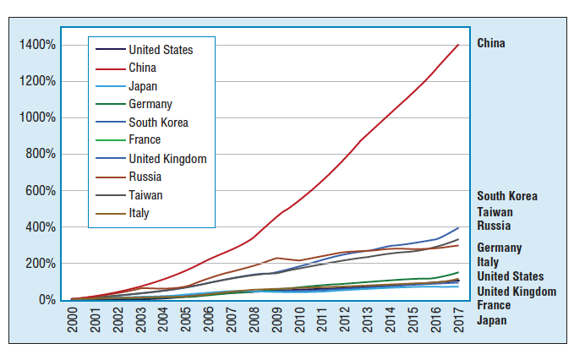
Investments in innovation
Notes:
Innovative companies do better but it is not due to investments in R&D alone but rather their ability to convert knowledge into value
At the company level - There is no long-term correlation between the amount of money a company spends on its innovation efforts and its overall financial performance. Instead, what matters is how companies sue the money and other resources, as well as the quality of their talent, processes and decision making to create products and services that connect with their customers.

Slide 10
To Gain a competitive advantage
“Companies achieve competitive advantage through acts of innovation. They approach innovation in its broadest sense, including both new technologies & new ways of doings things”
Michael Porter (Porter, 1990)
Notes:
ECONOMIST, HARVARD BUSINESS SCHOOL

Slide 11
Case Study: running shoes How innovation can strengthen competitive position
1st footwear designed to improve running performance was by Adolf Dassler in 1920 – who?
Room for more innovation?
New products and services, new designs, new fabrics, new approaches to the process of getting shoes to fit exactly e.g. 3D imaging and printing (custom made)
Nike new self-tying shoe-laces, controlled via a smartphone
Nike Vapofly – carbon-fibre plate with energy returning foam (increased share price by 90%)
Kipchoge new world record!
Notes:
Archeologists have found shoes from 40,000 years ago.
Main players in the industry have been running neck and neck for some time.
Nike recently came up with Vapofly, help runners move at least 4% more efficiently. Significant improvement in performance, risk of being banned from the 2021 Olympics. (can make a reduction of 1 or 2 mins off an enter marathon so difference between finishing 1st and coming 5th)
Asics competitor has had a sharp fall in share price, Nike share price has risen by 90%
Despite high cost of 250 dollars, the performance boost is irresistible even for the millions of ‘ordinary’ people.
Needless to say that the big competitors in the field like Asics and Adidas ahv been running hard to catch up on their own version fo carbon fibre plate shoes and are 3 years after Vapofly was introduced, only now emerging with this combination of carbon fibre plate combined with soft foam cushioning – the new dominant design.
But it takes time and money and Adidas are currently on the back foot, sales of its ‘boost’ show have flattened out reflecting its age and lack of excitement compared to Nike’s product.
https://theconversation.com/super-shoes-explaining-athletics-new-technological-arms-race-156265 2022 update
Breaking news…. Kipchoge's new world record of 2h, 1m and 9s was an astonishing achievement, even by his own lofty standards. It was 30s faster than his previous record (also set in Berlin, in 2018) and the second-largest lowering of the world record since 2003 (Kipchoge himself has the largest margin). https://theconversation.com/eliud-kipchoge-broke-the-mens-marathon-record-by-30-seconds-how-close-is-the-official-sub-2-hour-barrier-now-191421#:~:text=Kipchoge's%20new%20world%20record%20of,himself%20has%20the%20largest%20margin).
he was wearing super shoes!!
Similarly, advanced footwear is certainly helping track athletes run faster. But other innovative tools – such as the wave-light pacing technology, used during the 5,000m and 10,000m world records in 2020 – may also contribute to their increased speed.

Slide 12
Schumpeter (1950)
entrepreneurs will seek to use technological innovation
Strategic advantage and Monopoly Profits
Others imitate
New innovations emerge
Monopoly profit reduce, equilibrium reached
Re-write the rules of the game
Process of ‘Creative Destruction’
Notes:
Significant figure in economic theory
Argument: entrepreneurs will seek to use technological innovation – a new product / service or a new process for making it – to get strategic advantage.
The entrepreneur he said will expect to make a lot of money ‘monopoly profits’
Others will see and imitate it, other innovations will emerge
Monopoly profit will reduce until reach an equilibrium
At this point the cycle repeats – our original entrepreneur or someone else looks for the next innovation, which will rewrite the rules of the game and off we go again.
Schumpeter talks of a process of ‘creative destruction’ where there is a constant search to create something new that simultaneously destroys the old rules and establishes new ones, all drive by the search for new sources of profits.
competition strikes - Ultimately making things better and improving our lives,

Slide 13
Innovation is a risky business, but not innovating is even riskier
Pressures of short-product life cycles, complexity, convergence, environment constantly changing, shifts in socioeconomic field (what people believe, expect, want, earn), new legislation, competition
"Not to innovate is to die." - Christopher Freeman (English economist and business cycle theorist)
‘Innovation is the lifeblood of an organisation’ - Peter Drucker (Austrian-born American Management guru)
Notes:
Competitors may introduce new products, which represent a major threat to existing market positions.
In all these ways firms need the capability to respond through innovation.
‘Innovation is the specific instrument of entrepreneurship... the act that endows resources with a new capacity to create wealth’ - Peter Drucker, Management guru
Innovation and competitive success are not just about high technology
e.g. the German firm Wurth is the largest maker of screws (and other fastenings) despite low cost competition from competition in China, the company has managed to stay ahead through emphasis on product and process innovation across a supplier network.
UK Dairy Crest business has offered a stream of product innovation including resaleable packing, novel formats and new varieties of cheese and related dairy products, with manufacturing an logistics process innovations.

Slide 14
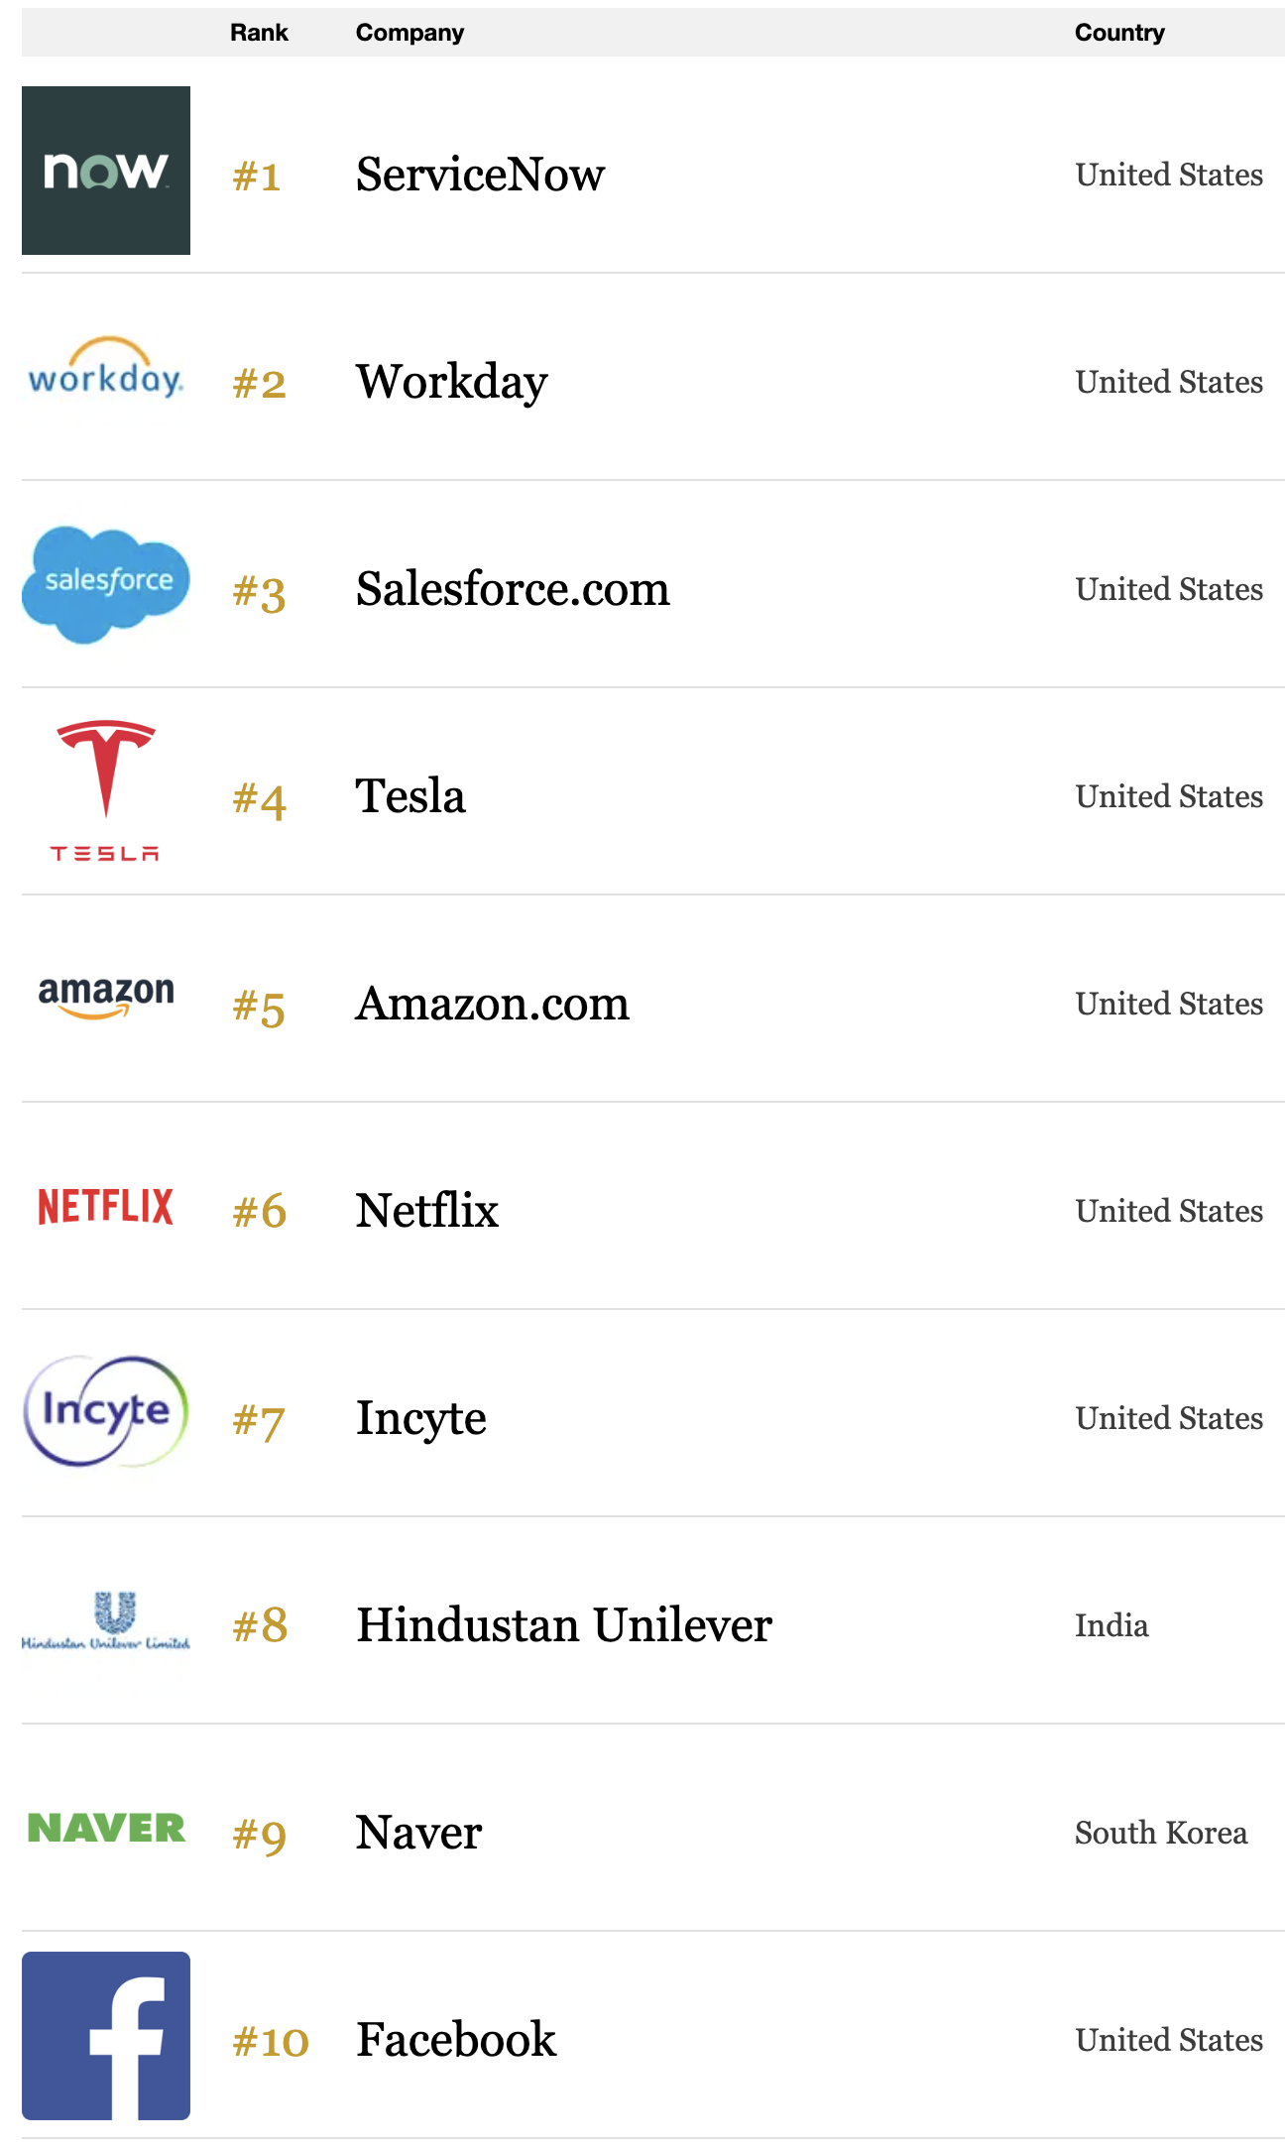
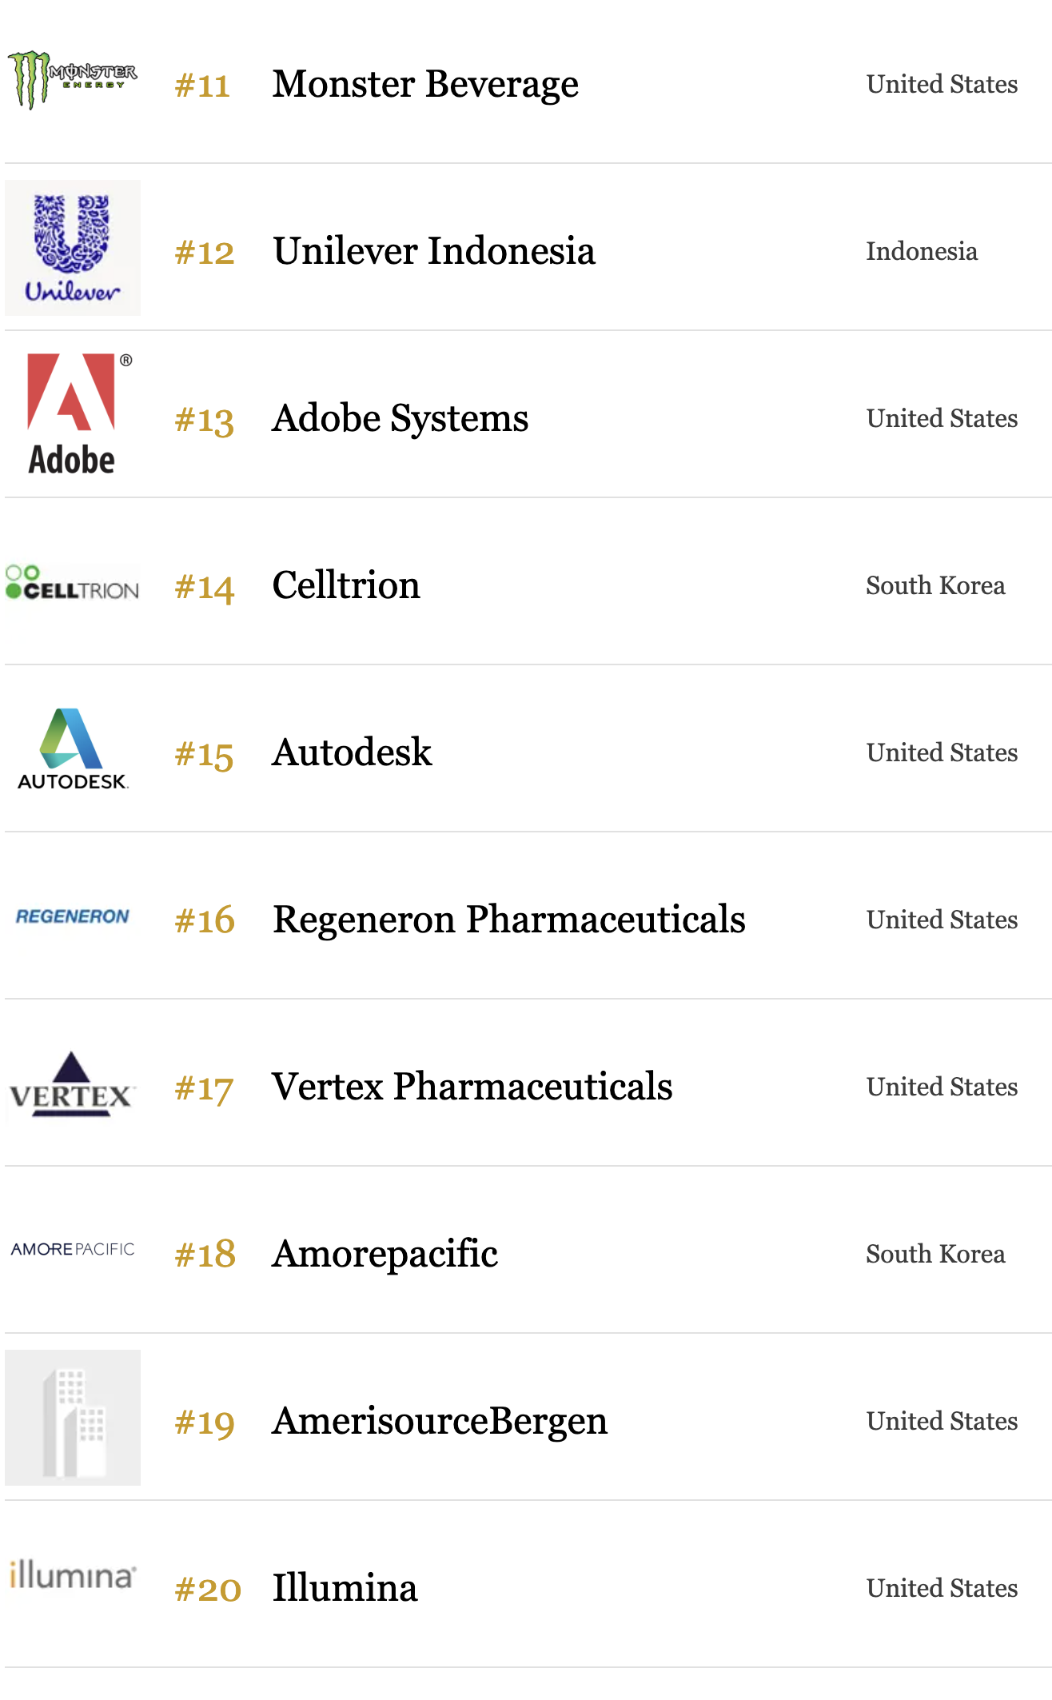
The 50 Most Innovative companies of 2024
https://www.forbes.com/innovative-companies/list/#tab:rank

Slide 15
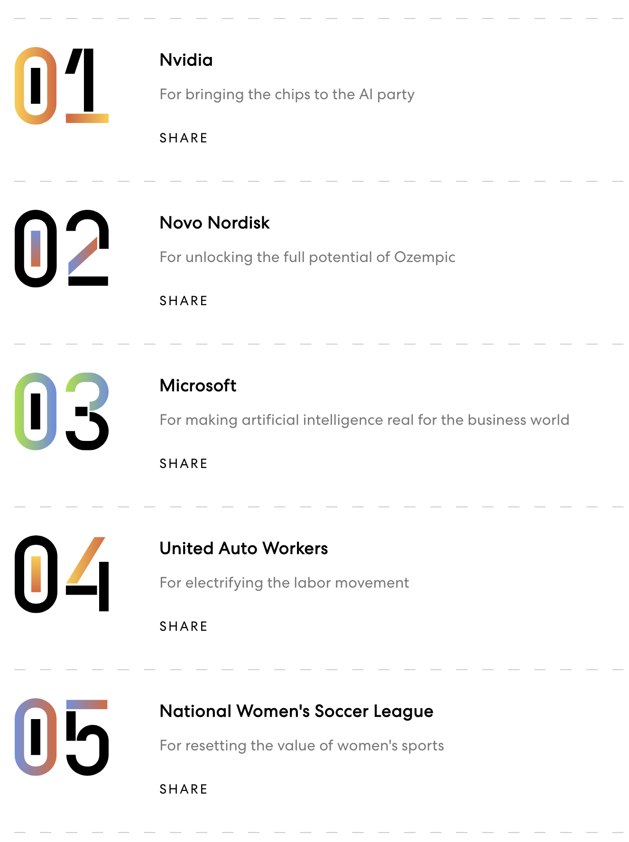
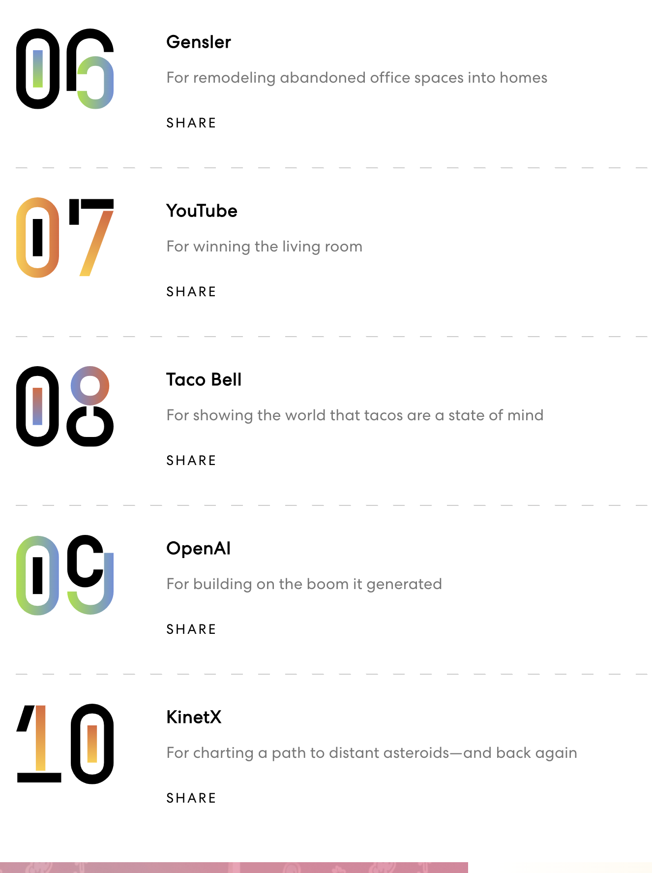
https://www.youtube.com/watch?v=A_ARQcw6dI0
Fast Company’s Worlds Most Innovative Company 2024 - https://www.fastcompany.com/most-innovative-companies/list
Notes:
Welcome to the future. For years, Fast Company has been tracking ideas and technologies that promise to transform the world but seem just out of reach.
Fast Company's annual ranking of the World's Most Innovative Companies covers 58 industries and sectors, from advertising to video.
Our annual ranking of the best in business showcases how companies can impact both industry and culture for the better.
As this year’s list of the Most Innovative Companies illustrates, they’re now firmly in our grasp.
There’s generative AI, of course, which is being built atop the chips and platforms of this year’s No. 1 company, Nvidia, and popularized by the likes of OpenAI and Microsoft. Emerging AI companies are also making their mark, whether that’s by managing the risks around the technology (Credo AI) or creating an entirely new way to search the web (Perplexity).
But the science fiction made real doesn’t stop there. Over the past year, Vertex Pharmaceuticals brought the first CRISPR-Cas9 gene-editing treatment to market, KinetX helped navigate a spacecraft on a 4.4 billion-mile mission to land on an asteroid and return home, and Climeworks used direct air capture to scrub carbon from the atmosphere. Not-for-profit 4 Day Week Global, meanwhile, has done the seemingly impossible: convince companies around the world to adopt a shorter workweek.
While new technologies fuel innovation, our rankings of the World’s 50 Most Innovative Companies—and the 58 lists that chronicle forward-looking organizations in sectors from advertising to video—showcase deeply human stories. Taylor Swift Productions, Beyoncé’s Parkwood Entertainment, Sphere Entertainment, and Mattel have demonstrated the power of collective, in-person experiences.
The National Women’s Soccer League is taking sports fandom to new levels. The United Auto Workers is pushing companies to center labor even as they pursue innovation. And everywhere, companies are finding new ways to connect to culture and delight consumers, from Taco Bell and J.M. Smucker’s embrace of playful foods to Chess.com’s efforts to turn a centuries-old game into must-see reality TV. The challenges facing business and the planet are immense, but the process of selecting these winners gave us optimism. (Here's our methodology for creating the list.) We hope you are similarly inspired.
Innovation: Does the company have a clear innovation (or innovations), and did it demonstrate how this innovation sets it apart from other companies and general current industry trends? Examples of innovations can include products, services, a new business model, a strategic acquisition that signals a reimagining of the business, etc.
Impact: Did the innovation have a clear, measured impact on the company and its industry? Did the company show how it has measured the impact of its innovation and provide data as evidence of its success? Examples of data can include revenue, revenue growth, user growth, impressions, qualitative impacts on culture or industry, etc.
Timeliness: Did the innovation happen within the past 12 months? Or—if the innovation is older—did the company provide evidence of meaningful iterative advances this year and how the impact from the innovation has been realized in the past 12 months?
Relevance: As much as possible, did the company explain how the innovation connects to current events or larger issues faced by industry or society?
Each winner is chosen after multiple rounds of judging and conversations.

Slide 16
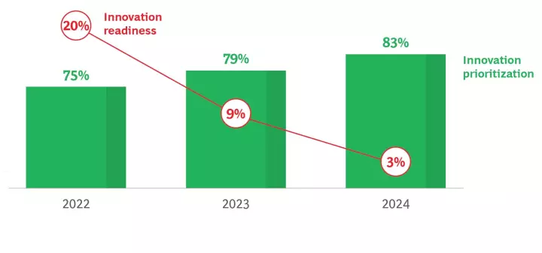
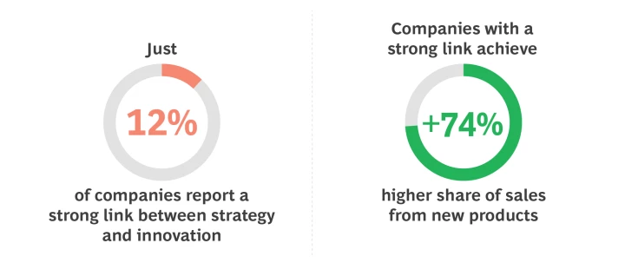
Boston Consulting Group – Most innovative companies report 2024
‘Innovation systems need a Reboot'
A Troubling Innovation Readiness Gap
Combating Zombies with Strategy
GenAI as an Innovation Accelerator
Innovation Systems need a Reboot, according to Boston Consultancy Group (BCG)
https://www.bcg.com/publications/2024/innovation-systems-need-a-reboot
Notes:
This year we investigate a paradox. In the history of our Most Innovative Companies research, organizations have never placed a higher priority on innovation, yet they have never been as unready to deliver on their innovation aspirations—and GenAI is coming. Their innovation systems urgently need a reboot. What lessons do the world’s most innovative companies provide?
Here’s a paradox. Companies have never placed a higher priority on innovation—yet they have never been as unready to deliver on their innovation aspirations. It’s a recipe for disappointment. BCG’s 2024 Most Innovative Companies report examines the readiness gap and offers perspectives on how companies can get back on track.
Innovation Readiness Gap
Today, our 2024 research finds 83% of companies seeing innovation as a top-three priority, but only 3% ready to translate their priorities to results.
Readiness has declined most sharply in those aspects of the innovation system that link business strategy to innovation strategy. And executives feel it: just 12% say their company has a strong link between the two. However, innovation activity—the number of projects going through the funnel—has remained steady, evoking a troubling image: "zombie" innovation systems just going through the motions.
Combating Zombies with Strategy
A strong link to business strategy focuses innovation investment—and it also delivers better innovation output. Strategy-led innovators achieve a share of revenue from new products 74% higher than companies with just a weak link between strategy and innovation. It’s time for innovators to recommit to strategy. Download the report or read the chapter for more.
GenAI as an Innovation Accelerator
While 86% percent of innovators in our research are experimenting with GenAI to at least some degree, ready innovators are moving out ahead. They’re applying GenAI more frequently in a single use case and are five times more likely to have applied it at scale.
And GenAI can be a powerful tool in helping organizations reshape their innovation systems for greater readiness. We spotlight ten use cases that span the three phases of the innovation cycle: strategize, create, and scale. Download the report or read the chapter for more.

Slide 17
Summary
Innovation is also a survival imperative. If an organisation doesn't change what it offers the world and the ways in which it creates and delivers those offerings it could well be in trouble.

Slide 18
Summary
And innovation contributes to competitive success in many different ways
– it’s a strategic resource - helping to get the organisation where it is trying to go
Whether it is delivering shareholder value for private sector firms, or providing better public services, or enabling the start-up and growth of new enterprises.
Notes:
BCG 2022 report - There is also encouraging news. We have written before that meeting the sustainability challenge requires using a combination of big data, deep technology, and strategic ecosystems to tackle the complexity and industry-level transformations involved. Consider the multiple consortia of auto OEMs, suppliers, tech companies, software designers, chip manufacturers, battery makers, telcos, mobility providers, and others that have come together around the idea of autonomous vehicles. Committed C&S innovators are more likely to engage with external partners, and ready innovators are 44% more likely to do so than those that are simply committed. High-emitting companies are 20% more likely than low emitters to target the kind of deep-tech solutions they’ll need to substantially decarbonize.

Slide 19
References
Fast Company (2024), The Most Innovative Companies of 2024 https://www.fastcompany.com/most-innovative-companies/list (accessed 22 September 2024)
Goffin K & Mitchell R (2017), Innovation Management, 3rd edition, Palgrave, Chapter 1
Porter, M.E., 1990. The competitive advantage of nations. Competitive Intelligence Review, 1(1), pp.14-14.
Tidd, J. & Bessant, J. (2021), Managing Innovation, 7th ed, Wiley, Chapter 1
Schumpeter (1950), Capitalisms, Socialism and Democracy, 3rd edition, Mew York: Harper and Row

