Slide 1
Types of innovation (4Ps) Sub-Lecture 2.2B
Management of Innovation and Creativity

Slide 2
Lecture Outline
Goffin and Mitchell’s – Different dimensions of Innovation
Schumpeter’s 5 types of Innovation
Tidd and Bessant’s 4Ps – Scope for Innovation / Innovation space
Degree of Novelty: Incremental, Breakthrough and Radical innovation
Level of Innovation: Architectural/component innovation
Discontinuous Innovation / Dominant designs
Hidden innovations

Slide 3
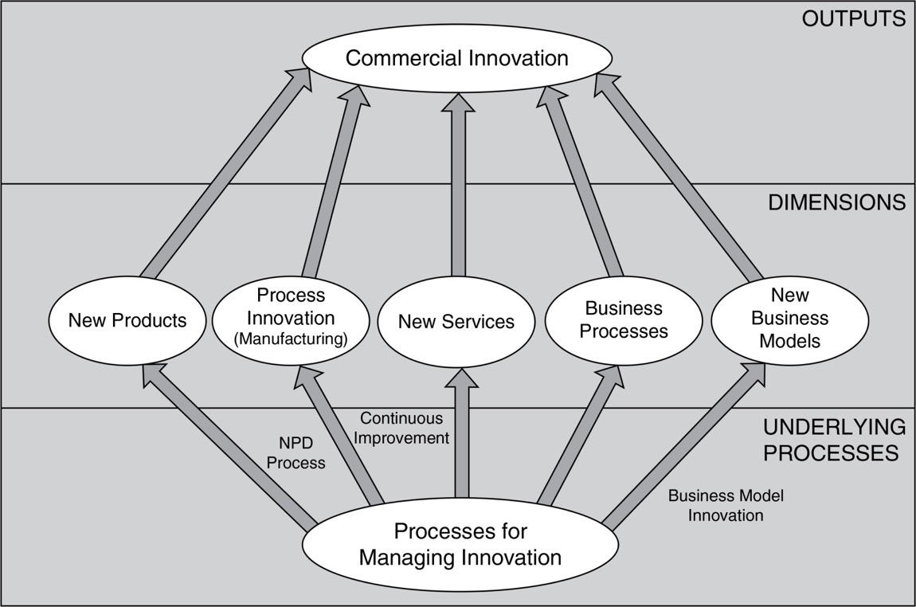
Fig 1.1: Dimensions of Innovation
Source: Goffin and Mitchell (2017, p. 6.)
Notes:
Mini case 1.1 Tetley’s Tea bags
Invented the round teabag.
Developed its manufacturing equipment on its own, so that competitors would not be able to copy quickly.
Now part of the Tata Group and has introduced ‘super teas’.
http://www.tataglobalbeverages.com/brands/tea/Tetley
Mini Case 1.2: Gillette Razors
First company to introduce a three-blade ‘Mach 3’ razor.
The innovation was quickly copied.
Even when Gillette went to 5 blades, the US Rite Aid pharmacy chain came up with a copy. (Compare this to Tetley’s Teabags.)
Now the innovations are about skin hydration, rather than the number of blades.
http://gillette.com/en-us
Mini Case 1.3 Lesconcierges
Have you ever said: ‘I just wish I had someone else to do this for me’? It could be shopping; everyday tasks; entertainment; and travel.
Founded 1988 in Bangalore India, the company helps busy professionals and deals with over 2 million requests a year.
Their business model is to post ‘onsite concierges’ to major companies, which pay a retainer and employees pay a fee for each task
“The only limit to our services is your imagination and we take on any request, provided it is legal and ethical” Dipali Sikand CEO and Founder.
www.macmillanihe.com/gm
Mini Case 1.4 Singapore Airlines
Provide legendary service and have won a top award in 20 out of 21 years.
Staff receive more training (e.g. they visit homes for the aged, to be able to empathize with older travellers). 40% of the innovation budget goes on staff training.
Strong focus on technology and process innovation.
https://www.singaporeair.com/en_UK/gb/flying-withus/
Mini Case 1.5 Lumkani, RSA
Have developed a low-cost fire alarm for informal settlements.
Company is a social enterprise that is innovating in the product it offers, and the way it is sold.
Needs to show the priority of the device against other things such as schooling.
http://lumkani.com/
Lumkani seeks to address the challenge of fires in urban informal settlements & townships in South Africa and across the globe.
We use innovative early-warning systems together with low-cost inclusive insurance products to provide safety and financial security to our clients.
Lumkani is a technology company which distributes insurance products to financially excluded households and businesses in townships and informal settlements
ensuring that those who are most vulnerable have a sense of security. Tens of millions of Rands of possible fire damage have been saved through our early-warning fire detectors.

Slide 4
Schumpeter (1996) Five Types of Innovation
The introduction of a new or improved good or service
The introduction of a new process
The opening up of a new market
The identification of new sources of supply of raw materials
The creation of new types of industrial organisation
Is this everything?
Notes:
Innovation is the process through which new ideas, objects, behaviours and practices are created developed and implemented
Schumpeter – criteria for innovation
Invention is not the only source of innovation to benefit firm and create national advantage. E.g.
Substitution of a cheaper material in an existing product
Better way of marketing an existing product or service
Better way of distributing or supporting an existing product or service
Schumpeter described five types of innovation but the core text Burns (2001) argues that there are considerable problems with interpreting these criteria for innovation e.g. what constitutes a new product or service? E.g. when a sofa manufacturer produces a ‘new’ sofa is that a new product. Economists may argue it is not but the entrepreneur might disagree. What if the sofa manufacturer starts manufacturing chairs? At what point does the firm start producing genuinely new products? The central role of the entrepreneurial firm in taking the innovation to the market needs to be explicitly acknowledged in any definition.

Slide 5
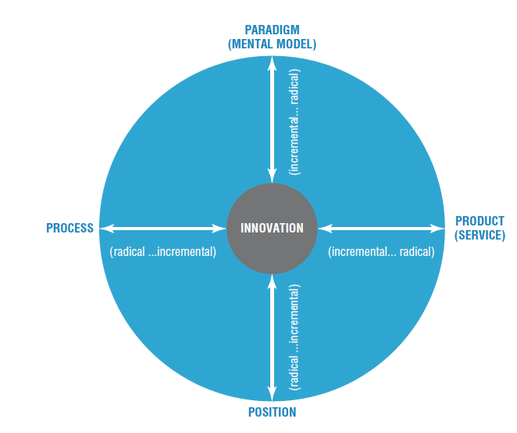
Scope for innovation
Figure 1.6 - Tidd and Bessant (2021, p 25)
Notes:
Each of the 4Ps of innovation can take place along an axis running from incremental through to radical change; the area indicated by the circle is the potential innovation space within which an organisation can operate.

Slide 6
Dimensions of innovation – what can we change?
Dimension | Type of change
‘Product’ | Changes in the things (products/services) which an organization offers
‘Process’ | Changes in the ways in which these offerings are created and delivered
‘Position’ | Changes in the context into which the products/services are introduced
‘Paradigm’ | Changes in the underlying mental models which frame what the organization does

Slide 7
Examples of the 4Ps model: Product
 | INCREMENTAL – DO WHAT WE DO BUT BETTER | RADICAL – DO SOMETHING DIFFERENT
‘Product’ – what we offer the world | Windows 7 and 8 replacing Vista and XP – essentially improving on existing software idea New versions of established car models – e.g. the VW Golf essentially improving on established car design Improved performance - incandescent light bulbs CDs replacing vinyl records – essentially improving on the storage technology | New to the world software – for example the first speech recognition program Toyota Prius – bringing a new concept – hybrid engines. Tesla – high performance electric car. LED-based lighting, using completely different and more energy efficient principles Spotify and other music streaming services – changing the pattern from owning your own collection to renting a vast library of music
Notes:
Product/service innovation - Dividing line may be blurred!
Tangible products v Intangible services
Making beneficial changes to products or services
Can include
Incremental improvements
Additions to product families
Next-generation products
New core products
Process - Improving the way jobs are done to meet organisation’s mission - E.g. new Car versus new manufacturing process
Service innovation
Innovation not just about manufactured products!
Offer better service e.g. faster, cheaper, higher quality – source of competitive advantage e.g.
UK First Direct bank – telephone banking
Direct Line – car insurance cut out ‘middle man’
Amazon – internet sales of diverse products
Ebay – auction house into living rooms
Public-sector innovations e.g.
postage stamp, the NHS
Karolinsa Hospital, Stockholm – cut waiting list by 75% and cancellations by 80% (process & social innovation?)
Being able to offer a better service
In banking the UK First Direct organization became the most competitive bank, attracting around 10,000 new customers each month by offering a telephone banking services using dsophisticated IT – a model which eventually become the industry standard.
Directline pioneered sale of car insurance in UK despite mature – long established product, innovative by telephone and then internet, cut out insurance brokers (copied a US firm who did the same). Innovation is about doing something different! Innovate value chain, found customer got now value from interaction with broker.

Slide 8
Examples of the 4Ps model: Process
What can you be critical about Process Innovation?
 | INCREMENTAL – DO WHAT WE DO BUT BETTER | RADICAL – DO SOMETHING DIFFERENT
‘Process’ - how we create and deliver that offering | Improved fixed line telephone services Extended range of stock broking services Improved auction house operations Improved factory operations efficiency through upgraded equipment Improved range of banking services delivered at branch banks Improved retailing logistics | Skype and other VOIP systems On-line share trading eBay Toyota Production System and other ‘lean’ approaches Online banking and now mobile banking in Kenya, Philippines – using phones as an alternative to banking systems On line shopping
Efficiency and cost reduction, innovation enablement, quality improvement, speed & time savings, flexibility & Adaptability, Competitive Advantage.
Notes:
Process Innovation
Transformations in the ways products/ services are created and delivered
Introduction of new, or significantly improved, method for production or delivery of output that adds value and better performance
Can include:
New manufacturing method
New office procedure
Make something no one else can or make in ways that are better → advantage e.g.
The Toyota Production System
Citibank, 1st bank offer ATM
Benetton sophisticated IT-led production network
Southwest airline, turnaround times
Great Ormond Street Hospital/Ferrari
Risk of imitation, need constant ???
New products seen as cutting edge of innovation in marketplace, but process innovation plays just as important a strategic role
e.g. Japanese dominance in the late 20th Century across several sectors – cars, motorcycles, shipbuilding, consumer electronics – owed a great deal to superior abilities in manufacturing – something which resulted from a consistent pattern of process innovation. The Toyota production system and its equivalent in Honda and Nissan led to a performance advantages of around two to one over average car makers across a range of quality and productivity indicators.
One of the main reasons for the ability of relatively small firms to survive in highly competitive global markets is the sheer complexity of what they make and the huge difficulties a new entrant would encounter in trying to learn and master their technologies.
Citibank was the first bank to offer automated telling machinery (ATM) services and developed a strong market position as a technology leader on this process innovation.
Benetton, one of world’s most successful retailers largely due to its sophisticated IT-led production network, which it innovated over a 10-year period – same model used effectively by Zara.
Southwest Airlines enviable position as most effective airline in USA, success due to process innovation in areas such as reducing airport turnaround times. Model became template for generation of low-cost airlines, revolutionised world of air travel.
Advantages from process innovation get competed away as others imitate, must move constantly innovate, or risk left behind as others take the lead in offerings, their operational processes or underlying models that drive their business. E.g. leaders in banking, those who capatalised in ICT, all retailers adopted advanced IT – production operations respond rapidly to the signals flagged by the IT systems
Great Ormond Street Hospital took inspiration from Formula 1 racing team Ferrari – pit-stop procedure kept simple, minimal movements all planned in advance. All members of team knew what to do from a single diagram. Ferrari videoed the hospital’s handover, Doctors shocked at lack of structure. Due to ever-changing team and unpredictable demand. Ferrari helped hospital design a simple formula they could understand and work to for handover teams.
Key benefits of process innovation are:
Efficiency and Cost Reduction: Process innovation aims to streamline operations, eliminate bottlenecks, and optimize resource utilization, resulting in increased efficiency and cost savings. By eliminating redundant tasks or automating manual processes, organizations can reduce operational costs and improve productivity.
Innovation Enablement: Process innovation can help create a culture of innovation. By optimizing processes, organizations can free up resources, reduce administrative burdens, and provide more time and space for employees to engage in creative thinking, problem-solving, and innovation efforts.
Quality Improvement: Process innovation can lead to enhanced quality control measures, reduced errors, and improved consistency in output. By reevaluating and redesigning processes, organizations can identify areas where quality improvements can be made, resulting in higher customer satisfaction and reduced waste or rework.
Speed and Time Savings: Process innovation can accelerate the pace of work, reduce lead times, and shorten cycle times. By identifying and eliminating non-value-added steps or implementing technological innovation, organizations can speed up processes and improve responsiveness to customer demands.
Flexibility and Adaptability: Process innovation enables organizations to be more agile and responsive to changing market conditions, customer needs, or regulatory requirements. By designing processes that are adaptable and easily adjustable, organizations can quickly respond to market shifts or accommodate customization requests.
Competitive Advantage: Effective process innovation can provide a significant competitive advantage. By continuously improving and refining processes, organizations can differentiate themselves from competitors, deliver products or services faster and at a lower cost, and enhance customer experiences.

Slide 9
Examples of the 4Ps model: Position
 | INCREMENTAL – DO WHAT WE DO BUT BETTER | RADICAL – DO SOMETHING DIFFERENT
‘Position’ – where we target that offering and the story we tell about it | HaagenDazs changing the target market for ice cream from children to consenting adults Airlines segmenting service offering for different passenger groups – Virgin Upper Class, BA Premium Economy, etc. Dell and others segmenting and customizing computer configuration for individual users On line support for traditional higher education courses Banking services targeted at key segments – students, retired people, etc. | Addressing underserved markets – for example the Tata Nano aimed at emerging but relatively poor Indian market with car priced around $2000. Low cost airlines opening up air travel to those previously unable to afford it – create new market and also disrupt existing one Variations on the ‘One laptop per child’ project – e.g. Indian government $20 computer for schools University of Phoenix and others, building large education businesses via online approaches to reach different markets ‘Bottom of the pyramid’ approaches using a similar principle but tapping into huge and very different high volume/low margin markets – Aravind eye care, Cemex construction products
Notes:
Introduction of new, or significantly improved, method for production or delivery of output that adds value and better performance
Position Innovation
Changes the context/position in which products/services are introduced/offered
Does not significantly affect the composition or functionality of the product
Changes the meaning of the product in the customer’s eyes
E.g. incremental: Häagan Dazs changing the target market for icecream form children to adults. Radical: low-cost airlines opening up air travel to those unable to afford, create new market disrupt old.
Incremental – online support for traditional higher education courses
Radical – Tata Nano aimed at emerging but relatively poor indian market with car priced around 2000 dollars (£1200) addressing underserved markets.
You are probably familiar with the term Bottom of the pyramid (BOP) which refers to the poorest two-thirds of the human pyramid in economics. It is a market-based model of economic development that promises to improve widespread poverty while providing profits and growth for multinational companies at the same time.
The bottom of the pyramid, bottom of the wealth pyramid or the bottom of the income pyramid is the largest, but poorest socio-economic group. In global terms, this is the 2.7 billion people who live on less than $2.50 a day.^{[1][2]}
Management scholar CK Prahalad popularised the idea of this demographic as a profitable consumer base in his 2004 book The Fortune at the Bottom of the Pyramid, written alongside Stuart Hart.^{[3]}

Slide 10
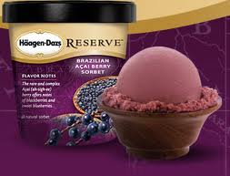

Slide 11
Examples of the 4Ps model: Paradigm
‘Paradigm’ – how we frame what we do | Bausch and Lomb – moved from ‘eye wear’ to ‘eye care’ as their business model, effectively letting go of the old business of spectacles, sunglasses (Raybans) and contact lenses all of which were becoming commodity businesses. Instead they moved into newer high tech fields like laser surgery equipment, specialist optical devices and research in artificial eyesight Dyson redefining the home appliance market in terms of high performance engineered products Rolls Royce – from high quality aero engines to becoming a service company offering ‘power by the hour’ IBM from being a machine maker to a service and solution company – selling off its computer making and building up its consultancy and service side. | Grameen Bank and other microfinance models – rethinking the assumptions about credit and the poor iTunes platform – a complete system of personalized entertainment Cirque de Soleil – redefining the circus experience Amazon, Google, Skype – redefining industries like retailing, advertising and telecoms through online models Linux, Mozilla, Apache – moving from passive users to active communities of users co-creating new products and services
Notes:
Paradigm Innovation
Changes in the underlying mental models which frame what the organisation does/ change the way we look at something
Shift in values or business design
are changes in how companies frame what they do e.g. Sainsbury’s product range
Another example is Low cost airlines. The first low-cost airline was the American company Southwest which launched in 1971. A company that cuts out all the fancy things and gives you what you need at a reasonable price. What the people need? Everybody likes to travel but high costs made it hard. This company started a new market of low cost flights and soon were followed by the likes of Easy Jet and Ryanair. By giving the customer what they need they can eliminate what is desirable and start a whole new market.
Incremental do what we do but better
Bausch and Lomb, moved from ‘eye wear’ to ‘eye care’ as its business model effectively letting go of the old business of spectacles, sunglasses (Raybans) and contact lenses, all of which were becoming commodity businesses. Instead the company moved into newer high-tech fields like laser surgery equipment, specialist optical devises and research into artificial eyesight.
Radical – do something different
Grameen bank and other microfinance models – rethinking the assumptions about credit and the poor. Itunes platform – a complete system of personalised entertainement

Slide 12
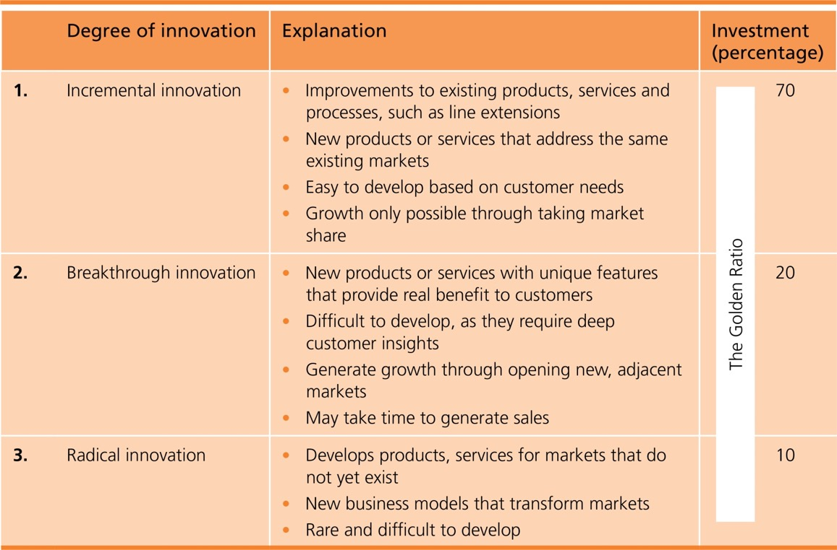
Table 1.1: Degrees of Innovation
Goffin and Mitchell (2017, p. 13)
Notes:
Incremental:
Minor improvements
Doing the things we do, but better
Continuous
Doing what we already do, but better’
Continuous improvement
Minor incremental improvement
e.g. Bic ballpoint pen 1957 – change in ink, material, ball technology, safety
Improving quality and productivity e.g. TQM, lean
Studies suggest cumulative gains in efficiency, greater over time than those from occasional radical changes
Updating the styling on a car versus coming up with a completely new concepts e.g. electric car.
A key issue in managing innovation relates to the degree of novelty involved in different places across the innovation space.
Managing the innovation process is different for radical and incremental innovations.
Novelty is in the eye of the beholder, degree of novelty matter e.g. technology advanced organsiations e.g. IBM advances Innovation systems are commonplace for small dealership more of a major challenge.
Ettlie (1999) suggests disruptive or new-to-the world innovations are only 6%-10% of all projects labelled innovation
Continuous improvement, originally part of ‘total quality management’ movement in late 20th century, significant gains by Japanese manufactures in quality and productivity through sustained incremental change.
More recently deploying ‘lean’ thinking in manufacture and services provide further scope for continuous innovation.
Bic pen 14 million units sold worldwide daily. Strong product superficially same shape but host of incremental changes have taken place.
Innovations e.g aerofoil allows heavier than air flight and the transistor in modern electronics have fundamentally changed society. Others such as velcro or the ball-point pen are useful but modest effects on life as we know it.
Radical:
Transforms the way we think about and use things
Major improvements to something established
Discontinuous
Can be disruptive:
Transforming business practice
Rewrite rules
Radical Innovation
Radical changes that transform the way we think about and use the innovation e.g. transistor
Can be for a sector or transform society e.g. steam power, ICT
Disruptive e.g. Polaroid - digital photography
Sustaining e.g. Sony MP3 vs apple - need not lead to fall of established firms – may enhance capabilities and resources of incumbents, survive
Radical changes can be changes to a particular sector or activity or far-reaching that change the basis of society e.g. role of steam power in industrial revolution
Some radical innovations can enable incumbents to transfer lessons and experiences from one industry era to the next. E.g. music players or MP3s Sony found themselves overtaken by Apple but they still remain active in the market – survive and prosper in new regime.
Polaroid’s technological expertise was in instant photography. Because of the digital era's change of focus consumers left instant photography well behind. Polaroid continued to stick to what it knew best and became obsolete. "Polaroid filed for bankruptcy protection in 2001

Slide 13
Dimensions of innovation
Incremental ←-→ Radical
Component and system
Architectures, platforms and systems

Slide 14
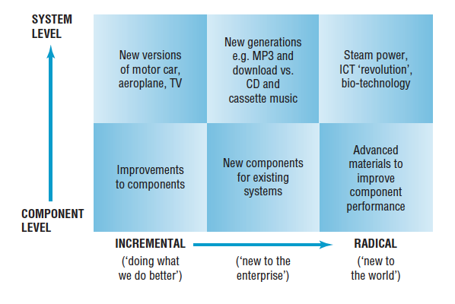
Types of Innovation
Source: Figure 1.8 Dimensions of innovation (Tide and Bessant, 2021, p. 32)

Slide 15
Discontinuous innovation
Triggers for discontinuity include:
New market emerges
New technology emerges
New political rules emerge
Running out of road
Sea change in values and public opinion
Changes in regulatory context
Fractures along ‘fault lines’
Architectural innovation/ business model innovation
Unthinkable events
Etc.

Slide 16
Hidden innovation
Type I: Innovation that is identical or similar to activities that are measured by traditional indicators, but which is excluded from measurement
Type II: Innovation without a major scientific and technological basis, such as innovation in organizational forms or business models.
Type III: Innovation created from the novel combination of existing technologies and processes.
Type IV: Locally-developed, small-scale innovations that take place ‘under the radar’, not only of traditional indicators but often also of many of the organizations and individuals working in a sector.

Slide 17
Examples of ‘hidden’ innovation
Type I: the development of new technologies in oil exploration.
Type II: the development of new contractual relationships between suppliers and clients on major construction projects.
Type III: the way in which banks have integrated their various back office IT systems to deliver innovative customer services such as Internet banking.
Type IV: the everyday innovation that occurs in classrooms and multidisciplinary construction teams

Slide 18
Dominant Designs
Source: Goffin and Mitchell (2017, p. 53)

Slide 20
Summary
Innovation is about growth – about recognising opportunities for doing something new and implementing those ideas to create some kind of value. It could be business growth, it could be social change. But at its heart it is the creative human spirit, the urge to make change in our environment.

Slide 21
References
Goffin K & Mitchell R (2017), Innovation Management, 3rd edition, Palgrave, Chapter 1
Tidd, J. & Bessant, J. (2021), Managing Innovation, 7th ed, Wiley, Chapter 1

