Slide 1
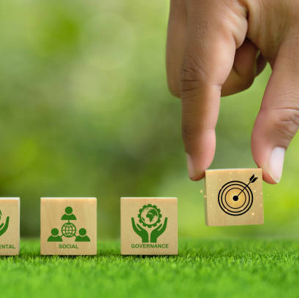

Social and Environmental Reporting
(SER)
Lecture – Part 1 – Introduction to Sustainability

Slide 2
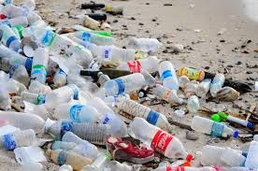
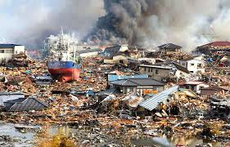
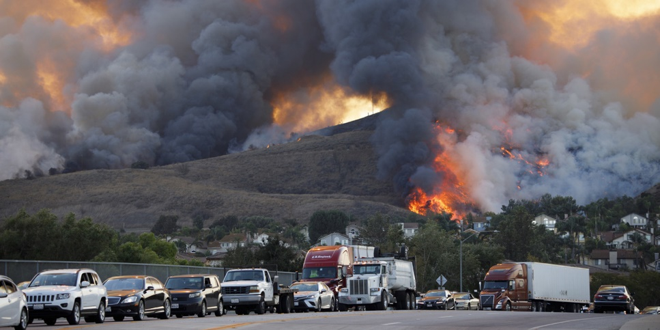
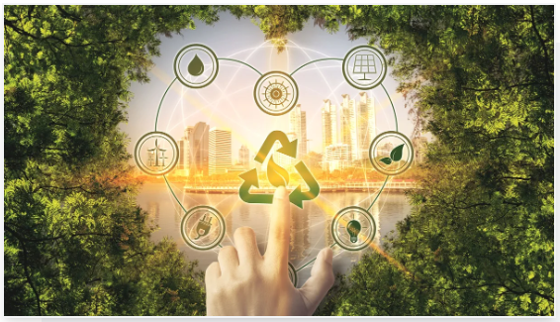
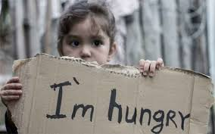
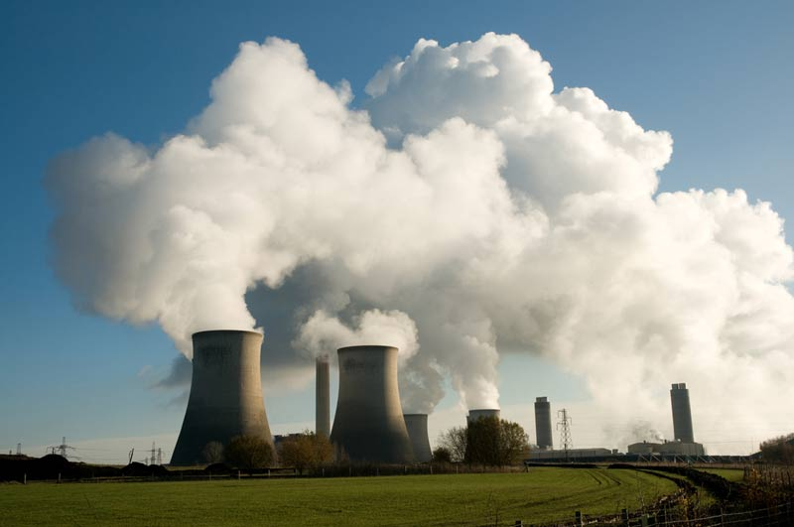
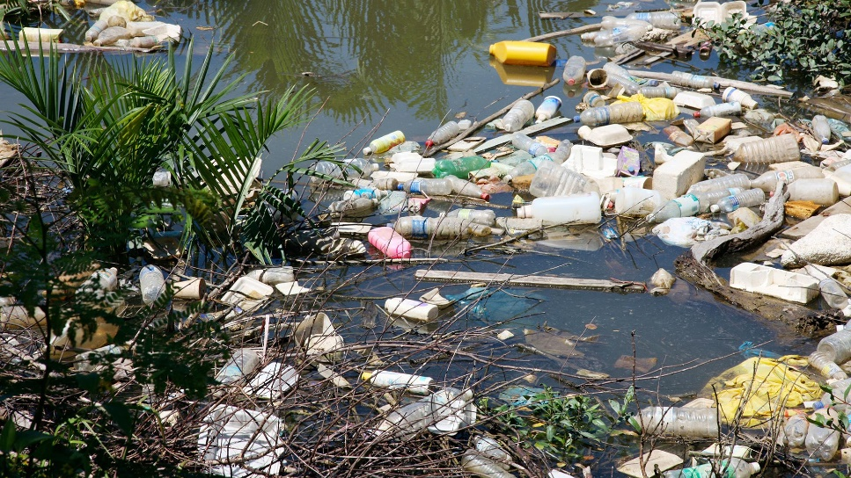
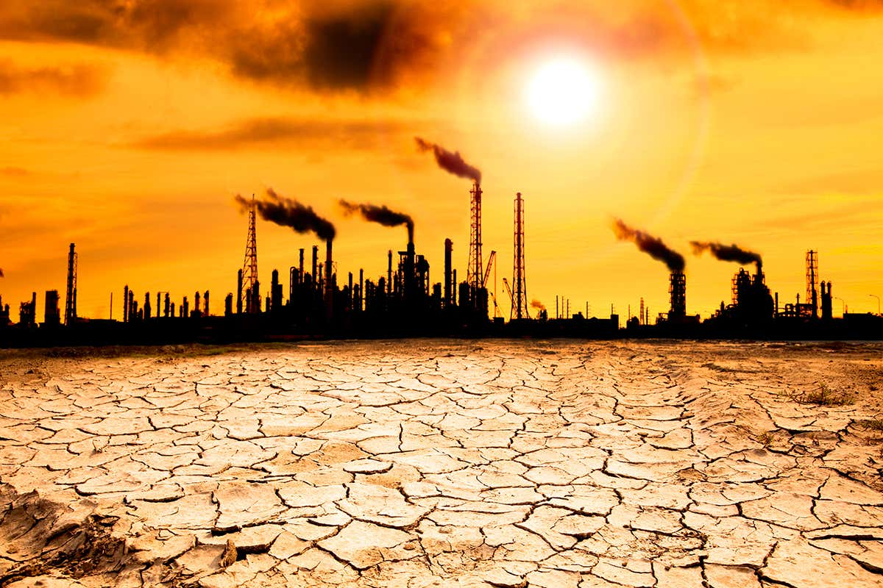
Sustainability

Slide 3
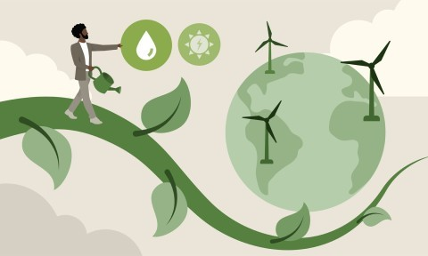

Sustainable Development
Sustainable development is the concept of meeting present needs without compromising the ability of future generations to meet their own needs.
Watch me
Link to video; https://youtu.be/jfsWI8XgQyo
Notes:
Link to video https://youtu.be/jfsWI8XgQyo
Peter, a teacher, believes he leads a sustainable life by buying organic products, biking to work, and using green electricity. But is that truly sustainable? Sustainability has been a concern since the 18th century. Carl von Carlowitz introduced the principle of using resources responsibly, ensuring they regenerate. Sustainability is based on the three-pillar model: environmental, economic, and social factors must be balanced.The environmental pillar focuses on climate protection, biodiversity, and responsible resource use, like reducing reliance on petrol for transportation. Alternative energy sources, like electric cars, are necessary to replace depleting fossil fuels.
The economic pillar emphasizes local, seasonal production to reduce pollution from long-distance food transportation.The social pillar includes education, gender equality, poverty reduction, and fair resource distribution, such as water access in developing countries. Peter aims to follow the three-pillar model by making sustainable choices, but greenwashing is a challenge—some products falsely claim to be sustainable. Consumers must stay informed and critically evaluate FairTrade and organic claims to ensure true sustainability.

Slide 4
Imagine you are looking to invest in some shares.
What things would you want to know about a company to help you decide where to invest?
Do the things you are interested in change when you are a customer rather than an investor?

Slide 5

Theory of the Firm
“There is one and only one social responsibility of business – to use its resources and engage in activities designed to increase its profits so long as it stays within the rules of the game, which is to say, engages in open and free competition without deception or fraud”
Milton Friedman (1970)

Slide 6
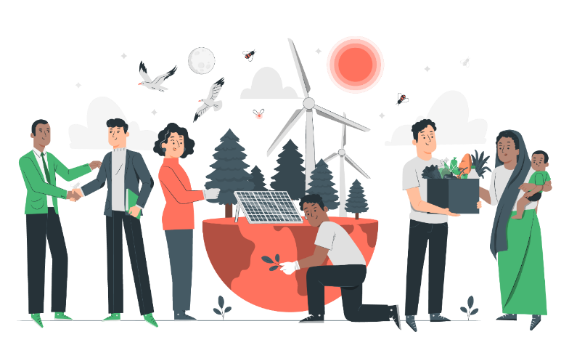
What is Social and Environmental Reporting?
Reporting on the social and environmental impact of the operations of a business.
Seeks to address concerns that the overall success or failure of a company is not captured by the financial statements and the bottom line.
Tends to be those issues that most affect the performance of the business and that matter most to the key stakeholders.
Also known as
Triple bottom line reporting
Corporate Social Responsibility Reporting, and
Sustainability Reporting
Relatively new and constantly evolving area.

Slide 7
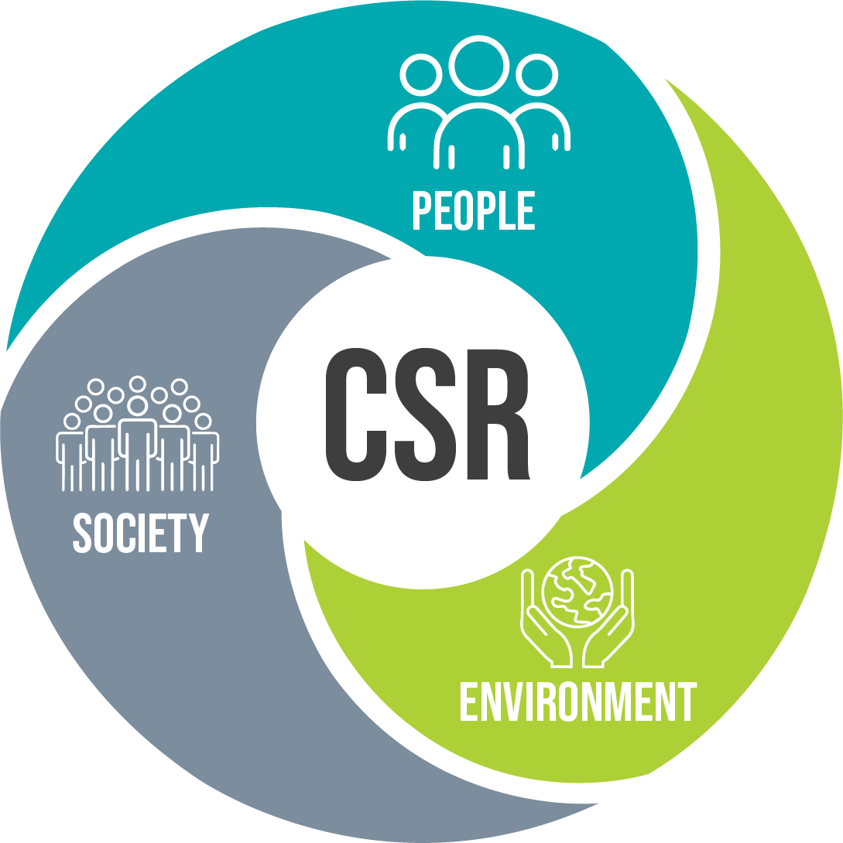
What is Social and Environmental Reporting?
Public disclosure of information concerning an entity’s social and environmental performance.
Deegan and Unerman define SER as the
“provision to a range of stakeholders of information about the performance of an entity with regard to its physical and social environment, inclusive of information about its support of employees, local and overseas communities, safety record and use of natural resources.”
Social and environmental reporting makes organisations appear more accountable for the economic, environmental and social consequences of their activities.

Slide 8




History….
Although SER only became widespread since the early to mid 1990s, some authors have found evidence of non financial disclosures in annual reports dating from much earlier.
For example:
Unerman (2000) found evidence of social disclosures by Shell as far back as 1897 and becoming more prevalent in the 1950s
Hogner found evidence of social disclosures by US Steel in 1905
Tinker and Neimark (1987, 1988) found social type disclosures in the annual reports of General Motors from 1916
Deegan and Unerman (2011) argue that the development of social and environmental reporting from the 1990s might actually be a renaissance rather than completely new.

Slide 9
Questions
Is business success gained at the expense of social and environmental degradation?
Does business success make a net contribution to the well-being of society and the natural environment?

Slide 10
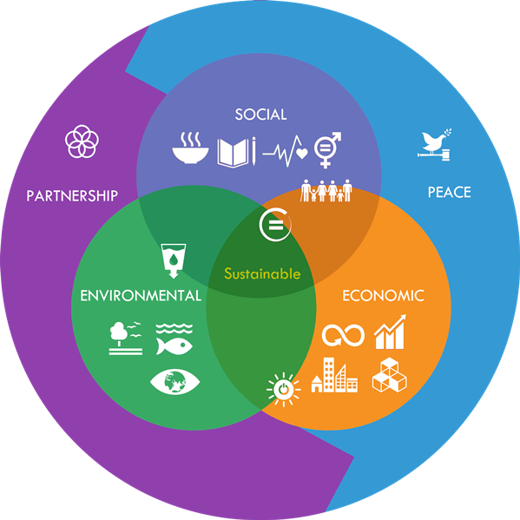
Developing notions of sustainability
Our Common Future report presented in 1987 by the World Commission of Environment and Development – became known as The Brundtland Report
Defined sustainable development as:
“development that meets the needs of the present world without compromising the ability of future generations to meet their own needs”
World Commission on Environment and Development 1987
The move towards sustainability implies that something other than short-term self-interest should drive decision making.
1992 Earth Summit in Rio de Janeiro

Slide 11

Developing notions of sustainability
1992 EU released Towards Sustainability – suggested the Accounting Profession should take a role in implementing costing systems that internalise many environmental costs.
2002 – follow up to the Rio de Janeiro Earth Summit held in Johannesburg.
Launched a revised set of guidelines – the Sustainability Reporting Guidelines
Developed by a broad range of organisations under the Global Reporting Initiative (GRI)

Slide 12

Developing notions of sustainability
Since the late 1980s/early 1990s, many documents relating to the need for a shift towards sustainable development have been issued and sustainability appears to have become a central part of the ‘language of business’.
As such, communities will expect to be provided with information about the sustainability of organisations, governments and other bodies.

Slide 13
What is meant by sustainability?
For an organisation to be sustainable, it must achieve an optimum balance between financial security, minimising negative environmental impact and acting in line with society’s expectations (Deegan and Unerman, 2011).

Slide 14
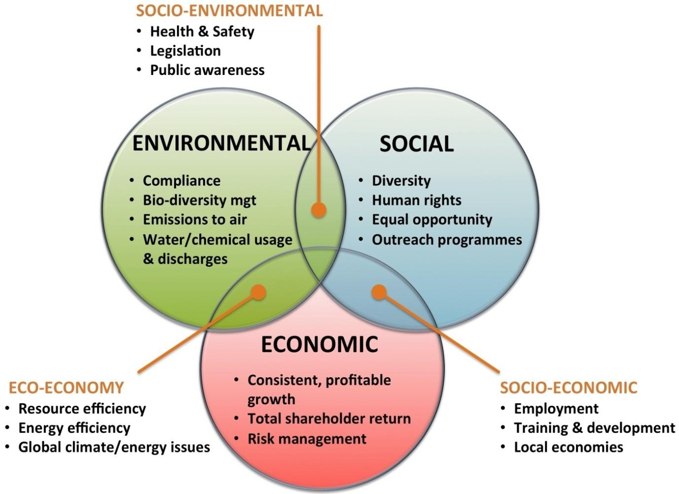
Sustainability
Sustainability
http://www.implats.co.za/sustainability-reporting.php
Image: www.sellingsustainabilitysolutions.com

Slide 15
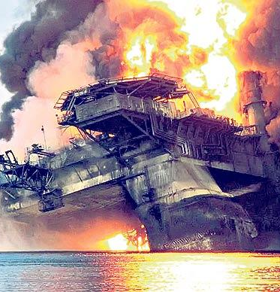
Is it possible?
Dilliard et al (2005) say that
‘social systems have come to dominate and exploit natural systems’
In particular, they say economics based social systems are dominant.
Example: BP Deepwater Horizon disaster
Gulf of Mexico, 20 April 2010
Immediate social impact => 11 oil platform workers killed
In the following weeks and months ongoing oil leak into the Gulf of Mexico caused a major ecological and social disaster
Largest oil spill in history (4.9 million barrels), devastating many eco-systems in the Gulf, including the deaths of many fish, birds, plants etc in the sea and on large stretches of coastline
Major impact on livelihoods of many Gulf communities
Clean up cost BP many billions of dollars
Negative impact on BP’s reputation
US Congress found a culture at BP dominated by a drive for short term cost savings

