Slide 1


Social and Environmental Reporting
(SER)
Lecture – Part 2 – Sustainability Reporting

Slide 2

What is sustainability reporting?
Sustainability reporting is a form of non-financial reporting that enables companies to convey their progress toward goals on a variety of sustainability parameters, including environmental, social and governance metrics, as well as risks and impacts they may face, at the moment or in the future.
A sustainability report details the entity’s economic, social and environmental effects.
There are lots of reasons why companies should set sustainability goals and report on their progress towards achieving these goals:
It is ethical
Government funding will increasingly focus on sustainable businesses
There will be a reduction in reputational and regulatory risk
Sustainable products and services are a growth area
Short-term, profit-based models are now less relevant for many investors.

Slide 3
The key stages of sustainability reporting
Why do we want to publicly disclose information about social and environmental performance?
Who are the stakeholders to whom the disclosures are directed?
What information should the disclosures address?
How should the reports be compiled?

Slide 4
Why?
SER is predominately a voluntary process
Lack of regulation
However, many organisations choose to release information about social and environmental performance.
Depends on managers’ motivations to report.
e.g. Accountability to stakeholders
To win support of powerful stakeholders
Various theoretical perspectives set out by Deegan and Unerman (2011) e.g. Stakeholder theory, institutional theory, legitimacy theory etc.

Slide 5
Why?
Hopwood et al., (2010) identified a number of components that contribute to the business case for embedding sustainability into decision making:
Role in winning and retaining customers
Competitive advantage through identifying opportunities for innovation and new products
Attracting and retaining key staff
Managing risks arising from sustainability issues
Operational efficiencies derived through social and environmental practices
Accessing capital
Reputational impact
Improved stakeholder management
Enhanced accountability and transparency

Slide 6
Who to report to?
If motivation is managerial reasoning and strategising, stakeholders will be narrowly defined as those who hold and exercise the greatest economic power over the organisation.
If motivation is ethical/moral reasoning, seek to address the information needs of a broader range of stakeholders, mainly those most affected by the operations of the organisation.
Impossible to address the information needs of all stakeholders so, even taking the ethical reasoning basis for reporting, need to prioritise stakeholders.

Slide 7


Who to report to?
Real life case:
Co-operative Group identified 6 main groups of stakeholders in their sustainability review 2009:
Members
Customers
Employees
Co-operative movement
Suppliers
Wider society

Slide 8

What to report?
Will depend on who the stakeholders we are reporting to are – what are their information needs?
A useful starting point might be to ask For what social and environmental issues do stakeholders wish to hold organisations responsible and accountable?

Slide 9
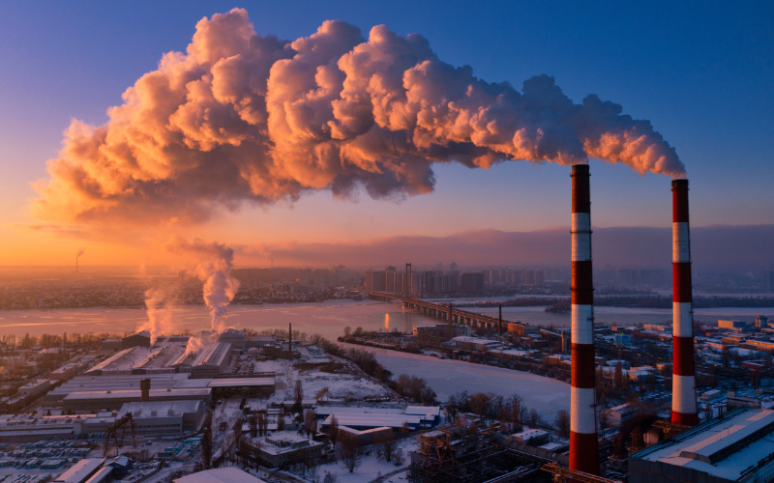
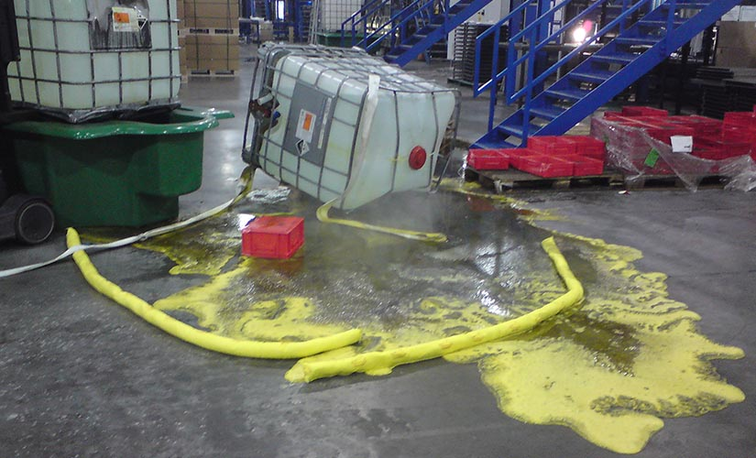
What to report?
Freedman and Patten (2004) found that where US businesses reported information about high levels of pollution from their factories, the share price reaction was lower than for companies which were known to emit high levels of pollution but did not report it in their annual reports.
Blacconiere and Patten (1994) examined stock market reaction to Union Carbide’s chemical leak in India in 1984. Firms with more extensive environmental disclosures before the leak experienced a smaller negative reaction than those with less extensive disclosures.

Slide 10
What to report - pressures
In recent years, banking and insurance institutions have had a role in demand for increased SER disclosures.
In some countries, banks will not provide finance to organisations unless environmental policy and performance information is provided.
Growing market for socially responsible investment, therefore fund managers seek social and environmental information.
Supply chain pressures – many organisations seek social and environmental performance information before entering into supply contracts.

Slide 11

What to report - requirements
Certain information must be reported by organisations, including:
Number and pay of employees
Arrangements for consultation with employees
Arrangements for disabled employees
Pension arrangements and share ownership schemes
Corporate governance
Charitable and political donations
Directors’ involvements, remuneration and options

Slide 12


What to report – voluntary disclosures
Additional voluntary disclosures could include:
Information about health and safety at work
Equal opportunities
Community, arts and schools involvements
Environmental information

Slide 13

How to report? What form?
Several bodies have been involved in developing guidelines for social and environmental reporting, including:
Global Reporting Initiative
Good Corporation Standard
Ethical Trading Initiative
UN Environment Programme
Business in the Community
The Prince of Wales’ Accounting for Sustainability Project
And many others......

Slide 14

How to report?
Sets principles for defining report content and ensuring quality of reported information as well as standard disclosures (performance indicators and other disclosure items).
Report content guidelines include: materiality, stakeholder inclusiveness, sustainability context and completeness.
In defining quality, emphasis is placed on balance, comparability, accuracy, timeliness, clarity and reliability.
Provides a number of ‘core’ and ‘additional’ performance indicators organisations can report against.
Categories of PI include economic performance, environmental performance and social performance.

Slide 15
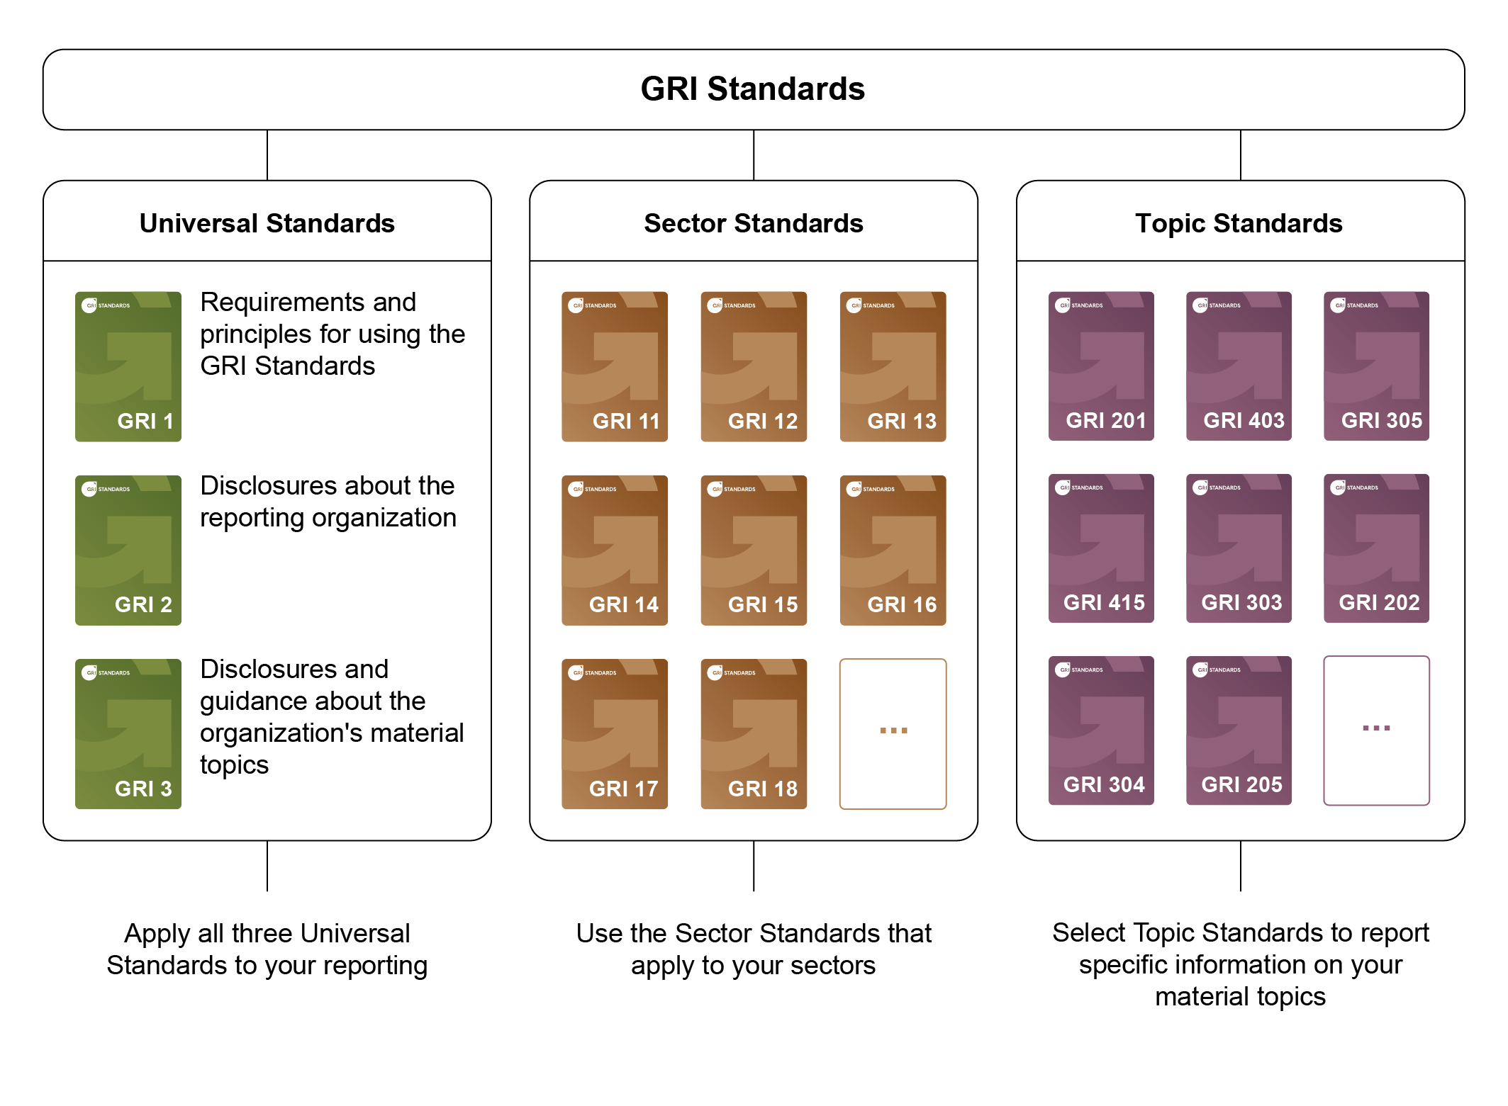

Slide 16

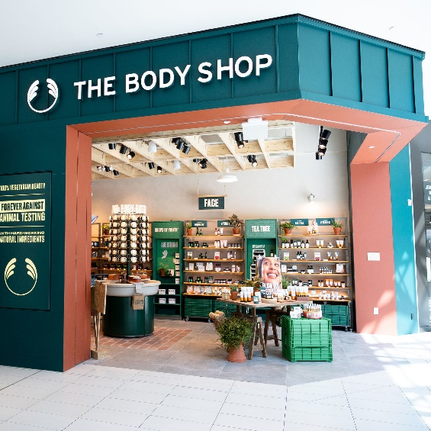
How to report – levels of reporting
Level 1: descriptive data about stakeholder relationships
Level 2: info re accountability of the organisation
Level 3: Full stakeholder dialogue information (rare)
Sometimes separate reports are used, eg. Employee or community reports
Overall, reporting is common practice, but variable and scattered around the annual report and other documents.
Best practice includes The Body Shop, Traidcraft plc, The Co-operative

Slide 17

Social and Environmental Audits
A way to identify whether an organisation’s performance is conforming with the expectations of various stakeholder groups.
Often done by directly contacting various stakeholder groups to gain their views.
Allows a company to examine its social and environmental impacts and assess whether it is meeting its own social and environmental objectives.
Increases credibility of information reported in the annual report if the social and environmental audit is undertaken by an independent third party.

Slide 18

Any drawbacks to companies?
The main disadvantage of making disclosures is that the associated labour hours and printing costs may be substantial.
Potential for giving away trade secrets? But, at present, disclosures are voluntary.......
Risk of reporting negative information – reputational risks?

