Slide 1


Social and Environmental Reporting
(SER)
Lecture – SER wider context and developments – Part 3

Slide 2
Is SER information useful to users?
Can give very valuable, useful information to stakeholders to help with decision making and can include information which is not evident from the financial statements, but....
Voluntary disclosures so companies can report (or not....) whatever they choose – is it accurate?
Risk that the firm concentrates on the positive aspects and ignores the negatives – is it unbiased?
Disclosures are not audited – is it reliable?
Level of detail and format of reports vary – is it comparable?

Slide 3

Should it be mandatory?
Robins (2008) considered:
Whether CSR is a business duty or a ‘benign delusion’
How CSR relates to theory regarding shareholders, stakeholders and stewards
Who pays for CSR?
Who makes decisions about CSR?
Political consequences of CSR

Slide 4
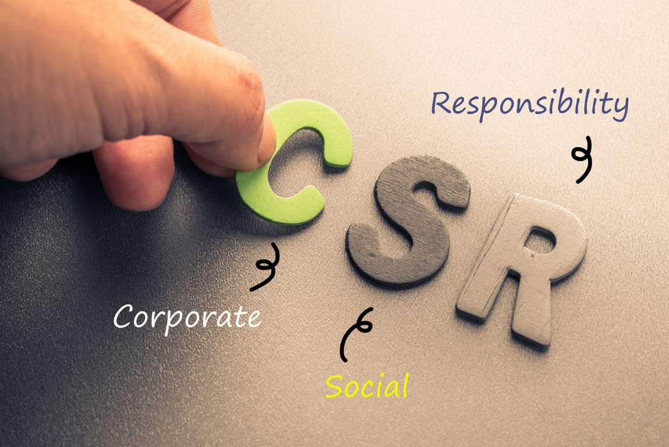
Accounting for CSR
Legitimate business expense?
Implications of expenditure on CSR activities……
Should we expect firms to include social and environmental costs of their activities in their accounting information?

Slide 5


Questions to consider....
What is the purpose of SER?
Should SEA be compulsory?
Who pays for the information?
What should be disclosed?
What form should the report take?
Should the report be prepared by accountants?
Should the report be audited? Who by? Who pays?
Is the enthusiasm for SER real or just to make a company ‘look good’?
Is it realistic to expect UK-type levels of concern in economically poorer countries?

Slide 6
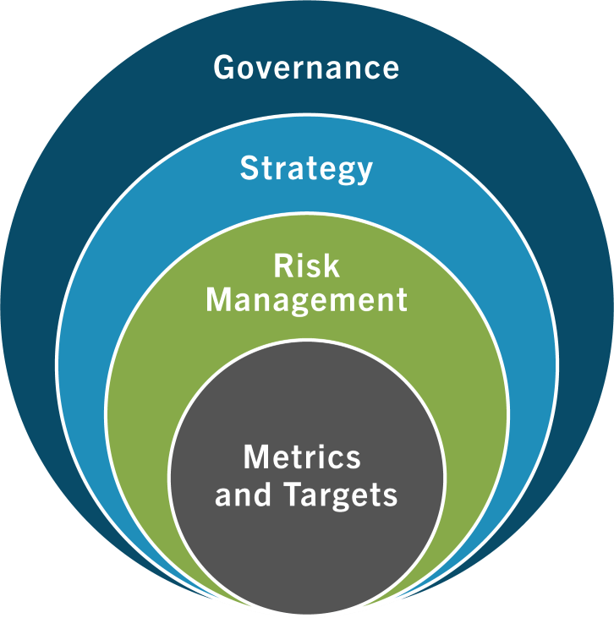

Taskforce on Climate-related Financial Disclosures (TCFD)
The TCFD was established in 2015 by the Financial Stability Board (FSB), an international body formed in response to the global financial crisis.
Its mission: strengthen financial systems and increase the stability of international financial markets by coordinating national monetary authorities and international standard-setting bodies.
The TCFD began as a voluntary set of recommendations intended to guide investor-grade risk disclosures and is now the common thread across international legislation on climate disclosure, including the U.S., E.U., U.K., Switzerland, Singapore, Hong Kong, New Zealand, and Japan. As of October 2021, it had over 2,600 global supporters, including over 1,000 financial institution.

Slide 7

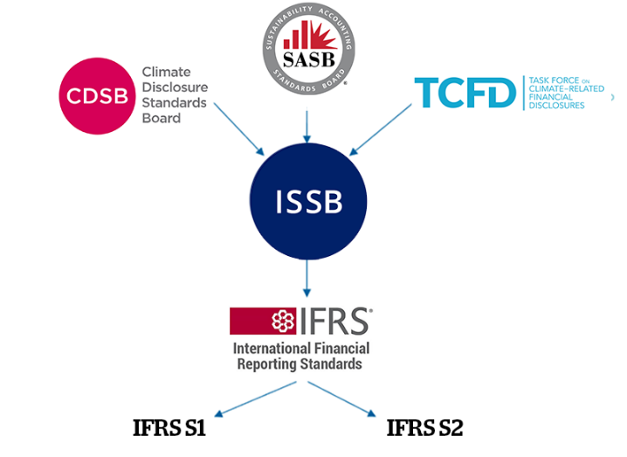
International Sustainability Standards Board
International Sustainability Standards Board (ISSB) is directing efforts:
To Develop standards for global sustainability disclosures and an electronic tagging of disclosures
To focus on meeting the information needs of investors
To enable companies to provide comprehensive sustainability information for capital markets globally.
To facilitate the addition of requirements that are jurisdiction-specific or aimed at a broader group of stakeholders.

Slide 8
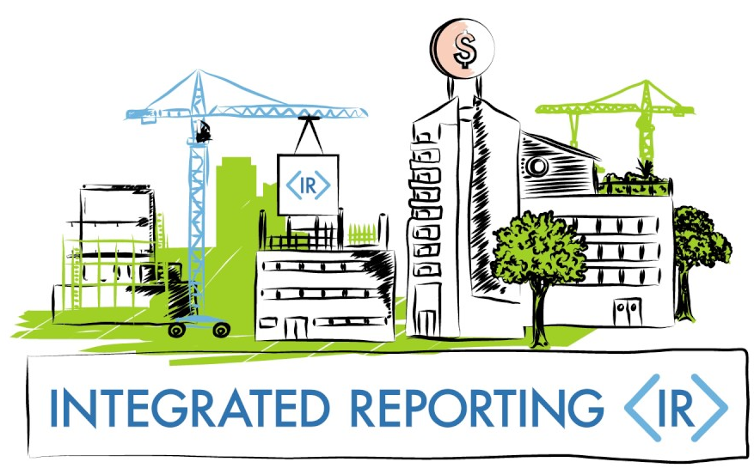
Accounting Standards and Sustainability disclosures
Integrated reporting (IR)
Integrated Reporting Council to advise IASB and ISSB on connectivity via fundamental concepts/guiding principles of integrated reporting.
Integrated Reporting (<IR>) is a process that results in a concise communication about how an organization's strategy, governance, performance and prospects, in the context of its external environment, lead to the creation of value over the short, medium and long term.
In simpler terms, Integrated Reporting tells the story of how an organization creates value over time, considering all the relevant factors, not just financial ones.
The contents of the financial statements (both quantitively and qualitatively) in terms of sustainability must meet the needs of investors and other capital market participants.
Notes:
Link to video: https://www.youtube.com/watch?v=7LuyJcUBu8g
International transactions reporting system (ITRS)

Slide 9
Sustainability: Reporting initiatives
A number of sustainable reporting initiatives have emerged in recent years. These include:
The United Nations Global Compact (UNGC), which is a voluntary initiative that encourages entities to report actions taken to implement UN principles in respect of human rights, labour, the environment, and anti-corruption.
The Global Reporting Initiative (GRI), which encourages entities to produce a balanced report that represents their positive and negative impacts on society and the environment.
The International Integrated Reporting Framework, which encourages entities to report on how they create value in the short, medium and long term by discussing their impact on a range of capitals.
There are no worldwide agreed standards on sustainability reporting. This limits the ability of stakeholders to compare one company’s sustainability reporting with another.

Slide 10
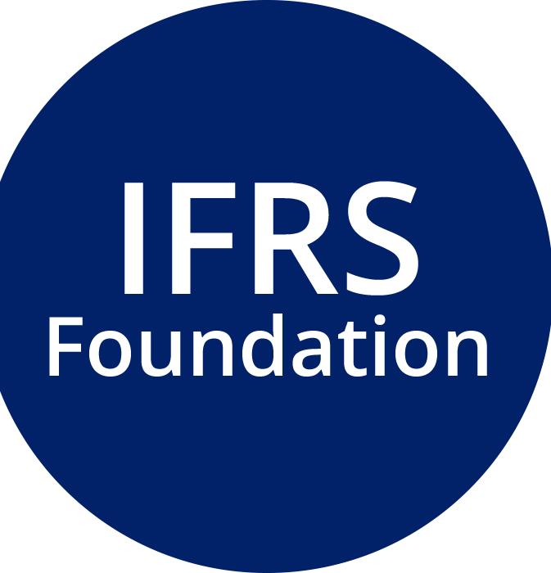
The IFRS Foundation
The IFRS Foundation has publicly recognised the importance of sustainability reporting for an entity’s stakeholders. For example:
Investors want more information about climate risks in order to inform their decision making.
Banks are focusing on climate-related risks when assessing financial stability.
As noted, many sets of sustainability standards already exist. This causes significant diversity in how entities report sustainability issues.
The IFRS Foundation believes that stakeholders need to be presented with more consistent and comparable sustainability reporting. With its expertise in standard setting and relationships with governments and regulators around the world, the IFRS Foundation believes it can offer a solution.

Slide 11
IFRS Sustainability Disclosure Standards
The Trustees of the IFRS Foundation announced the formation of the International Sustainability Standards Board (ISSB) on 3 November 2021 at COP26 in Glasgow, following strong market demand for its establishment.
Climate risk is of growing and immediate importance to investors and regulators. In response, the ISSB would initially focus on developing standards focused on climate-related information, while also consulting on other environmental, social and governance priorities.
In June 2023 the ISSB issued :-
IFRS S1
General Requirements for Disclosure of Sustainability-related Financial Information.
IFRS S2
Climate-related Disclosures
IFRS S1 and S2 is effective for annual reporting periods beginning on or after 1 January 2024
Notes:
COP stands for Conference of the Parties and it often refers to the United Nations Framework Convention on Climate Change (UNFCCC) international meeting focusing on climate. COP is the main decision-making body of the UNFCCC.
The objective of IFRS S1 is to require an entity to disclose information about its sustainability-related risks and opportunities that is useful to users of general purpose financial reports in making decisions relating to providing resources to the entity.
IFRS S1 requires an entity to disclose information about all sustainability-related risks and opportunities that could reasonably be expected to affect the entity’s cash flows, its access to finance or cost of capital over the short, medium or long term (collectively referred to as ‘sustainability-related risks and opportunities that could reasonably be expected to affect the entity’s prospects’).
The objective of IFRS S2 is to require an entity to disclose information about its climate-related risks and opportunities that is useful to users of general purpose financial reports in making decisions relating to providing resources to the entity.
IFRS S2 requires an entity to disclose information about climate-related risks and opportunities that could reasonably be expected to affect the entity’s cash flows, its access to finance or cost of capital over the short, medium or long term (collectively referred to as ‘climate-related risks and opportunities that could reasonably be expected to affect the entity’s prospects’).
IFRS S1 is effective for annual reporting periods beginning on or after 1 January 2024 with earlier application permitted as long as IFRS S2 Climate-related Disclosures is also applied.
IFRS S2 is effective for annual reporting periods beginning on or after 1 January 2024 with earlier application permitted as long as IFRS S1 General Requirements for Disclosure of Sustainability-related Financial Information is also applied.

Slide 12

Legislation
Some countries are introducing legislation on sustainability reporting:
The European Union requires certain large companies to disclose non-financial information.
Corporate Sustainability Reporting Directive (CSRD): Requires EU and non-EU companies with activities in the EU to report annually on their sustainability. The CSRD went into effect in January 2023.
(UK) Streamlined Energy and Carbon Reporting (SECR): Mandates energy use, carbon emissions, and efficiency actions for large UK companies under the Companies Act.
The United States Climate-Related Financial Risk Act: Requires companies with over $500 million in annual revenue to disclose climate change threats and mitigations.
The Singapore stock exchange has made sustainability reporting mandatory for listed companies, on a “comply or explain” basis since 2016.

Slide 13

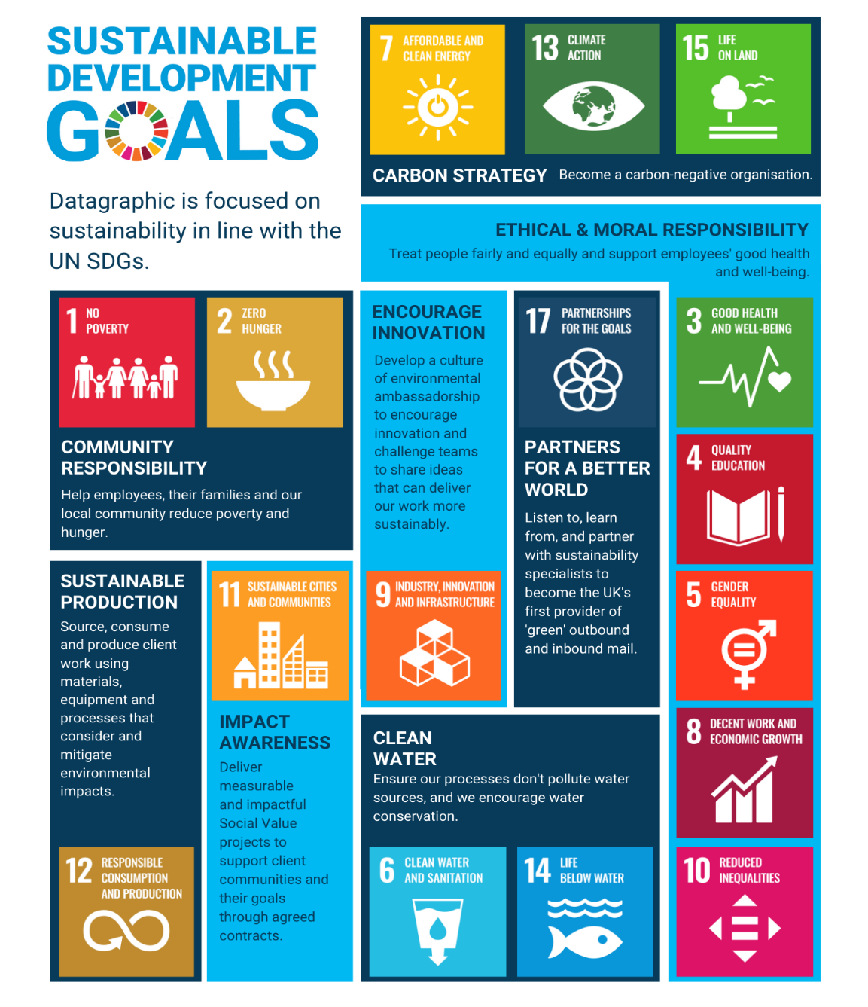

Sustainable Development Goals (SDGs)
The 2030 Agenda for Sustainable Development, adopted by all United Nations Member States in 2015, provides a shared blueprint for peace and prosperity for people and the planet, now and into the future
At its heart are the 17 Sustainable Development Goals (SDGs), which are an urgent call for action by all countries - developed and developing - in a global partnership.
How to Engage
Governments: Policy alignment, funding, and partnerships.
Businesses: Integrate SDGs into ESG strategies.
Individuals: Advocate, reduce waste, support ethical practices.
https://sdgs.un.org/goals

