Slide 1


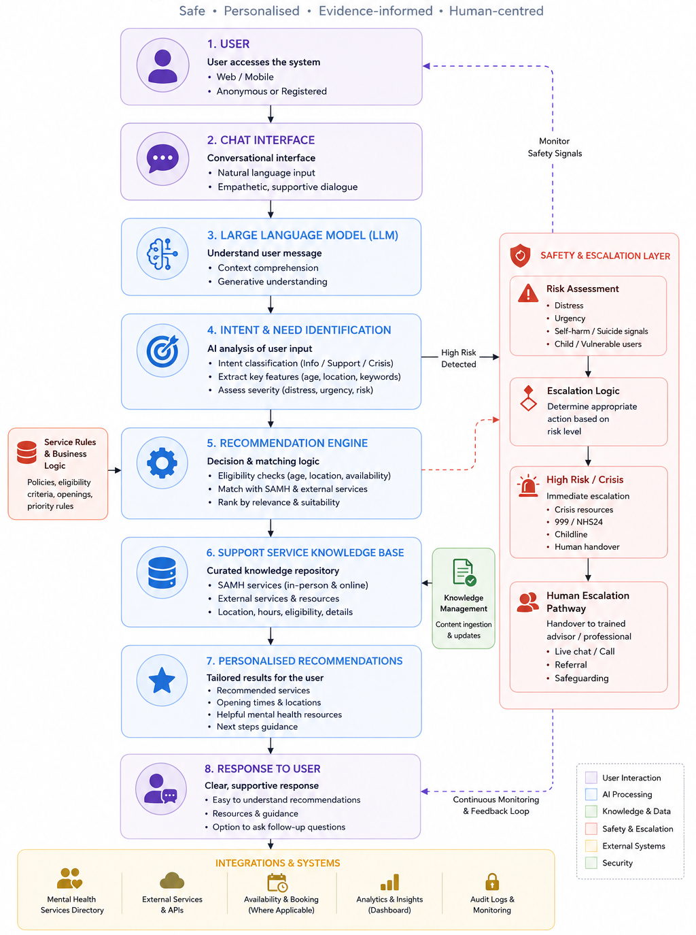
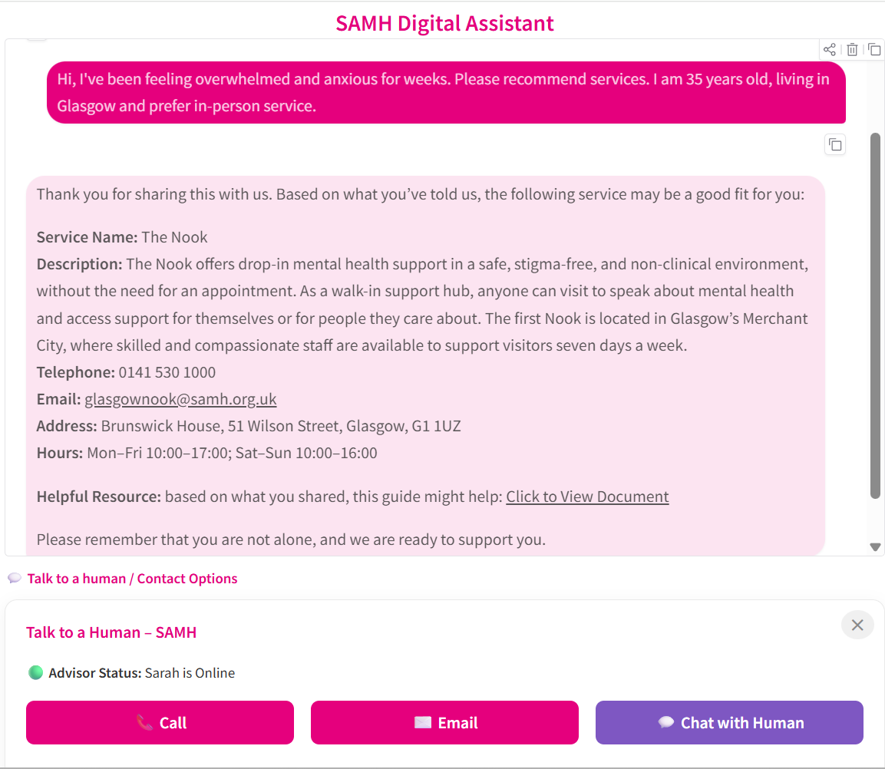
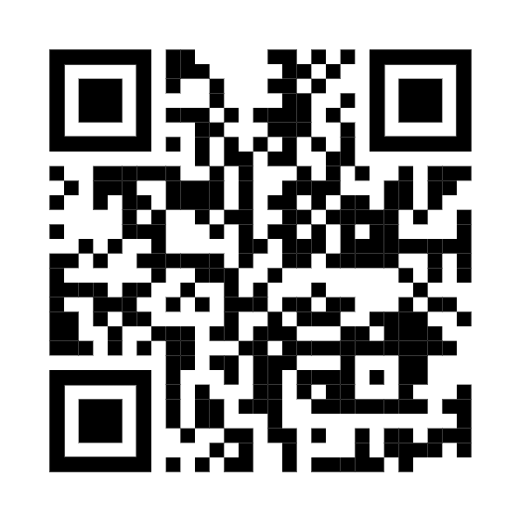
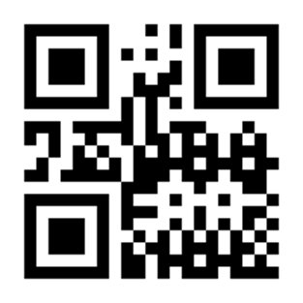
v
AI Gateway to
Mental Health Services
A Safe, Knowledge-Grounded Conversational AI for Mental Health Service Navigation · SAMH–GCU Knowledge Transfer Partnership
The Challenge
System Architecture
Our Approach
Scottish Action Mental Health provides multiple forms of mental health support, each with different referral routes, eligibility criteria and risk thresholds. For members of the public, choosing the right route is difficult, especially when people are unsure what kind of help they need.
The SAMH–Glasgow Caledonian University Knowledge Transfer Partnership is developing an AI-powered gateway to support service navigation and referral recommendation. The system is not designed to diagnose or provide therapy, but to help users describe their situation, access trusted information, and move towards appropriate support.
The key challenge is safety. Retrieval-augmented generation grounds responses in curated knowledge but does not make an AI system safe by itself. Safety must be designed through conversation flow, routing logic, escalation pathways and governance.
Traditional mental health services face increasing demand and finite capacity. An AI-powered triage layer can help bridge the gap, directing people to the right support faster, reducing burden on overstretched services.
The project uses retrieval-augmented generation (RAG) to connect conversational AI with curated SAMH service knowledge — retrieving grounded, service-specific guidance from an approved knowledge base rather than generating unchecked responses.
Stakeholder workshops are being used to map referral pathways, eligibility criteria and risk thresholds across SAMH self-referral services. This knowledge is translated into retrieval structures that support routing logic, safety checks and future validation.
The emerging architecture combines RAG, hybrid safety checking and Microsoft Azure cloud deployment. Crisis-related disclosures are treated as a distinct safety-critical interaction type, using rule-based detection and LLM-assisted checking to support appropriate signposting.​
Safety Framework
NON-DIAGNOSTIC
Research Question
Evidence-Grounded Responses
All responses grounded in SAMH's verified knowledge base via RAG. The system never provides clinical diagnosis or therapy of any kind.
How can AI-powered conversational systems support safe and effective mental health triage and service navigation within a national mental health organisation?
RISK-AWARE
Prototype: Example Interaction
Confidence-Based Escalation
What is this project about?
Ambiguous or low-confidence inputs trigger clarification requests or flag the need for additional professional guidance before responding.
The SAMH–GCU KTP is developing an AI-powered assistant that helps people find the right mental health support — navigating SAMH's services safely, 24 hours a day.
HUMAN-IN-THE-LOOP
Crisis Detection & Escalation
Is it just a chatbot?
The system includes early-stage mechanisms for identifying high-risk conversations and supporting future integration with SAMH escalation pathways. In crisis scenarios, the design prioritises referral to human support rather than AI-only responses.
No. It combines RAG knowledge retrieval, routing logic, safety checks, and human escalation — grounding every response in SAMH's verified service knowledge base.
Emerging Contribution
What makes it safe for mental health?
This work contributes a practical case study of how AI-powered service navigation can be developed in a sensitive, public-facing mental health context. It shows the central design problem is not simply improving chatbot responses, but aligning service knowledge, retrieval, safety checks, escalation routes and governance.
Safety is by design: non-diagnostic positioning, confidence-based escalation, and automatic handover to trained professionals when risk indicators are detected.
What is the contribution?
Development Roadmap
A replicable framework for responsible AI adoption in third-sector mental health — a governed, evidence-grounded service interface, not just a conversational AI.
✓
✓
✓
NEXT
1
2
3
Discovery &
Requirements
3
4
5
6
Built on: Microsoft Azure · OpenAI GPT-4o · PostgreSQL pgvector · Python FastAPI
Knowledge Modelling &
System Architecture Design
Initial Prototype
Development & Testing
Safety
Validation & Expert review
User
Evaluation & Co-Design Refinement
Pilot
Deployment & Impact Assessment
DMHW 2026 · International Digital Mental Health & Wellbeing Conference · Glasgow, UK · June 17–19, 2026
Gokul Sivarasu, Dawn Carmichael, Ciaran Barber, Euan Millard and Bryan McCann
Knowledge Transfer Partnership · SAMH & Glasgow Caledonian University · Funded by Innovate UK

