Slide 1
Marion Kelt, Senior Librarian Digital Development
Our new OER policy: What we did next …
m.kelt@gcu.ac.uk @mugpunter7
This work is licensed under a Creative Commons Attribution 4.0 International License.

Slide 2
Who am I talking to?
People who are:
working in the field of developing and promoting OERs
developing institutional policies
building institutional policies into day to day practice

Slide 3
What am I talking about?
An institutional OER policy is a great start, but it can do nothing in isolation. You need three things which stand together:
A community actively developing and using OERs
A place to store and share them
A policy to let the creators and users know where they stand
I want to talk about how these things fit together and how we are putting them into practice at GCU.

Slide 4
A good start …
We already have a community actively developing and using OERs
Our team started to look into how we could help more of the university community develop and share OERs
We identified common barriers to the widespread use and development of OERs across the university
Then we started to think of ways to break them down …

Slide 5
What are the barriers to OER use and production?
Lack of knowledge - people are unsure what OERs are. They think they have to be complex web-based items
Ways to share - people didn’t have a quick and easy way to share items
Insecurity - people didn’t know what GCU’s official stance was with regard to OERs
Fear - of copyright and licensing issues, people need advice and support to do things right!

Slide 6
How we tackle the problems …
Lack of knowledge
We will offer OER advice and training
We already provide clear web based guidance on our library website
Ways to share
launch of edShare@GCU with easy to use self-deposit

Slide 7
How we tackle the problems …
Insecurity - promote GCU OER policy to show staff where they stand
Fear - clear copyright and creative commons advice on library website backed up by workshops and practical training

Slide 8
The GCU institutional OER policy
The policy was developed in a “bottom up” manner by a working party made up of academic and support staff from all schools
The library was seen as a non-partisan logical home for policy development
Now that the policy has been adopted, we need to promote it both within the university and externally

Slide 9
Promoting the OER policy at GCU
We published it on our institutional web site
The policy is licensed using a Creative Commons (CC) Attribution Non Commercial Share Alike licence to allow it to be shared and adapted
We will work with GCU LEAD to identify OER champions across the university
The policy has already been promoted in LEAD’s Blended Learning Coffee Club as part of Open Education Week
We have used internal publications like our staff newsletter
Social media - items in our library blog and twitter account to raise the policy’s profile

Slide 10
Promoting the OER policy externally
It has been added to the CC OER Policy Registry to help other people worldwide develop their own policies or guidelines
We will also add it to edShare@GCU so that repository users have the guidance to hand. edShare’s better indexing will make it easier to find on Google
We aim to tell people about how we use the policy at conferences, meetings and by writing about it in journals and other publications
We will work with GCU LEAD as part of the Open Scotland initiative

Slide 11
Using the OER policy
Our team are in the process of building a educational resources repository, edShare@GCU, and aim to launch it in November 2015
The goals of edShare@GCU are to promote the storing, preservation and sharing of educational resources
It will allow our users to self-deposit and embed resources in our VLE
We aim for the majority of the content to be OERs available under CC licenses

Slide 12
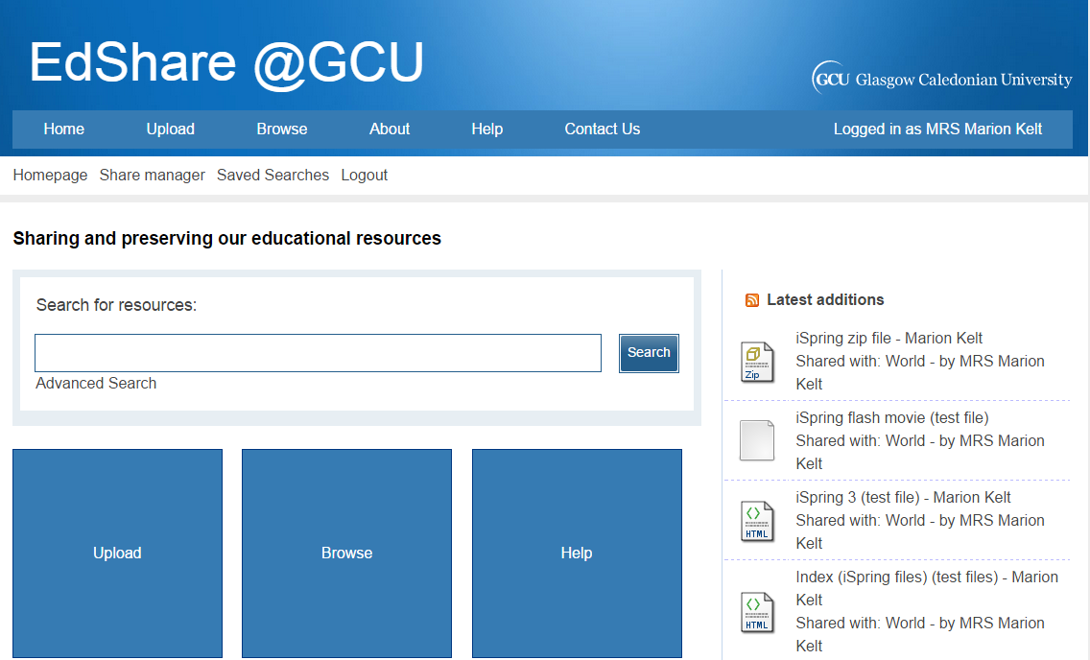

Slide 13
Handy links:
GCU OER policy http://bit.ly/1J4RZAK
Library guidance on OERs http://bit.ly/1JmPd65
CC OER Policy Registry https://wiki.creativecommons.org/
Open Scotland blog http://openscot.net/
Scottish Open Education Declaration http://declaration.openscot.net/
Slideshare http://www.slideshare.net/mke1/our-oer-policy-what-we-did-next
All images from Open Clipart

Slide 14
Thank you.
m.kelt@gcu.ac.uk @mugpunter7

