Slide 1
Assessing the impact our Information Literacy skills packages (SMILE - Study Methods and Information Literacy Exemplars) and PILOT (Postgraduate Information Literacy Online Training).
Marion Kelt, Senior Librarian for Digital Development and Information Literacy
This work is licensed under a Creative Commons Attribution 4.0 International License.
Notes:
Good morning
Marion Kelt, Glasgow Caledonian University

Slide 2
The audience:
17,000 students worldwide who need support using blended learning resources on our VLE (Blackboard). Campuses in London, India, China, New York and Oman.
Notes:
GCU is one of three universities in Glasgow.
It is one of the new universities in the UK, founded after 1992.
It has many blended learning courses and several overseas campuses.
All of these students need the same level of support. SMILE allows us to offer this to all our students.

Slide 3
Feedback and measures?
Feedback from trainers (Academic Development Tutors and Subject Librarians and lecturers).
Direct feedback from students.
User statistics from GCULearn (Blackboard).
Accesibility – talk to your disability team!
Notes:
SMILE is a blended learning package which teaches information literacy and communication skills.
It uses web pages and multimedia content.
It is useful in supporting international students and dealing with time differences.
SMILE was originally created as a JISC project by Imperial College, Loughborough and Worcester Universities. We have updated and customised it.

Slide 4
Why bother?
Change and develop content of packages. If it does not develop, it is dead!
Look at new modes of delivery – mobile devices.
User statistics feed in to library KPIs for management information.
Notes:
SMILE is a blended learning package which teaches information literacy and communication skills.
It uses web pages and multimedia content.
It is useful in supporting international students and dealing with time differences.
SMILE was originally created as a JISC project by Imperial College, Loughborough and Worcester Universities. We have updated and customised it.

Slide 5
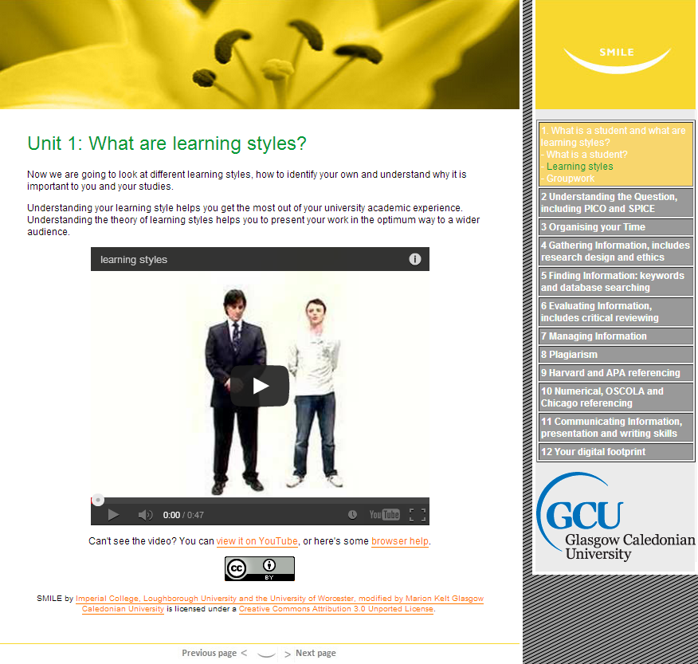
Notes:
Example page from SMILE showing the
Strong visual identity.
multimedia content.
We have recently (two weeks ago) changed the navigation at the foot of the page, as some users thought that it was a design feature, not a forward and back arrow! We have added text saying previous and next page!

Slide 6
Pilot
Notes:
SMILE is embedded in over 100 modules in our VLE blackboard, using deep links so that students can go directly to relevant sections without logging in again.
Some lecturers use SMILE modules as learning objects built in to the module timetable or prework before practical sessions.
SMILE is available 24-7 to support our Subject Librarians

Slide 7
SMIRK?
Notes:
We mapped SMILE against GCU graduate attributes and the other attributes on the slide
we also decided to talk to the teaching staff, to see what was not covered by the more formal frameworks.
This showed up quite a few areas that needed extra content
The cartoon character is a Scottish one called Oor Wullie (used by permission of DC Thomson)

Slide 8
User feedback?
Talk to lecturers – they will tell you about new modules and suggest new content. They don’t read emails!
Meet with Academic Development Tutors and get their feedback, also see where content overlaps and can be modified.
Use Google forms to get student feedback which is easily collated.
User statistics from GCULearn (Blackboard) – not easy!

Slide 9
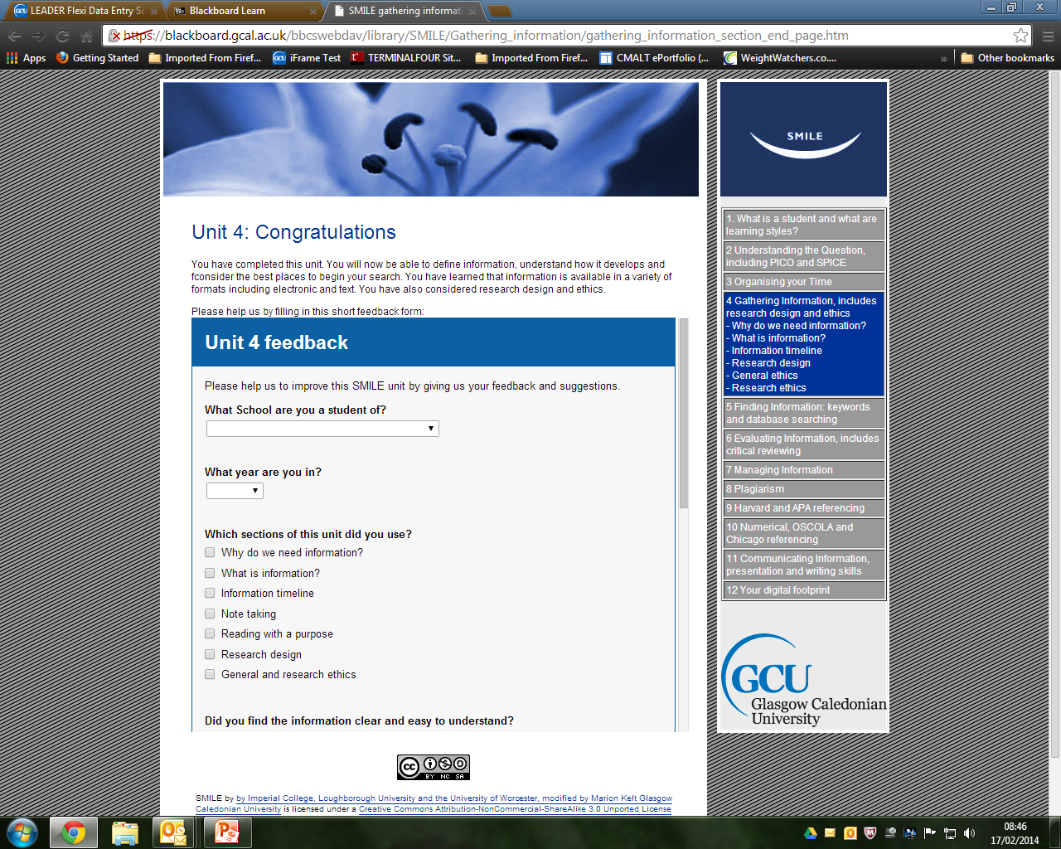
Student feedback

Slide 10
Google forms spreadsheet
Notes:
Jorum First stop as items produced in the UK may need less editing
Google advanced creative commons search. This goes worldwide and finds a wider variety of items such as blogs.

Slide 11
Excel sheet of blackboard stats
Notes:
Origins of new items added. Non library GCU resources have been counted in the Scottish section.
Special mention to Cardiff for their referencing tutorials.
The best source of Chicago referencing from Red Deer College in Canada.

Slide 12
Pulling it together
Ongoing programme of changes
Development of new modes of delivery (SMIRK!)
Provision of reliable management information
Notes:
SMILE has a strong visual identity, so some resources may have to be heavily edited to fit in with the format and style.
You may need to change fonts, colours and split text over several pages. SMILE uses short sentences, plain English and bullet points.
Examples may need to be changed, tutors complain if examples are old or refer to other countries. Example of dollar sign

Slide 13
In conclusion…..
Any questions?
Contact m.kelt@gcu.ac.uk for more information
Check out SMILE at http://www.gcu.ac.uk/library/SMILE/Unit_1_vers3/start.html
Check out Pilot at http://www.gcu.ac.uk/library/PILOT/
Not forgetting SMIRK at http://www.gcu.ac.uk/library/SMILE/SMIRK/SMIRK_index.html
Notes:
Using OERs is worthwhile!
If you plan ahead you can:
build on best practice.
save time and work cost effectively
Remember to select resources critically
allow time to convert source material and test it
Look at what we have done and contact me, I’m happy to talk

