Slide 1
Growing a SMIRK
Marion Kelt, Senior Librarian, DDIL
This work is licensed under a Creative Commons Attribution 4.0 International License.

Slide 2
In the beginning, there was SMILE…
SMILE is a blended learning package which teaches information literacy and communication skills.
It uses web pages and multimedia content.
SMILE was originally created as a JISC (Joint Information Services Committee) project.
We have updated and customised it.
Notes:
SMILE is a blended learning package which teaches information literacy and communication skills.
It uses web pages and multimedia content.
It is useful in supporting international students and dealing with time differences.
SMILE was originally created as a JISC project by Imperial College, Loughborough and Worcester Universities. We have updated and customised it.

Slide 3
The problem with SMILE
New content did not fit easily into existing structure
Not totally mobile friendly, OK on a tablet but very bad on a smartphone due to menu construction and placing.
Blackboard user stats inadequate
Blackboard login offputting for users
Temporary fix – add set of deep links into individual modules in VLE (over 100!)

Slide 4
The way forward?
The choices:
Either develop a new version of SMILE using HTML5, which involved rewriting all the templates and menus using Dreamweaver.
Move SMILE onto our T4 CMS using new mobile friendly templates. Present project to upgrade library web site running over summer. Potential delays….
Scrap the lot and start fresh!
Look for other development options.

Slide 5
Jquery mobile
Available as part of Dreamweaver 6
Designed for small mobile sites with under ten pages
Comes with a few standard style sheets, but you can create your own.
Not much help available in the standard package, but I recommend the Youtube videos! They are great!

Slide 6
The issues
Further rewrite content to cut down “wordiness”
Shrink or remove illustrations
Cut large units into small, bite sized chunks
Figure out a way to use a template designed for very small websites to accommodate a monster

Slide 7
Nesting

Slide 8
Enter SMIRK
So, after successfully building a site structure. Our package needed a name.
I decided on SMIRK (the wee mobile Smile!)
We needed an acronym, so:
Small Mobile Infolit Realworld Knowledge!

Slide 9
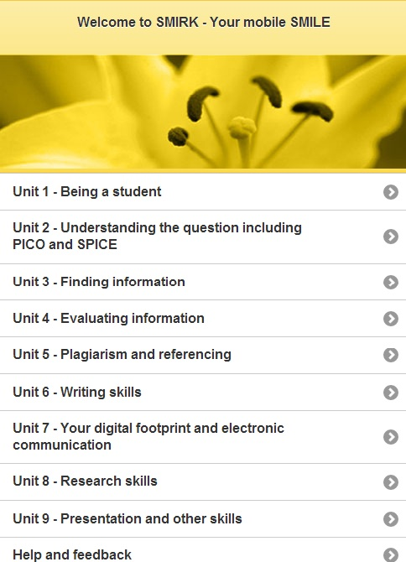
SMIRK main menu

Slide 10
SMIRK content

Slide 11
The problem with SMIRK ….
You can’t properly test a mobile site on your PC, so we made it live and asked library staff to have a go.
Feedback:
Standard “back and forth” navigation is frustrating in a larger mobile site
No automatic resizing to suit mobile device type (never assume!)
Gloom!

Slide 12
User community to the rescue!
As well as asking library staff for feedback, I had asked some of the wider user groups, such as LIS-InfoLit, LIS-CoPilot, and ALT-C
One of my fellow learning technologists came to my rescue with a great line of code! Resizing problem solved!
Back to work…

Slide 13
Enter SMIRK 2 …
Revised version of SMIRK including:
Additional navigation in the form of back and forward arrows at the foot of each screen
Jumps to next unit start pages and back to main menu
Automatic resizing for different mobile devices
SMIRK 2 announced to user and internal GCU community
So far a total 2,557 views

Slide 14
Mobile device use

Slide 15
GCU use
Established SMILE users have been given a set of SMIRK links in their modules.
SMIRK will be promoted to students once trimester 1 is underway
User feedback will be gathered from students and staff

Slide 16
What next?
GCU staff and students need a quick source of applied copyright information.
I am also the copyright advisor, so next stop, SMIRK answers your copyright questions!
SMIRK is an open access resource, so why not try it at:
http://www.gcu.ac.uk/library/SMILE/SMIRK/Start.html
If you like it, use it free!
SMIRK will be made available as an OER on Jorum.

Slide 17
SMIRK – the next chapter
SMIRK on T4 to take advantage of the increased mobile functionality. Will corporate better menus and GCU branding.
Open access site as part of our main mobile library site.
Custom menus also on offer to suit different courses and levels.

Slide 18
Contact me for more information! m.kelt@gcu.ac.uk
http://www.gcu.ac.uk/library/SMILE/SMIRK/Start.html

