Slide 1
Creating Conversations
Caledonian Creates | Student Research conference
Supporting students to engage with academic research
Dr. Mary Maclachlan | Enhancement theme scholar Project

Slide 2
Project Aim
The aim of this project is to inspire, support, engage and promote a student research agenda by adopting a partnership approach with students to organise and run a design focused student research conference.

Slide 3
Transition
Student transitions through HE – provide the much needed support, feedback and confidence to achieve excellence.
Student transitions out of HE – Enhancing professional attributes.

Slide 5
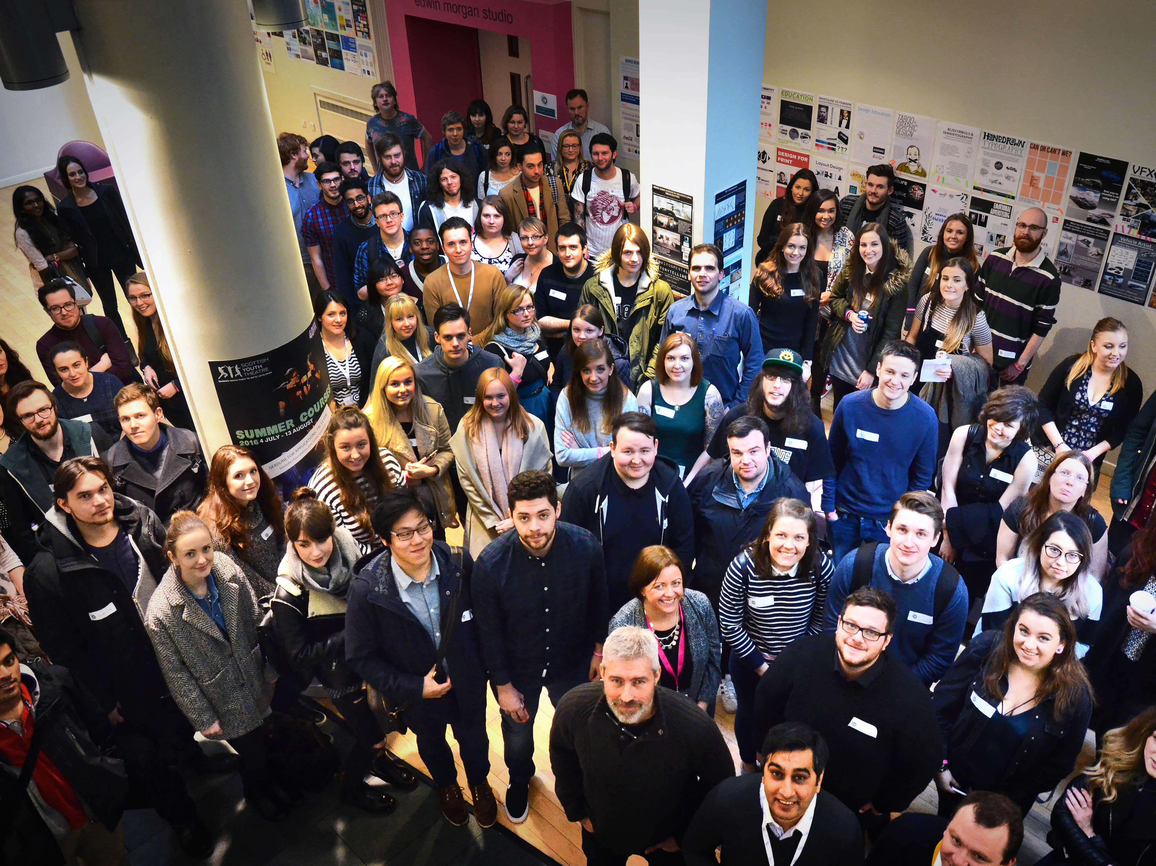
128 students attended - 92%

Slide 6
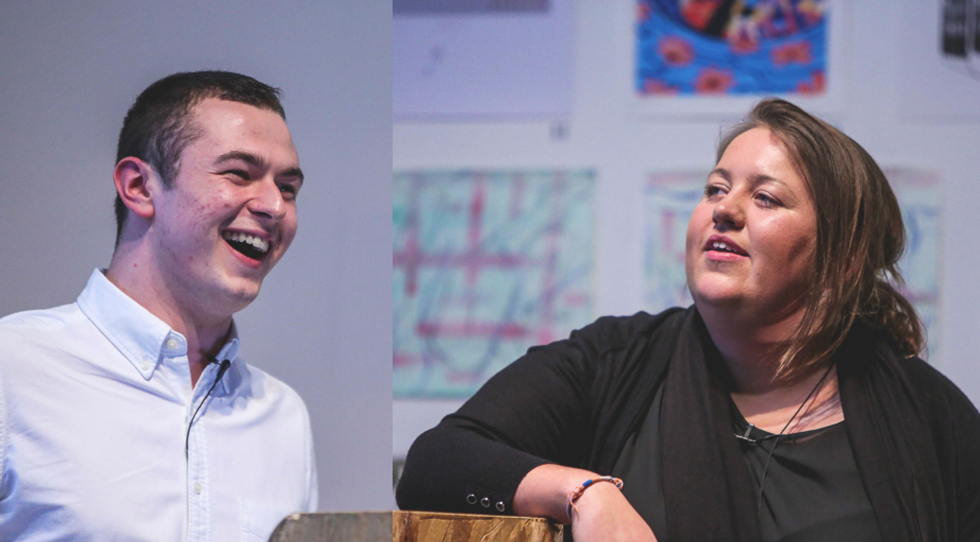
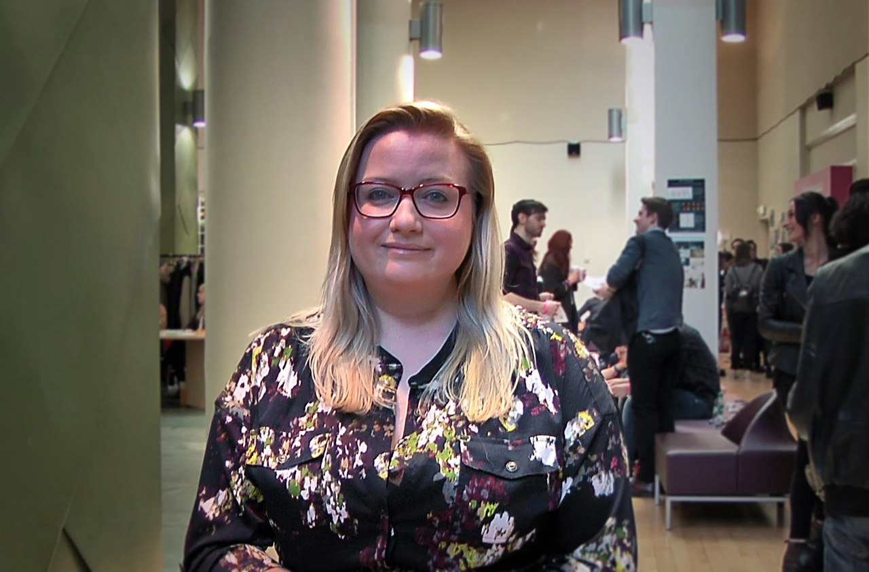
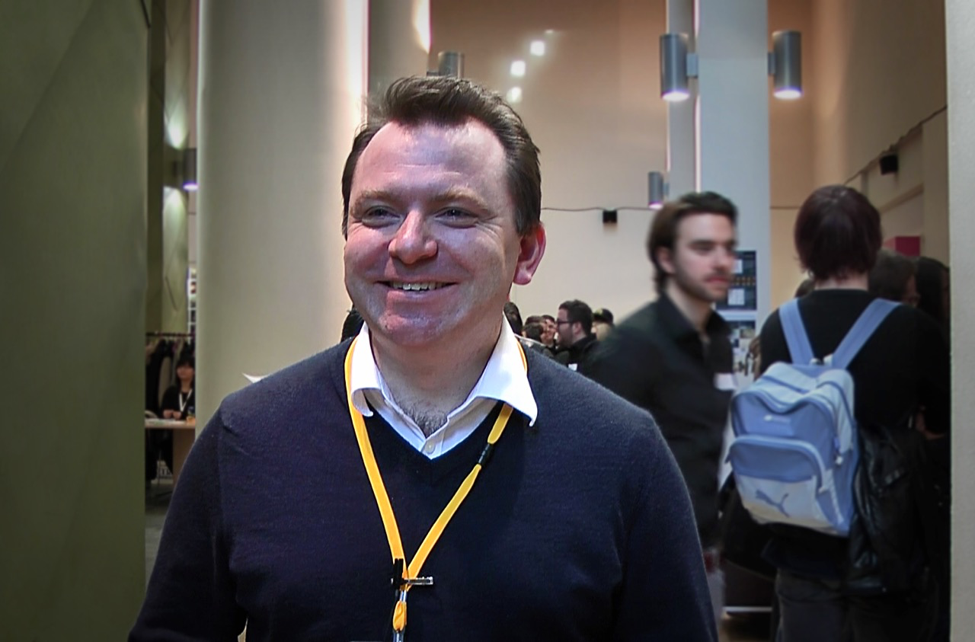
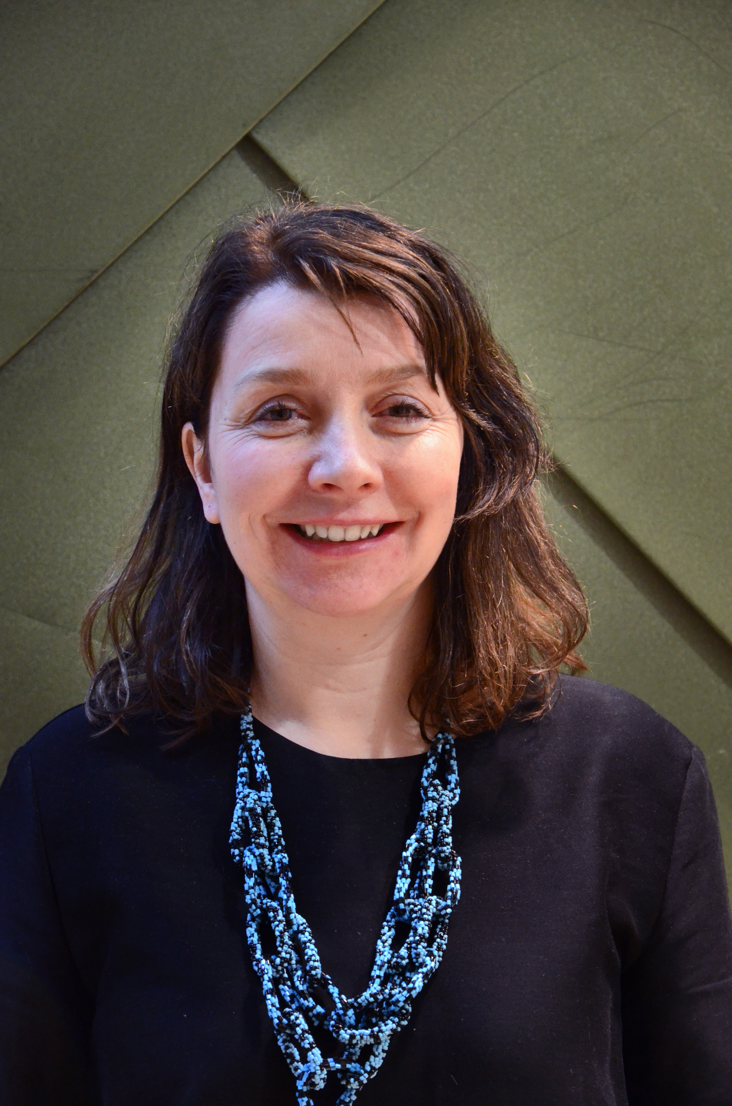
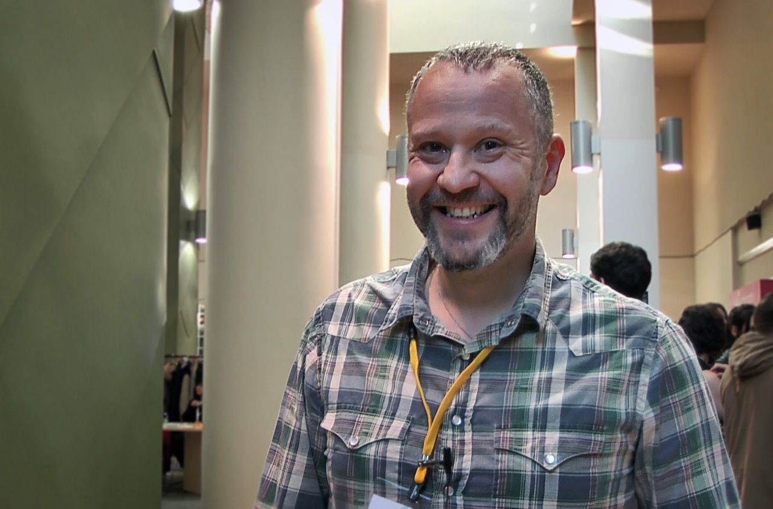
8 Guest Speakers

Slide 7
28 students presented

Slide 8
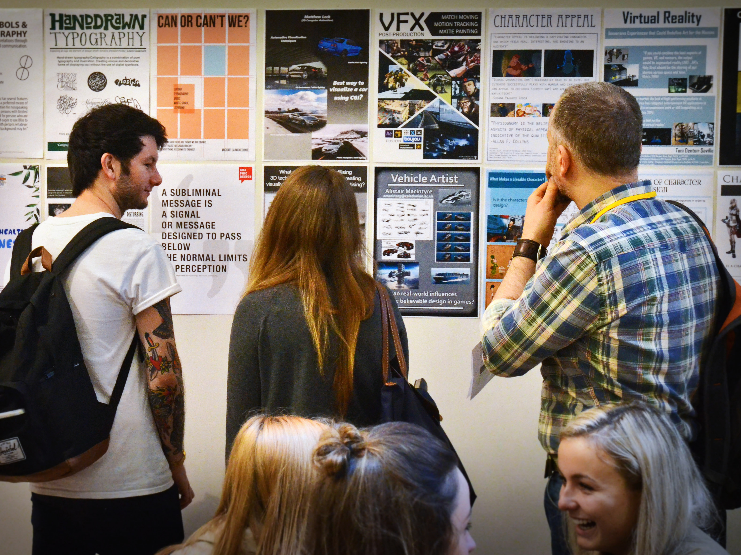
82 student posters

Slide 9
“Hearing from the 4th years has give me the confidence
to push and refine my own research ideas further as well as a glimpse of where we will be this time next year. A refreshing and insightful day.”
3rd year graphic design for digital media

Slide 10
“I didn’t really see how I could present unfinished work, but it wasn’t about that, it was about getting feedback to drive my project forward and
gaining experience in presenting and networking.”
4th year 3D computer Animation

Slide 11
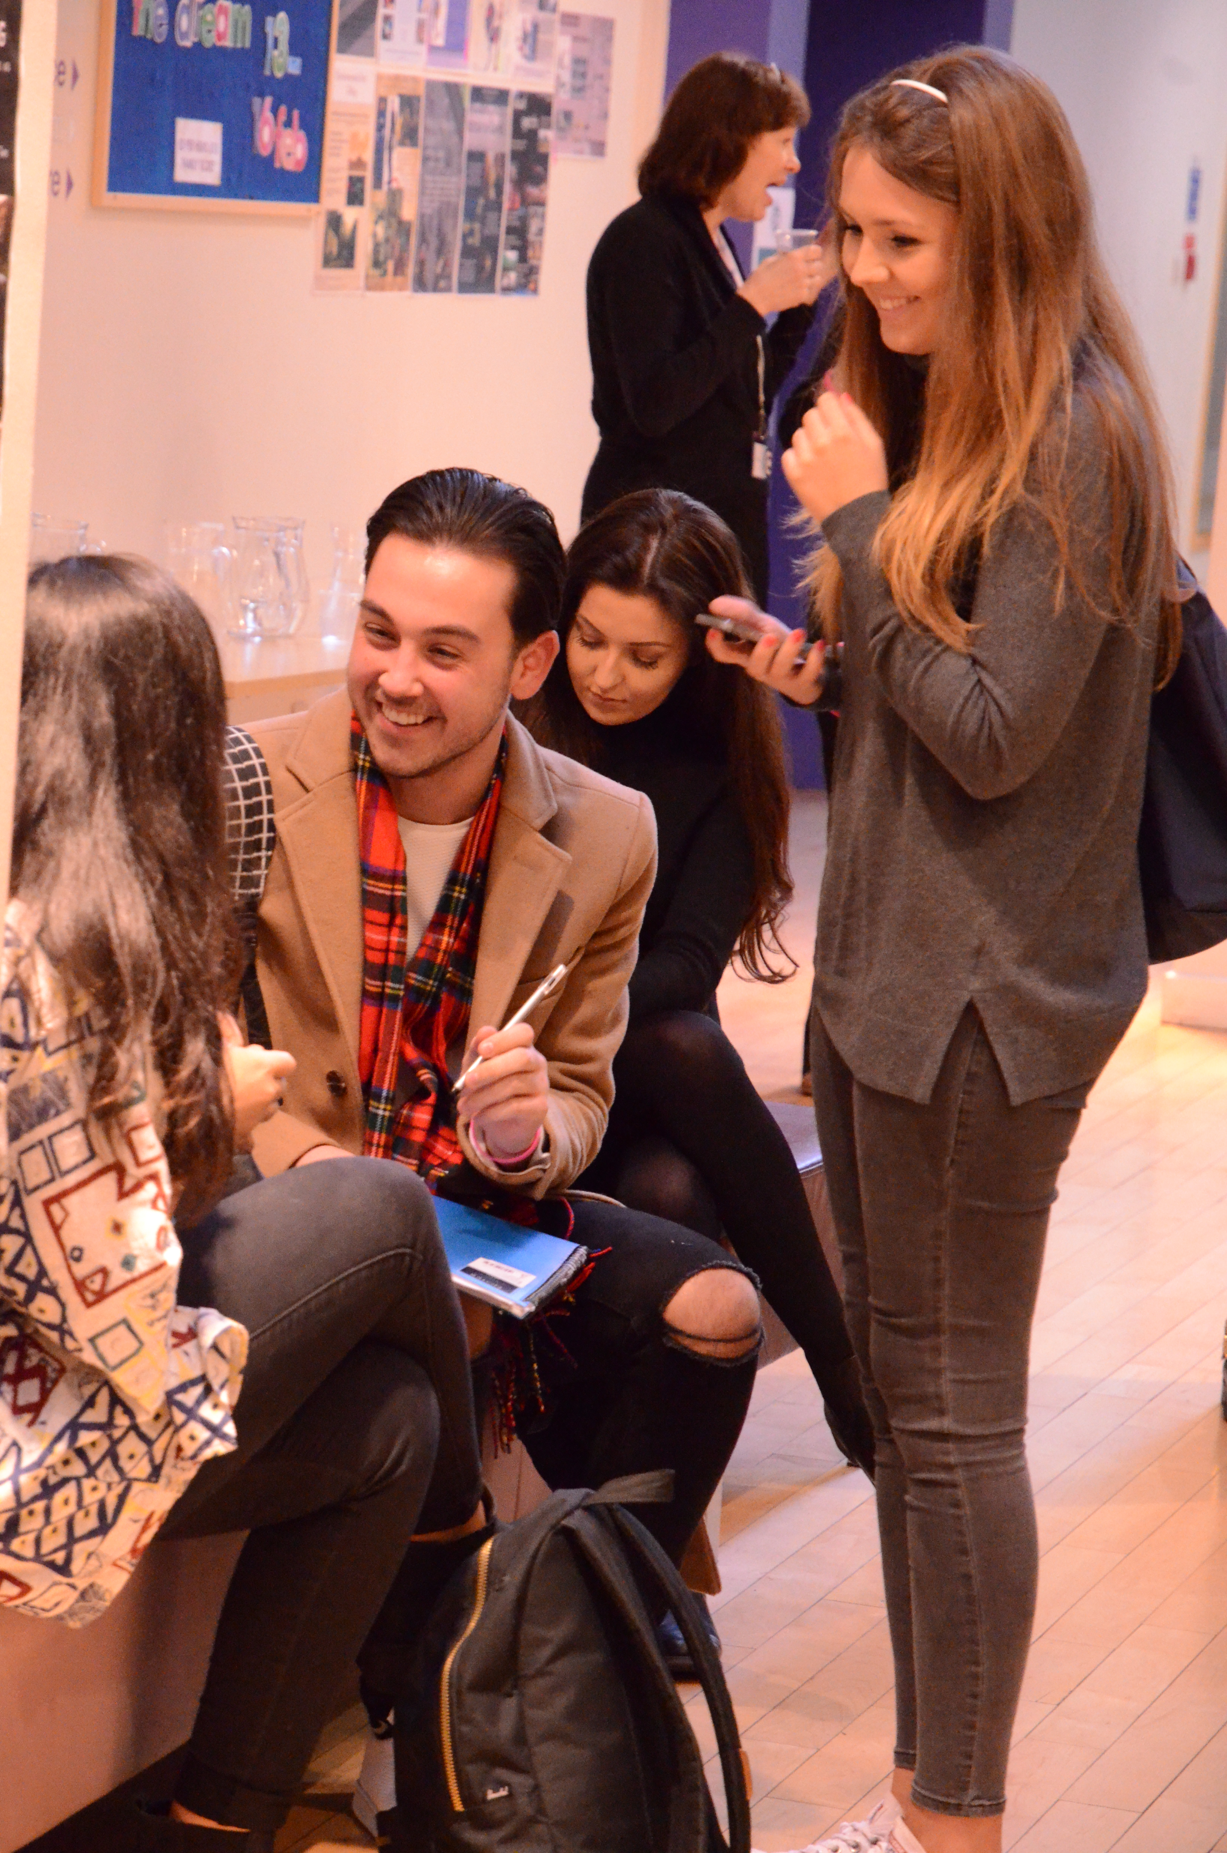
100%
should be an annual event
93%
enhanced their understanding of research within their discipline area
92%
enhanced their confidence
Students rated the conference 4.48

Slide 12
Outcomes
Enhanced student confidence
Enhanced peer mentorship and cross level communication
Enhanced understanding and enthusiasm surrounding academic research

Slide 13
Creating Conversations
Caledonian Creates | Student Research conference
Dr. Mary Maclachlan | Enhancement theme scholar Project

