Slide 1
Marion Kelt
Copyright guidance for the production of ALC resources

Slide 2
Copyright and ALC - Presentation Summary
Introduction
Exceptions for education
Licences for education
Open educational resources
Questions

Slide 3
Introduction
Copyright is a form of intellectual property that protects original literary, dramatic, musical and artistic works, as well as layouts or typographical arrangements of published work, sound recordings, film and broadcast.
There is no formal registration procedure for copyright; a work is protected as soon as it is in a permanent or fixed form.
More than one person can own copyright on a resource.
Infringement of copyright occurs when someone takes either all of a work, or a substantial part of it, without permission.
Soetendorp, R., Meletti, B. Education. http://copyrightuser.org/ Available under a CC-BY 3.0 License

Slide 4
Copyright and ALC
Copyright is territorial. This means that you need to consider where the teaching is taking place, rather than where the resources are produced.
For ALC we need to comply with Section 19 of the Mauritius Copyright Act 2014 which includes a variety of exceptions for education.
Exceptions allow you to use part of a work without seeking permission from the copyright owner(s).
Notes:
Explain the difference between where a resource is produced and where it is used. Where it is used is the relevant bit with regard to copyright law.

Slide 5
Exceptions for education
Exceptions for education permit the use of short excerpts from any publication, broadcast, video, or audio recording for the purpose of teaching, provided that:
The copying is used to illustrate a point about the subject being taught;
The purpose of the use is non-commercial (educational use is considered non-commercial);
The use of the material is fair;
Where practical, sufficient acknowledgement of authorship of the work is provided.

Slide 6
What is fair use?
“Minor uses, such as displaying a few lines of poetry on an interactive whiteboard” – UK Government
Uses which undermine sales, including of teaching materials, are not permitted without a licence.
Other examples:
A short clip from a TV programme
A paragraph of text from a book
A diagram from a journal article
An image from a website

Slide 7
What is sufficient acknowledgement?
Sufficient acknowledgement is required to appropriately credit the original creator of a work.
It also allows a user to easily locate the work in its full form, either online or in print.
Always cite the original source:
Use a standard citation system for academic works (e.g. Harvard).
For other resources use this basic citation format, providing as much information as possible: Type of content: Title by Author. Link.

Slide 8
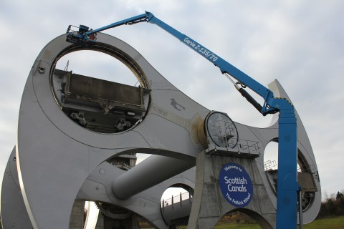
Example 1 - Photograph
Image: The Falkirk wheel gets an MOT by Angela Finlay. https://www.scottishcanals.co.uk/media-centre/galleries/the-falkirk-wheel-gets-an-mot.
Notes:
Why do this? If I have found this photo on the web and want to illustrate my talk on the maintenance of the Falkirk Wheel, this referencing format allows me to acknowledge the photographer’s work and the student to view the photo in its original context.

Slide 9
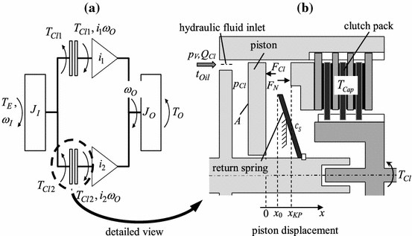
Example 2 - Diagram
Schematic diagram of a double clutch (a) and detailed cylinder model. In: WURM, A., BESTLE, D. 2015. Robust design optimization for improving automotive shift quality. Optimization and Engineering [online]. [viewed 13 April 2016]. Available from: http://dx.doi.org/10.1007/s11081-015-9290-1.
Notes:
Why do this? If I have found this diagram in a text and want to illustrate my talk on engineering design, this referencing format allows me to acknowledge the authors’ work and the student to view the full text.

Slide 10
Example 3 - Quote
“Environmental assessment is the process of assessing, or measuring, the change or consequence to environmental factors when making plans, such as those for an engineering construction project, or decisions, such as deciding whether to go forward with a new, tax-funded project.”
JAIN, R. et al. 2012. Handbook of Environmental Engineering Assessment [online]. Boston: Butterworth-Heinemann. [viewed 13 April 2016]. Available from: http://dx.doi.org/ B978-0-12-388444-2.00001-4.
Notes:
It is useful to add definitions, this format allows the student to view the whole ebook online.

Slide 11
Licences for education
Copyright exceptions for education do not permit the following:
Digitising larger extracts of published material e.g. a book chapter;
Copying and using longer broadcast, video, or audio recordings;
Copying and using extracts from newspapers.
For uses not covered by the copyright exceptions the University holds a number of licences. Each of these licences has its own criteria.

Slide 12
Digitising larger extracts of published material
The Copyright Licencing Agency (CLA) licence with the overseas-campus based students extension permits the library to digitise book chapters and journal articles for distribution to students via GCULearn.
CLA license criteria:
Only one chapter from a book, one article from a journal issue or five percent of a published work may be digitised for each module;
The library must copyright check requests and digitise materials on behalf of lecturers;
Copies must be re-processed annually.
Visit the library scanning service web page to request digitisation.

Slide 13
Copying and using longer broadcast, video, or audio recordings
Box of Broadcasts is an off-air recording and media archive service. Only available in the UK and cannot be used by ALC.
If longer broadcast, video, or audio recordings are required for an ALC course they may only be played for students in the classroom.
Content played during a lecture cannot be recorded.

Slide 14
Copying and using extracts of newspapers
The Newspaper Licensing Agency (NLA) licence permits you to make copies of newspaper content for teaching purposes. This includes UK national and regional newspapers and newspaper websites.
The library subscribes to a number of current and archive newspaper services, including the Newsstand database which provides full text online access to over 1300 news publications.
Staff are advised to use this database when preparing newspaper content for ALC.
Visit the library newspapers web page for more information.

Slide 15
Recording demonstrations of software
Under Mauritian copyright law recording software demonstrations for educational purposes is permitted.
Recorded demonstrations must be restricted to GCU/ALC staff and students.
Upload recordings to edShare and select University permissions.

Slide 16
Using Open Educational Resources (OERs)
Open Educational Resources (OERs) are:
Digital educational materials such as images, audio, video, animations, content modules, and other digital resources.
To guarantee you stay legal when reusing content follow these three simple steps:
Reuse only licensed content e.g. Creative Commons;
Adhere to the terms of the licence;
Cite the content you use.

Slide 17
Why use Open Educational Resources (OERs)?
OERs are made available under a licence. Follow the terms of this licence and you don’t need to worry about copyright.
Use existing resources and develop them in ways that suit your needs.
Develop high quality resources on your own or with a small team of staff.
Save time and duplication of effort.
Build on best practice by experts in your subject area.
Use resources which you may not have the software, equipment or facilities to create yourself.
Find OERs using a Google Creative Commons search.
Use edShare to license and share your own OERs.

Slide 18
Thank you
Contact details and links:
http://gcu.ac.uk/library/servicesforstaff/copyright/
heather.marshall@gcu.ac.uk

